Slide 1
New Mexico High School Redesign Teams Organizing Adult Work Session June 11, 2018

Slide 2
Purpose for this Work Session
Explore insights the existing evidence base offers as we consider ways we might Organize Adults differently to shift the context in which teachers and students operate day to day .
Review teacher teaming, common planning, and distributed leadership models.
Examine innovative schedules as examples of how to align the schedule to the priorities, values and intentions of the redesign plan.
As school teams, develop an initial vision of structures and practices we might put in place at our high school that honor the importance of connections and interdependencies through relationships that help our school community thrive.

Slide 3
Working Norms
Fully participate
Listen with respect to maximize learning from each other- one voice at a time to ensure all are heard
Return attention to large group when you hear the chime
To minimize distractions leave cell phone/ iPad/ laptop sound on silent and step out for essential communications
Recognize / share the wealth of experience, expertise and understanding among the group
Honor time
Have fun

Slide 4
What mindsets might these individuals hold that might be limiting them from their intended outcomes?
Video removed

Slide 5
Design Thinking is a Mindset!
It’s Collaborative
It’s Human Centered
It’s Optimistic
It’s
Experimental
Notes:
After this slide we will have them read an example or talk through one create slides
Maybe Bank of America…..Maybe a different example

Slide 6
Organizing Adults

Slide 7
Organizing Adults
Evidence Based Practices
Supporting Structures
Teacher Teams
Student cohorts
Distributed Leadership
Interdisciplinary Teams
Leadership Development
Academies
Relationships and Trust
Collaborative Planning Time
Personalized Learning Lanes
Data Driven Decision Making
Influencing Factors
Student data/needs/voice
Teacher capacities
Community Opportunities

Slide 8
Teacher Teams—Listening to Podcast Activity
An interdisciplinary team of teachers sharing students affords many potential opportunities to impact the school community. As we listen to this 6 minute podcast think about organizational structures and schedules and how interdisciplinary teams of adults might impact:
Quality of Coursework—How students cognitively engage with their schoolwork
Quality of Relationships—What drives students to attend, focus, believe, and try
Equitable Access to Strong and Supported Pathways to Post-Secondary Success including Shaped Experiences (e.g. extra-curricular) —Where equity often falls short
Continuous improvement systems
Podcast How might the work in your school be strengthened through organizing adults in schools differently?

Slide 9
Paired Reflection
Share an experience when working interdependently led to an amazing program, event or practice at your school with your partner
Switch roles
Quick write thoughts—words—images about how those experiences might inspire ways interdependencies may support innovation at your school

Slide 10
Choice Board for Learning Stations
Having It Both Ways: Building the Capacity of Individual Teachers and Their Schools. School Organization and Teacher Teams - Blue
Collaboration is the Way We Work, Not an Activity – Teacher Team Case Study – Pink
Common Planning: A Linchpin Practice in Transforming Secondary Schools - Yellow
Key Components of Trust 4-5- Building Trust Among Teachers 15-16-17 – White with Red Print

Slide 11
Select one of the articles from the options provided.
Stack pack and move to that area of the meeting room.
Be sure to have one member of your team at each selection.

Slide 12
Text Protocol Say Something
Meet the members of your group. Decide on an amount of time for reading your text.
One person will be the timekeeper.
Read the article individually – annotate or highlight if you like any ideas you agree with, ideas you might argue with, ideas you would like more clarity around.
Form a circle and each person will have an opportunity to “say something” about the article.
One person talks at a time and the chance to say something proceeds around the group until everyone has a chance to be heard.

Slide 13
Processing Text Pieces in School Teams
Text Piece | Observation This is good because This is hard because | Inference I predict that One thing I wonder | Connect This reminds me of This process is like | Question How did In what ways
Having it Both Ways
Collaboration is the Way We Work
Common Planning a Linchpin Practice
Trust

Slide 14
Distributed Leadership

Slide 15
Why Distributed Leadership?
Leadership is the professional work of everyone in the school. (Lambert, 2003)
Powerful Leadership is distributed because the work of instructional improvement is distributed. (Elmore, 2003)
Teachers’ high levels of academic optimism were positively and significantly associated with planned approaches to leadership distribution, and conversely, low levels of academic optimism were negatively and significantly associated with unplanned and unaligned approaches to leadership distribution. (Mascall B., Leithwood K, Strauss T., Sacks R. 2009)
Building a broad base of capacity is not possible if control is limited to a few individuals.

Slide 16
Case Study
Hob Green School

Slide 17
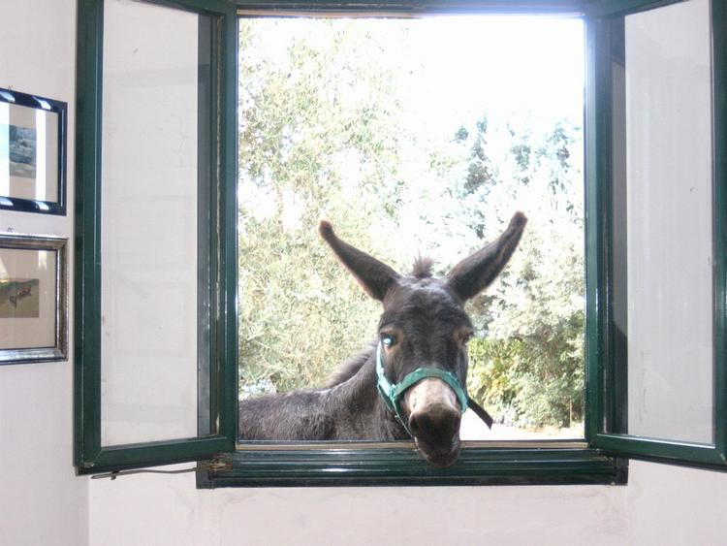
Time for a Break

Slide 18
Organizing Adults—Part 2

Slide 19
Innovative Schedules

Slide 20
Block Party- Your Schedule is Your Life!
Read your passage. Reflect on its meaning.
Stand up.
Find someone with another color passage.
Introduce yourself. Share what you read and your response.
Switch roles.
When you hear the chime find a new partner.

Slide 21
What Kinds of Schedules Would Support This Type of Learning?
Kids at Work

Slide 22
Innovative High School Schedules
Briefly review the schedules listed below as a school team:
NextGen Albuquerque
Brooklyn Generations HS New York
Innovative Approaches for HS Schedules Hanover Research 15-16
Design Tech High School San Francisco
Innovative Approaches…12-15
Model High School
Reimagining the School Day 13-14
Madeira School
Innovative Approaches 23 -25
Decide on one you would like to look at more carefully.
Consider how that schedule would interact with the evidence based practices of teacher teams, distributed leadership, relationships and trust and data driven decision making.
Uses the fishbone diagram provided OR chart paper to visually represent the interactions and how they might work in your context.

Slide 23
Schedule Scenario Activity How Do Each of the Mock Schedules Impact?
Relational Trust
Distributed Leadership
Meeting Needs
of All Humans
Data Driven Decision Making

Slide 24
How Might We Provide for Collaboration to Happen Effectively?
Common planning for adults sharing students
Parallel scheduling
Building cohorts of subs – roving coverage
Adjusted start and end times
Shared classes by grade level or course content
Banked time to create space for early dismissals or teacher work days
Extended time for collaboration in in-service and faculty meeting schedules.
Intensives

Slide 25
Design Time – Organizing Adults
What resonates with your team from the ideas in organizing adults?
What might be key collaborative interactions in your school community? What are your hopes relating to those interactions?
How might the path of support for those collaborative interactions be created? What supports, resources, and structures can be offered?
When thinking about interdependence as a school, what are two or three areas, practices, rituals that come to mind as islands of strength?
When asking students what would they name as an island of strength? Community members?

