Slide 1
Redesigning…Reimagining School
Engagement
WITH Community Members’ Contributions

Slide 2
Purpose
Engagement
Continuing to explore evidence-based insights as we consider processes that encourage community involvement.
Examining a variety of approaches to incorporate community stakeholders’ desires, values and feedback.
Considering structures and practices such as Design Charrettes, Conversation Café, Study Circles, Salons & Discussion Groups fostering open, inclusive, discussions of critical public issue(s) with community stakeholders.

Slide 3
Working Norms
Engagement
Fully participate
Ensure all are heard with one voice at a time
Minimize distractions by placing cell phone on mute
Recognize / share the wealth of experience, expertise and understanding among the group
Honor time
Have fun

Slide 4

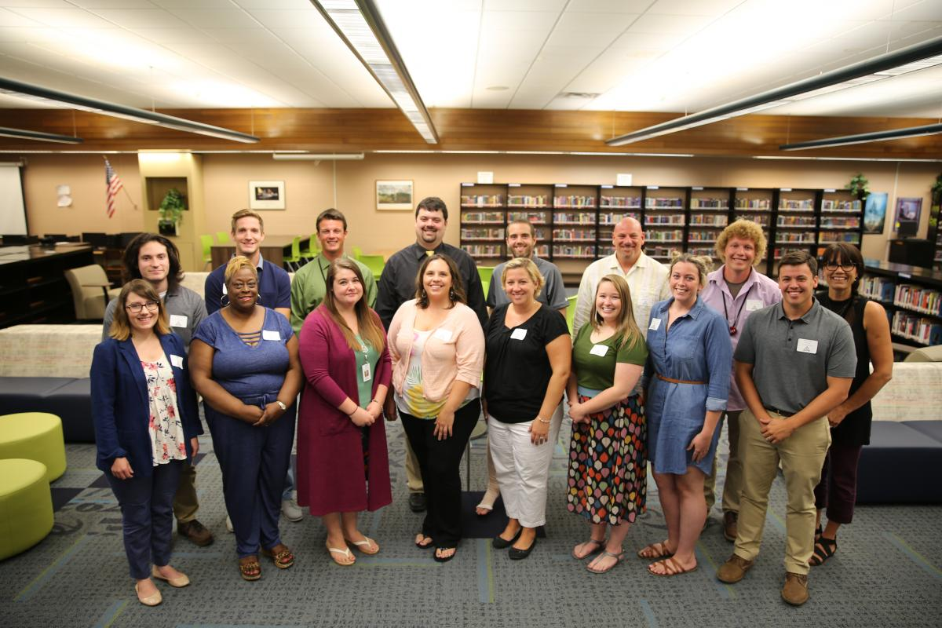
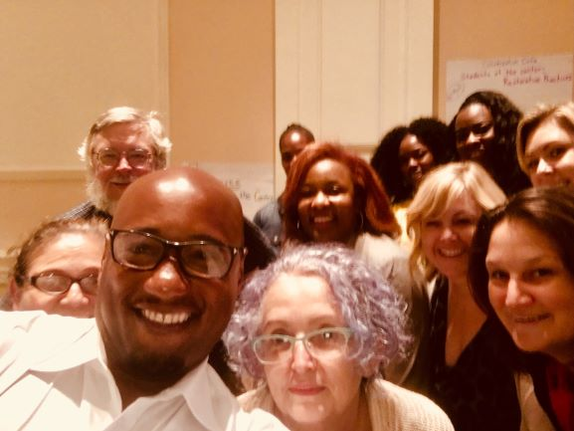
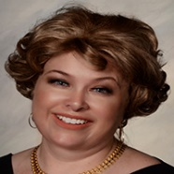
Our Team
Engagement
Take a picture of your team, share it on Yammer along with two unique things about your team

Slide 5
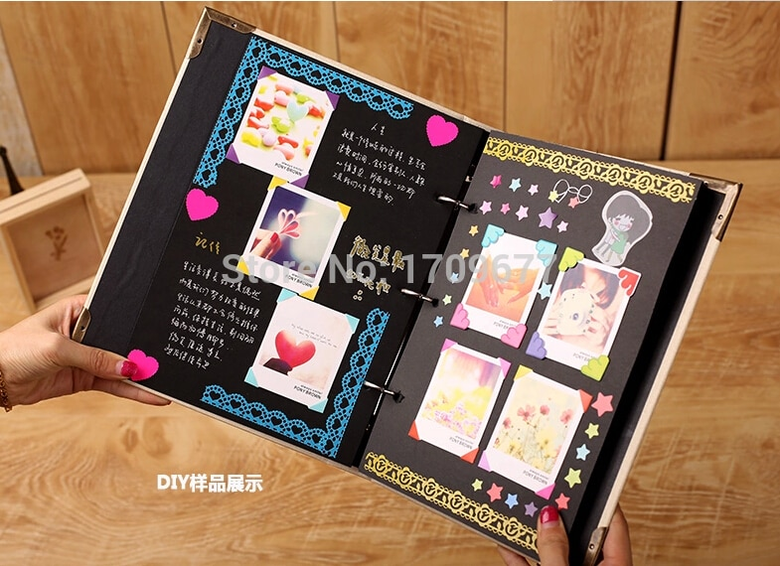
MY
Photo Album
Home Fun
October Convening

Slide 6
Community Input into School Redesign
http://www.hsredesign.org/getting-started/community-input/

Slide 7
Design Charrette
School Stakeholders explore and share a broad diversity of design ideas
Short
Collaborative Meeting
Sketch/Build Design
Charrette Protocol
The Charrette is a term and process borrowed from the architectural community. Its purpose is to improve a piece of work.
Teams call for a Charrette when they are “stuck” and they cannot easily move forward on their own.
They bring their current ideas, or the actual work in progress, to the Charrette, and then ask the group to “work on the work.”
https://www.youtube.com/watch?v=zwwqxa_dR8E&feature=youtu.be

Slide 8

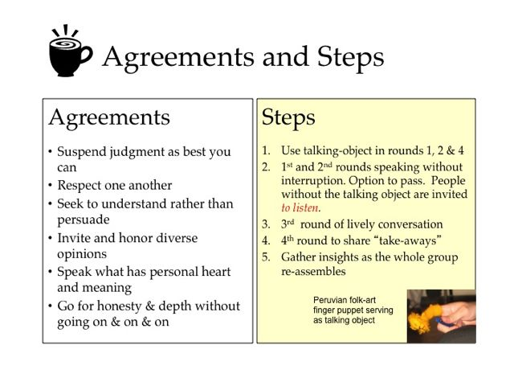
Engagement
https://www.youtube.com/watch?v=cgQMrqEOJcU
Notes:
This video is included for participants to watch on their own if they so desire.

Slide 9

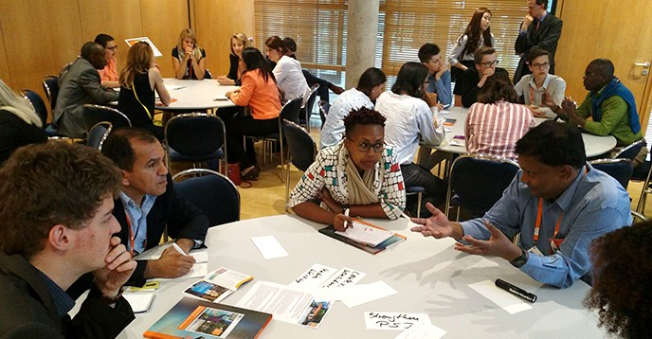
EVOKING THE WISDOM IN THE ROOM
World Café is a creative process for leading collaborative dialogue, sharing knowledge and creating possibilities for action in groups of all sizes. It is an intentional way to create a living network of conversations around questions that matter.
http://www.co-intelligence.org/P-worldcafe.html
Notes:
The purpose of the World Café is contribution to the community. It starts with a team/somebody giving something: time, ideas, energy, etc.
One may not blame anybody for giving. The World’s Café is in no way used to criticize.
In the Café one does not have to perform or pretend, only contribute…and when one/a team/a collaborative contributes, the knowledge of
the whole grows.

Slide 10

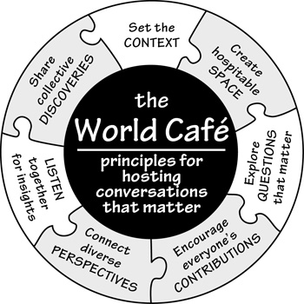
https://www.youtube.com/watch?v=vRM1I90SOUw
https://www.youtube.com/watch?v=_0d0Gybq-l0
Notes:
There are two video link-introductions to the World Café Strategy.
Based upon time availability, we’ll decide which link to use: 1st link is 4 min long while the 2nd video link is 2:28 min long

Slide 11
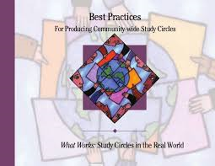
Community-Wide Study Circles
Engagement
Guides to organizing a study circle program to serve as a vehicle to achieve communitywide dialogue for action and change
Provides an overview of communitywide study circle programs, with special emphasis on their operation and impact
Community Tool Box-Everyday Democracy
What Works: Study Circles in the Real World
https://www.slideshare.net/everydaydemocracy/what-works-study-circles-in-the-real-world
http://www.hsredesign.org/getting-started/community-input/

Slide 12

Engagement
What does community mean to you?
Think about barriers/forces preventing your community from coming together
What actions/strategies have your team identified to increase communitywide participation?

Slide 13
Engagement
Questions from the Audience
Questions from the Audience
Questions from the Audience
XYZ
MW

Slide 14

Engagement

