Slide 1
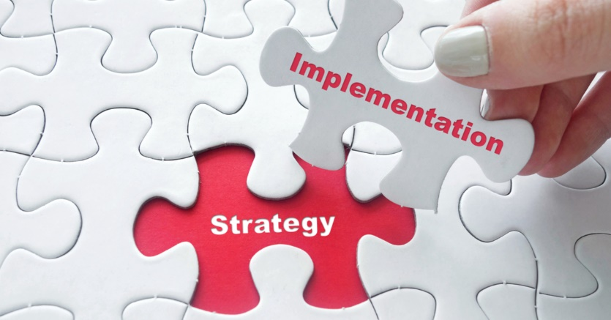
What Do We Know About Implementation
The Distance from Knowing to Doing

Slide 2
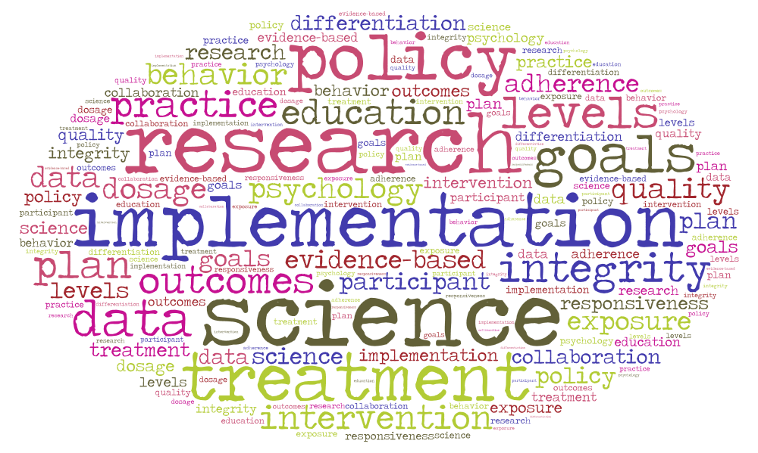
Implementation Science
New Field-foundations in medicine, public health, business and behavioral science.
There are some cross-sector findings that are applicable to education broadly and high school redesign specifically.

Slide 3

Insights from Behavioral Science— The Last Mile
First Mile = focus on the what - product development - program design
Last Mile = focus on how and when - product adoption and use -program implementation and delivery
The Last Mile is the hardest as it depends on knowing and shaping human behaviors

Slide 4
Last Mile—The Difficulty of Knowing Human Behavior—Two Common Errors
Innovators have a flawed understanding of the psychology of the end user-tend to believe benefits of innovation are obvious and end user will overcome obstacles to get those benefits.
Intention - Action Gap - the difference between what people think they would like to do and what they actually end up doing-role of inertia
Both of these are driven by the context and situations of the end user not human failings. Innovators need to be human behavior informed.

Slide 5
Mastering the Last Mile—Three Key Insights
Recognize that you are in the business of changing behaviors-to change their behavior people need motivation, knowledge, a common understanding, and often a nudge
Integrate new innovation into existing ecosystem of behaviors-if innovation requires dramatic change in behavior or understanding new terminology without a scaffold odds are high it will be rejected-time scarcity can make investment in learning new terminology seem not worth it
Cultivate data driven decision making-a belief in the value of concrete information-translate academic research into digestible insights, pilot and test innovations, monitor success

Slide 6

Insights from Business- The Importance of Understanding What an Organization Needs to Engage in Learning
Use video
Alignment to Personal Beliefs about what is important
Shared Vision across Organization
Ability to be Reflective –examine mental models and biases
Team Learning structures
Systems Thinking

Slide 7

Insights from Medicine and Public Health- How to Diagnose the Nature and Type of an Implementation Challenge
Is the main challenge the complexity of the new practice, or the readiness of the institution or both?
Use handout-New Approaches to Policy Implementation

Slide 8

Insights from Policy Implementation: Who Has the Problem Solving Capacity to Engineer Win-Win?
When authority is distributed across semi-autonomous levels in a complex system-like a state department of education, a school district and a school-someone in the system needs the capacity and know-how to engineer win-win outcomes for two or more levels in the system.
Otherwise, when disputes arise between levels of the system rather an innovation gets implemented or not-will be decided by power not knowledge or the greatest good.

Slide 9

Insights from Education: Sequence Matters

Slide 10
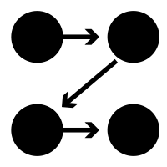
The Sequence in Which Improvements are Implemented Matters
Some improvements require foundational elements be in place (e.g., teacher teams, require common collaborative work time, which often requires changes to master schedule.)

Slide 11
Sequence Matters
Some improvements require more capacity building than others. It can be challenging to implement two improvements which require intensive capacity building at the same time (e.g., restorative practices and intensive instructional changes)

Slide 12
Sequence Matters
Some improvements require short term staffing additions to launch well, depending on resource limitations you may need to stagger these efforts (e.g., early warning systems and increasing postsecondary partnerships and experiences)

Slide 13
Sequence Matters
Some improvements may take longer to build faculty, student, or community buy in. These should be phased in – when buy in is achieved
Some improvements will need to be localized-test and refine them with smaller groups or over shorter time periods before rolling out schoolwide.

Slide 14
Can Create Layers of Sequence
Top layer is where you are building buy in and capacity over time
Another layer is where you are testing and localizing by limiting implementation to small groups or short time periods
The final layer are the components you are implementing schoolwide with quality

Slide 15
Lets Give it a Try- Sequencing Implementation Activity

Slide 16

Insights from the Human Endeavor: Relationships are the Super-Power
They provide motivation, are a source of knowledge, enable shared understanding, defuse tension and frustration, and magnify nudges.
Assume good Intentions, seek to understand, work with, build from strengths or starting points, understand the dynamics of stress, scarcity, and trauma.
Key is how to have the sustained dialogue needed for strong relationships. See time as friend, not enemy.

Slide 17
What Do the Emerging Findings from Implementation Science Mean for Building State Capacity to support Implementation of High School Redesign?
What seems close to being possible?
What seems far from being possible?

