Slide 1
Progress Monitoring and
High School Redesign
Cross-State High School Redesign
State Leaders and NM School Team Joint Meeting
New Mexico, May 2019

Slide 2
Walk through Today and Tomorrow

Slide 3
Fundamental Questions of
Progress Monitoring
How Do We Know What We Are Doing is Making A Difference/Working?
When and How Can We Know This?

Slide 4
Progress Monitoring is Different from Performance/Accountability Measures
Performance data, such as student achievement data and teacher evaluations, can support school leaders in setting goals for improvement but provide little guidance on how to improve.

Slide 5
Progress Monitoring Rooted in Improvement Science
Looking for processes, practices, and beliefs that are under the control of a school and can actively foster enhanced school capacity for improving student outcomes-e.g. connection to school, achievement, social-emotional-academic development, and post-secondary pathways etc.

Slide 6
Progress Monitoring Link to HS Redesign
Customized set of evidence based practices and process-rooted in needs assessment and local input
Built upon existing strengths
Implementation requires mindset shifts, as well as skill development
Need student, school staff, and community buy in, personal agency, and collective efficacy

Slide 7
HS Redesign Four Levers of Improvement Under the Control of Schools
Organizing Adults to Support School and Student Success
Teaching and Learning
Student Support-Students at the Center
Post-Secondary Pathways, Guidance, and Experinces

Slide 8
Some Challenges

Slide 9
Many Actionable Factors are Interactions-Need to Look at More than One Variable at a Time
Principal Instructional leadership can lead to higher levels of teacher collaboration, which in turn can lead to stronger teacher collective efficacy beliefs, which are a significant positive predictor of student achievement

Slide 10
Observer Effect
Observer effect (physics) In physics, the observer effect is the theory that the mere observation of a situation or phenomenon inevitably changes that phenomenon. This is often the result of instruments that, by necessity, alter the state of what they measure in some manner.
Standards measured with high stakes assessments leads to power standards-narrow curriculum

Slide 11
Heisenberg Uncertainty Principle
Heisenberg's Uncertainty Principle states that there is inherent uncertainty in the act of measuring a variable of a particle. Commonly applied to the position and momentum of a particle, the principle states that the more precisely the position is known the more uncertain the momentum is and vice versa.
Goal is to improve school climate approach is zero tolerance-can show behavior incidents going down-but school connectedness is likely declining as well and not being measured

Slide 12
Variability
Student academic, behavioral, and social experiences vary across the school day, over time, and among groups of students.
Thus, when and who you measure impacts what you find?

Slide 13
Cobwebs in Our Head-Current views of progress monitoring shaped by how we have experience it
Schools forever, have been progress monitoring individual students with report cards
Special Education extended to IEP’s, Student Conferences and Support Teams which led to RTI than MTSS
NCLB brought formative assessments to the forefront
School Improvement Grants gave us leading indictors-typically attendance and school climate
All of these have elements of progress monitoring but do not add up collectively to what we need

Slide 14
Some Tools We Might Consider
Students as Progress Monitors-Prichard Committee Kentucky-Student Voice Team
Audit of Equity of Access to Challenging Courses-Ed Trust West/XQ Educational Opportunity Audit

Slide 15
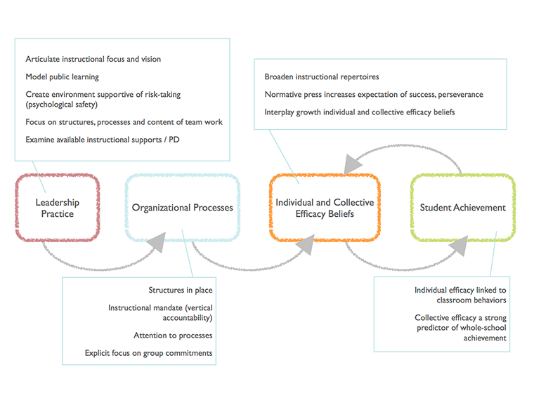
Internal Coherence Protocol /Survey-School Readiness for Continuous Improvement

Slide 16
Predictive indicators-What Tells Us A Student is On-Track to Post-Secondary Success?
Validated on longitudinal data-follow students over time and into post-secondary
Identify factors shared by students who succeed and those who do not
The ABC’s plus- Attendance, Behavior, and Course Performance and Taking Challenging Course, aligned with state university system plus exposure to college level work in HS
Can be found locally using national clearinghouse data on post-secondary outcomes of your students

Slide 17
Four-Year Degree Outcomes by Indicator Combination

Slide 18
Challenge-Outcomes in Two Year Institutions Harder to Predict
How students experience two year institutions and factors in their life outweigh differences in high school experiences and outcomes

Slide 19

Norms
Be Optimistic/Have Fun
Honor our Time
Err on the Side of Action/Fully Participate
Vegas Rules

Slide 20

While Others Get Furious We Get Curious…

Slide 21

cu·ri·ous ˈkyo͝orēəs
adjective
1. eager to know or learn something.

Slide 22
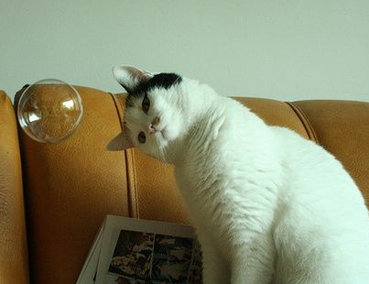
Connection Circle
Would you share
Your name
State or High School name
Some thing about yourself that might leave us curious

Slide 23
Knowledge Sharing- Round One
What is it about your current metrics (implementation, progress monitoring, early impact or other) and the way they serve you that is effective? best-in-class? School teams, the response to this may be some measure you have created or included in your design plan.
What conversations are you currently having about what you would like to measure that currently is not a part of your metrics suite and why (what insights are you aiming to gain?)
Is there a root cause or mindset that you believe is essential to address for high school redesign to succeed, that is not captured by your current set of metrics or on-going conversations about additional metrics?

Slide 24
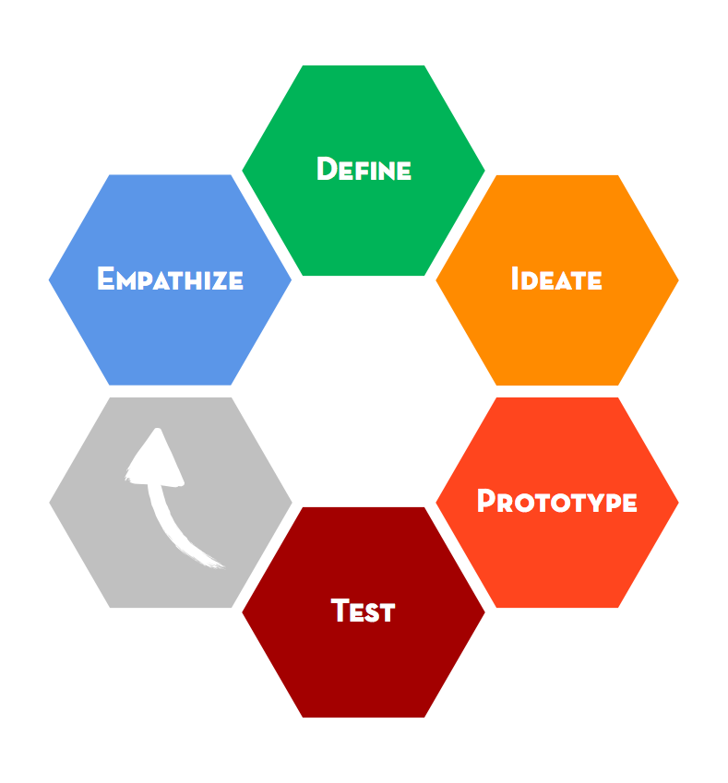
Notes:
remember d.t. biases towards empathy to inform definition
insights you cant get thinking about something
have to have direct experience

Slide 25
EMPATHY
Gives confidence that you are working on a meaningful problem; forces you to take a perspective other than your own
IDEATION
Gives you copious and diverse design solution possibilities to select, develop and test
PROTOTYPING & TEST
Gives confidence that your solution meets the need you uncovered; accelerates learning when you adopt a low-resolution prototyping mindset
Notes:
we think it is important to communicate through a direct design thinking experience
so we will work on a mini-project together today to “Improve the car maintenance experience”.

Slide 26
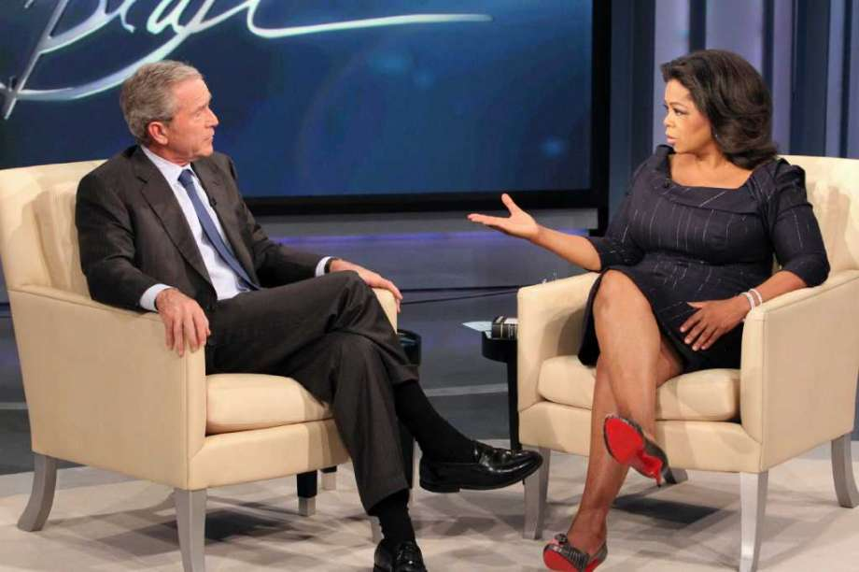
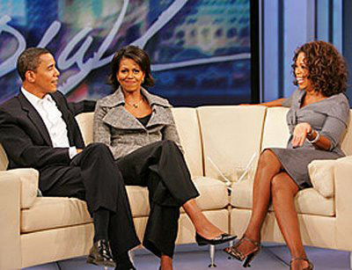
“The single most important lesson I learned in 25 years talking every single day to people, was that there’s a common denominator in our human experience. The common denominator I found in every single interview is we want to be validated. We want to be understood.
I’ve done over 35,000 interviews in my career. And as soon as that camera shuts off, and inevitably in their own way, everyone asks this question: ‘Was that okay?’
I heard it from President Bush, I heard it from President Obama, I’ve heard it from heroes and from housewives, I’ve heard it from victims and perpetrators of crimes. I even heard it from Beyonce in all her Beyonce-ness…
They all want to know: ‘Was that okay? Did you hear me? Did you see me? Did what I said mean anything to you?’”
Oprah Winfrey

Slide 27

Empathize: how?
without judgment
with a beginner’s eyes
with curiosity
optimistically
respectfully

Slide 28
Questions
“Tell me about the last time you…”
“What was the best…” “What was the worst…
“And why is that?” “Can you tell me more
about that?”

Slide 29
Our Challenge: How might we create indicators that will help us know if our actions in implementing our high school redesign plans are aligning with our intentions?
Start by gaining empathy…..
Interview
12 Min (2 sessions x 6 minutes each)
Dig Deeper
12 minutes each (2 sessions x 6 minutes each)
Notes from your first interview
Notes from your second interview
Switch roles and repeat
Switch roles and repeat

Slide 30
Reframe and Define for Your Partner

Slide 31
Reframe the Problem
Capture Findings
3 min
needs : Things they are trying do*
*Use verbs
Insights: New learning about partner’s feelings/ worldview to leverage in your design*
*make inferences from what you heard

Slide 32
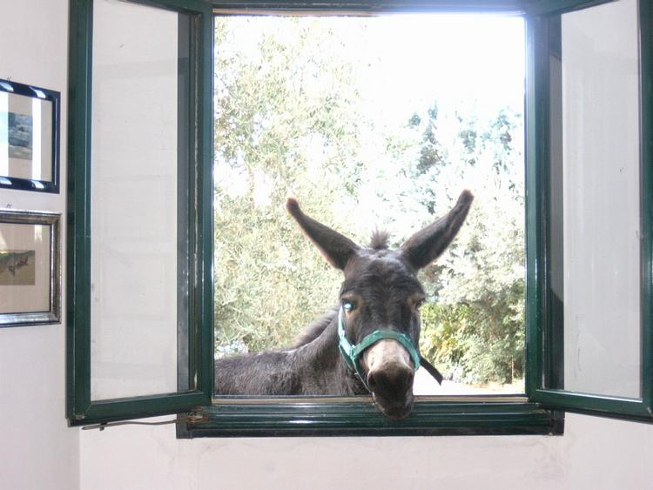
Time for a Break

Slide 33
Knowledge Sharing- Round Two
What is it about your current metrics (implementation, progress monitoring, early impact or other) and the way they serve you that is effective? best-in-class? School teams, the response to this may be some measure you have created or included in your design plan.
What conversations are you currently having about what you would like to measure that currently is not a part of your metrics suite and why (what insights are you aiming to gain?)
Is there a root cause or mindset that you believe is essential to address for high school redesign to succeed, that is not captured by your current set of metrics or on-going conversations about additional metrics?

Slide 34
Storyboard and Capture Method Cards and Directions

Slide 35

Suggested Lunch Topic:
State – District – School Relationships that Support State-Funded Redesign Opportunities
Share your experiences
.

Slide 36
Knowledge Sharing- Round Three
What is it about your current metrics (implementation, progress monitoring, early impact or other) and the way they serve you that is effective? best-in-class? School teams, the response to this may be some measure you have created or included in your design plan.
What conversations are you currently having about what you would like to measure that currently is not a part of your metrics suite and why (what insights are you aiming to gain?)
Is there a root cause or mindset that you believe is essential to address for high school redesign to succeed, that is not captured by your current set of metrics or on-going conversations about additional metrics?

Slide 37
Insert Slides Where Bob Frames Why the Four Questions Guide Us as Indicators of What’s Working

Slide 38

“If you want something new you are going to have to stop doing something old.”
Peter Drucker

Slide 39

Five Whys
“This is the basis of Toyota’s scientific approach…by repeating “why” five times the nature of the problem as well as its solution becomes clear.”
Taiichi Ohno

Slide 40
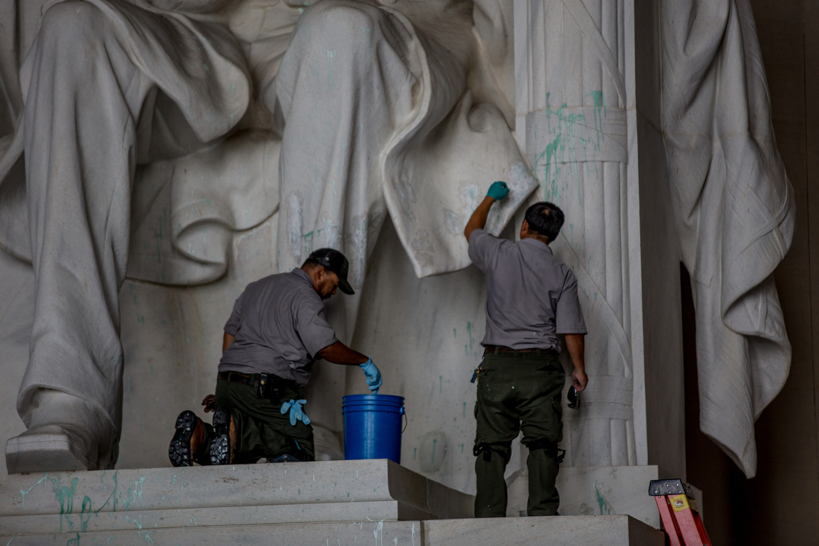
Why?
Notes:
Challenge -Lincoln Monument deteriorating – Why #1 harsh chemicals are frequently used to clean the monument.

Slide 41
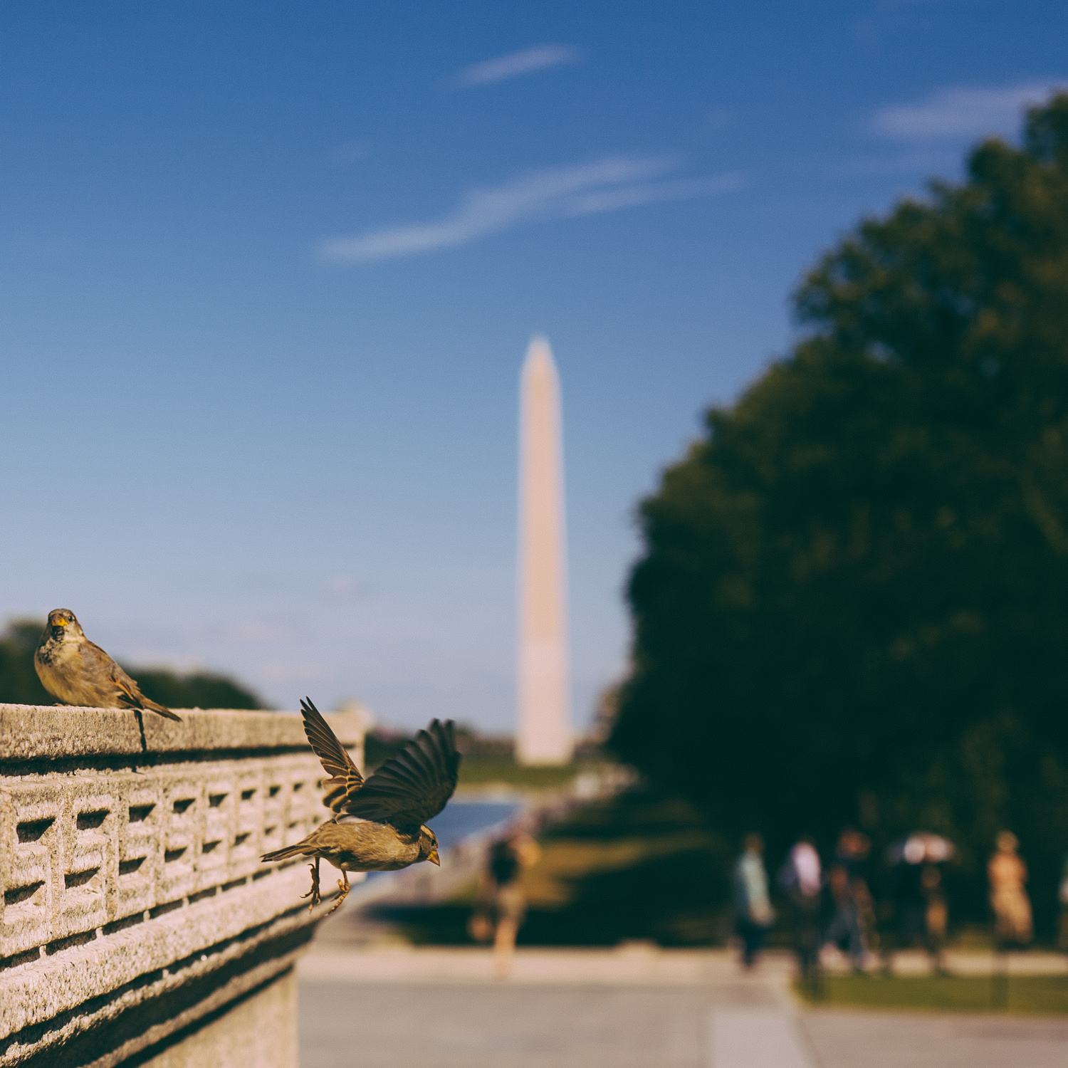
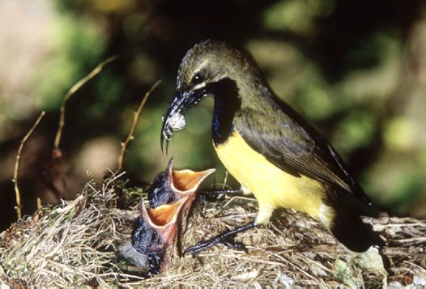
Why are harsh chemicals needed?
Why are there so many bird droppings?
Notes:
2 - Why are harsh chemicals needed? To clean off large number of bird droppings? 3- Why so many bird droppings? Because there is a large population of spiders- food source for starlings and sparrows.

Slide 42
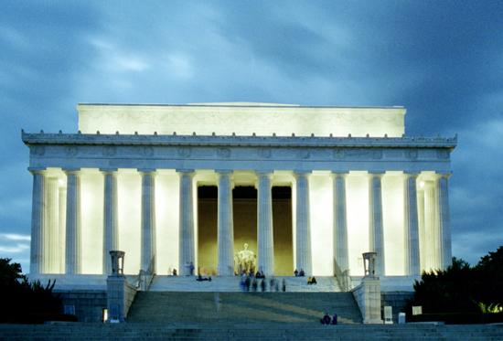
Notes:
4 – Why are there so many spiders? Because of the swarms of insects drawn to the monument at dusk that the spiders eat. 5 – Why are swarms of insects drawn to the monument at dusk? ---The timing of the lighting of the monument

Slide 43
At each station you will use the
5 Whys to brainstorm why the best practice is NOT in place.
Its Your Turn. . .
Notes:
We will give them time to complete…then either time in table groups or whole group here from a few people who had insights based on this opportunity.

Slide 44
Five Whys When Not Visible
Quality of coursework – how asked to use mind in class and out
Station One:

Slide 45
Five Whys When Not Visible
Quality of relationships - expanded so student/adult, student/student, adult/adult
Station Two:

Slide 46
Time for a Break

Slide 47
Knowledge Sharing- Round Four (If Needed)
What is it about your current metrics (implementation, progress monitoring, early impact or other) and the way they serve you that is effective? best-in-class? School teams, the response to this may be some measure you have created or included in your design plan.
What conversations are you currently having about what you would like to measure that currently is not a part of your metrics suite and why (what insights are you aiming to gain?)
Is there a root cause or mindset that you believe is essential to address for high school redesign to succeed, that is not captured by your current set of metrics or on-going conversations about additional metrics?

Slide 48
Five Whys When Not Visible
Equity of access to extra-curriculars, guidance, postsecondary explorations, learning opportunities outside of school i.e., shaped experiences that prepare for postsecondary success
Station Three:

Slide 49
Five Whys When Not Visible
Collective efficacy of adults-relational trust and access to and use of data, communication, teaming, and continuous improvement tools and structures
Station Four:

Slide 50
Reflections on Day and Framing for
Design Challenge—Day Two

Slide 51
Day Two

Slide 52
Design Challenge
We will use our deep understanding of the challenge and new insights to create a prototype for progress monitoring using indicators and metrics to determine the effectiveness of their design work.

Slide 53
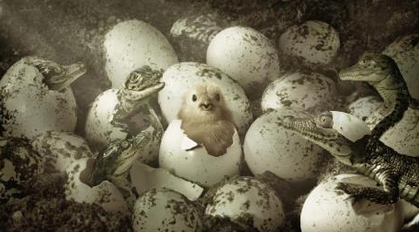

Connection Circle
Would you share a moment from yesterday when you experienced. . .
A sense of true
A belonging in our
group?

Slide 54
Insert Bob’s Framing Slides for Day Two

Slide 55
Norms
Be Optimistic/Have Fun
Honor our Time
Err on the Side of Action/Fully Participate
Vegas Rules

Slide 57

Prototype: what?
A tangible, testable representation of your idea
Notes:
Way to represent an idea that is testable

Slide 58
Prototype: why?
to gain empathy
to explore
to test
to inspire
get deeper understanding
build to think
learn and refine solutions
inspire with your prototype

Slide 59
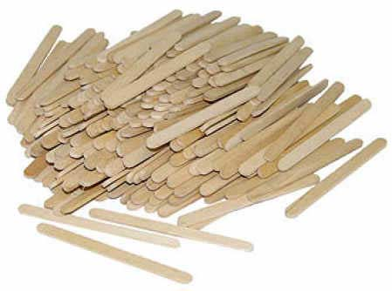
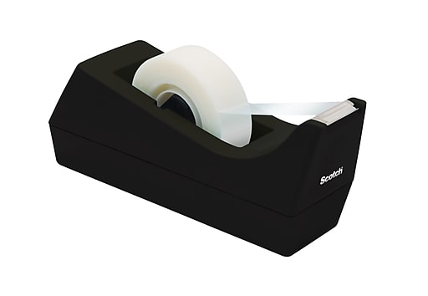

Prototype: tools
Notes:
Tools:
You can support almost any digital, physical, or service prototype at an early stage with these three tools.
Infrastructure—a building block. Craft sticks are EXCELLENT for this. Pipe cleaners are also good. Large scale woule be PVC pipe or wood.
Connector—blue tape; tape; hot glue. Blue tape is great because it is repositionable versus duct tape.
Boundaries or partitions—foam core works great to simulate walls; blue tape can demarcate spaces almost instantly.
Post-its—some repositionable surface that will allow you to use text or simulate user engagments such as buttons, screens, or signage.

Slide 60
Time for a Break

Slide 62
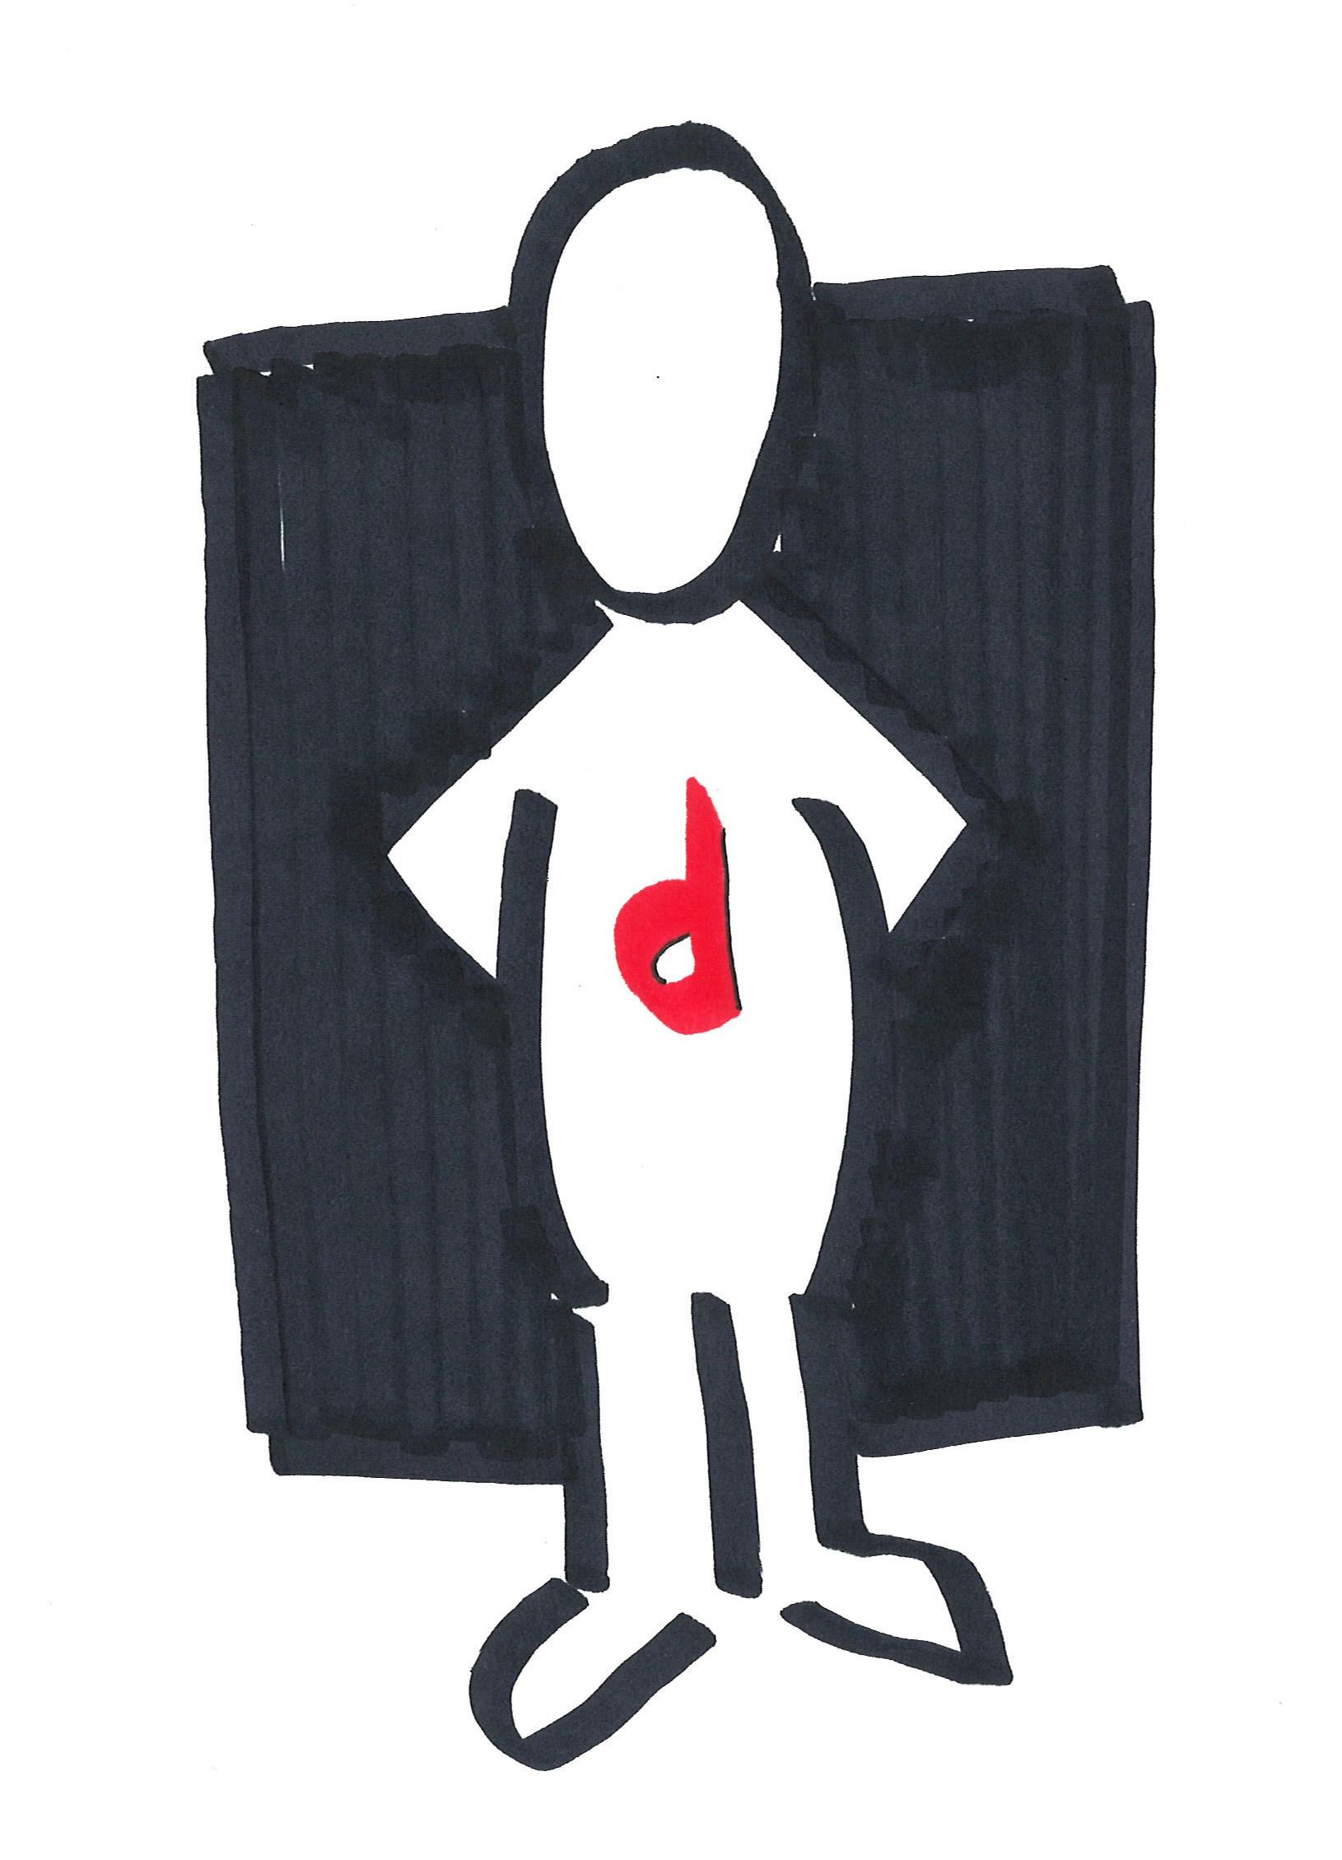
Get Feedback
Find a different group
Test your idea
Play the role of end user and give feedback.
6 minutes for each share/test, then switch.
Notes:
point of these rough protos are to test and learn from that as soon as possible…
go right into testing…visibility through pair work
AFTER: ideas out on paper, tested with another person, learned what works and what doesn’t, imagine if you had another cycle (what would you prototype, how would the next cycle be different)

Slide 63
Opportunities and Options
Reflect on convening and identify areas of needed support and generate a plan for next steps.

