Slide 1
Mississippi Department of Education School Improvement Coaches
Supporting Comprehensive School Improvement High School Redesign Implementation
July 16, 2019
Everyone Graduates Center, School of Education,
Johns Hopkins University
Notes:
Overview of our plan to raise awareness of the low-performing schools time and circumstance have left behind, highlight similar schools that have been reformed, and move toward strategy to improve them, leveraging ESSA
Get your thoughts on different options to identify and call them out in a constructive way; to tell their stories that will prompt action and reform; and to begin to envision a strategy boost their performance

Slide 2
Preview of our Day
You
4
Supporting Collaborative Teams
3
Stances of a Coach
2
Connection Circle
Mindsets to Support Implementation
1
Notes:
I need Gregg to help me clean this one up once we firm up what goes in each box.

Slide 3
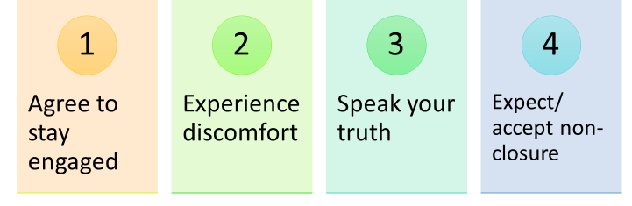
Group Agreements
Notes:
I was thinking of using these to model a different type of norms… and to speak to necessary intentions for building community

Slide 4
If we are going to be part of the solution, we have to engage the problems
— Majora Carter
Change will not come if we wait for some other person or some other time. We are the ones we’ve been waiting for. We are the change that we seek.”
— President Barack Obama

Slide 5
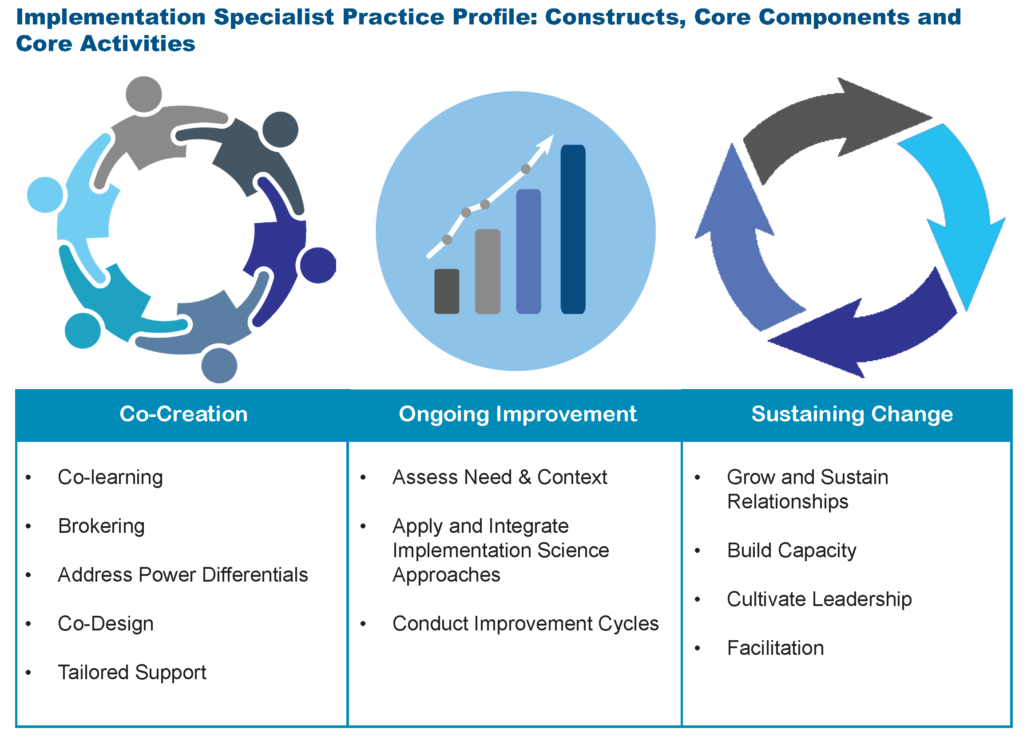

Slide 7
Organizing Adults “It’s Teams, Not Individuals”
FROM:
Isolated classrooms
Every person for him/herself
Individual perspective
Bureaucratic
Hierarchical
Compliance Driven
TO:
Integrated teams of adults
Relational trust
Team perspective
Human/End user
Distributed leadership
Commitment

Slide 8
Students at the Center “Hope, Agency, Trust and Relationships”
FROM:
I am not a social worker
Those people
Data for accountability
Punitive
Deficit
Fixed mindset
Shame
Compliance
TO:
How can I help?
We are the people
Data for improvement
Restorative
Asset-based
Growth mindset
Resilience
Commitment

Slide 9
Teaching & Learning Supported, Engaged and Challenged
TO:
Collective efficacy
Assessment for learning
Learning scientists and activators
Intrinsic, Choice, Autonomy
Competency attainment of something worthwhile
Mistake = Learning
FROM:
Individual orientation
Assessment of learning
Stand and deliver
Extrinsic
Ritualized practice
Mistake = Bad

Slide 10
Post Secondary Pathways Once an Endpoint, Now a Stepping Stone
FROM:
Sorting and ranking
Compliance
Seat time
School as single purveyor of knowledge
TO:
Universal participation in a post secondary plan
Commitment
Relevance
Learning beyond school walls

Slide 11

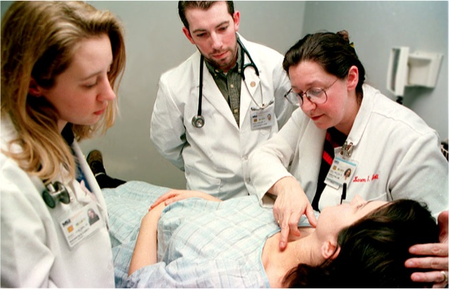


Coaching and BEAM
JH Bayview Medical Center
Pre-rounds
Litany of conditions
Complications
Failure
Diagnostic information
Dosage
The aim is to shine a light on what it means to be human, for patients and their doctors, and enhance humanistic understanding of the patient's experience of illness.
The Human Side of Illness
Studies have shown that art can be an effective tool to both foster empathy and improve observation skills, which have been linked to improved patient outcomes

Slide 12


Slide 13
Getting a meaningful conversation going….
Offering Support:
JHU School of Medicine’s Department of Psychiatry and Behavioral Sciences offers BEAM as a way to foster empathy with patients. Looking at the human side rather than the limiting support of treating the illness.
Mobile App inspired by Parker J. Palmer’s pedagogical approach of a “third thing”
Creating
Challenge:
Images or objects can serve as icebreaker between two parties to create a safe space for difficult topics of conversation
Facilitating a Professional
Vision:
“Our hope is that it does not only bring the medical team closer together but the team closer with the patient as well”
Dr. Chisolm

Slide 14
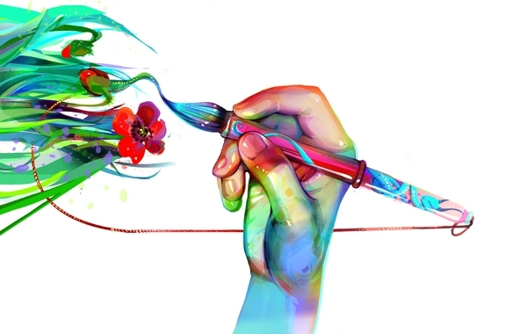
The Art of Coaching
CONSULT
COLLABORATE
COACH

Slide 15
The Art of Coaching
Please take a few minutes to interact with your art
Art Review:
Walk About Review
DISCOVERY | Name:------ | Name:-------- | Name:--------
WONDERING | Name:----- | Name:---- | Name:----
INSIGHT | Name:---- | Name:----- | Name:-----

Slide 16
Continuum of Learning and Support Response Pattern
CONSULT
COLLABORATE
COACH
?
?
?

Slide 17
Three Stances: Consulting, Collaborating, Coaching
Apply and Test Shared Ideas
Inform pedagogical knowledge and skills
Interpersonal Communication
Developing Trust and Rapport
Planning Conversation
Role of Data
Ways of attending, listening, and responding
Form ideas, approaches, solutions, and focus for inquiry
Share accepted practices and policies
Goal Setting
Self-Reflecting

Slide 18


Putting All Together
Curiosity
Ask questions, engage with evidence and ways of knowing across content areas and disciplines, tolerate uncertainty
EMPATHY
Transdisciplinary
Approach the change facilitation process with regard for others as legitimate, respected, and valuable contributors to the development and growth of the model and associated processes and outcomes (Jordan, 2016)
Embrace and use different ways of knowing, different ways of being, and diversity of discipline (content) expertise to bring about mutual and transformative learning
Coaching
Collaborating
Methodical
Access and integrate scientific findings to make informed decisions for stakeholders and service beneficiaries (Shapiro, 2002)
Consulting
Commitment
Bring patience, resilience, and willingness to challenge the status quo to the process; create readiness, and invest in building effective teams (Fam, Smith, & Cordell, 2016)
Coaching + Philosophical Principles

Slide 19


Matching Coaching Stances with HS Re-design Levers Perspective
In thinking about your school(s) HS re-design plan, how might sequencing and coaching stances support implementation?
-------
-----
-----
-----
----
-------
-----
----
AWESOME
CELEBRATE!
Phase 1
days
July 20 – Aug 14
Phase 2
18 days
Aug 15 – Sep 7
Phase 3
24 days
Aug 15 – Sep 17
Phase 4
16 days
Sep 8 – Sep 30
Phase 5
25 days
Oct 4 – Nov 7
Phase 6
21 days
Nov 11 – Dec 11

Slide 20
The Engaged Feedback Checklist

Slide 21
Skillful leadership is widely distributed to access the means for improvement that exist within the school community and community at large.

Slide 22
Collaborative Teams

Slide 23
Relationships are the Super Power
The quality of human relationships creates the energy source that produces ALL organizational work.
Marshaling, focusing and developing energy, information and relationships becomes the role of leaders.
Margaret Wheatley

Slide 24
We make choices and decisions based on our value system, and differing values often lead to misunderstandings and misinterpretation. This, in turn, hampers our relationships and lessens the effectiveness of our work together.

Slide 25
Facilitation Supports Collaboration

Slide 26
What do effective facilitators have in common?
Flexibility
They follow principles not rules
They improvise
They know their own cognitive and emotional style and can work beyond them when it will serve the group
Comfortable with self and can set aside judgment of others
Clear about intentions
They think about outcomes
They are reflective and learn from experience
They can direct or request be firm or soft serious or light and focus on tasks or relationships
Have abundant knowledge of processes and groups

Slide 27
What capabilities support facilitation?
Knowing our intentions and choosing congruent behaviors
Setting aside unproductive patterns of listening, inquiring, and responding
Choosing when to integrate and when to self assert
Knowing and supporting the groups purposes, topics, processes and development
Emotionally disassociate from events to make strategic decisions about processes
Garmston and Wellman the Adaptive School

Slide 28

Stages of Community – M.Scott Peck
Notes:
I might hand out the article that includes the storming / forming / norming stages of Team Development and compare to stages of Community Development

Slide 29

Pseudocommunity
Faking it
People are overly polite
Symptoms- Conflict avoidance, ignore individual differences, speak in generalities

Slide 30

Chaos
Fighting and struggling as differences move in
Symptoms- Members trying to convert
others
to their way of viewing a situation. Instead of
trying to hide…movement to a frame of blaming.

Slide 31
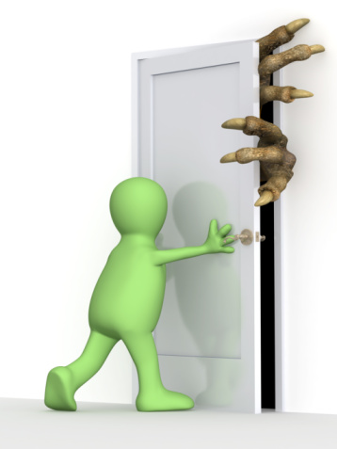
Emptiness
Emptying of barriers to communication
Transition from rugged to soft individualism
Symptoms- Eliminating barriers such as:
expectations, preconceptions about community and people
one right way
need to fix and solve problems of others, need to control

Slide 32
Community
People are open, vulnerable and lucid, comfortable
with silence.
Peck suggests groups formed to do a task must pay attention to
community building first and problem solving second.
Symptoms- Eliminating barriers such as:
expectations, preconceptions about community and people
one right way
need to fix and solve problems of others, need to control

Slide 33
Dialogue and Discussion
Healthy conversations move team learning on a continuum from :
-----X---------------------------X-------------------------X---------------------
Raw Debate Polite Discussion Skillful Discussion Dialogue

Slide 34
Skillful Discussion
A process in which people come to some type of closure on an issue:
Making a decision
Reaching an agreement
Identifying priorities
Develops deeper meaning among members, but the primary focus is on task and convergent thinking.

Slide 35

Dialogue
Dialogue is a process in which people engage in conversations where they openly share their views and develop knowledge about each other’s assumptions.
Peter Senge, 1990, The Fifth Discipline

Slide 36
Dialogue
Balances advocacy with inquiry
Invites learning at a deeper level
Encourages us to listen on multiple levels – self, one another, and collectively…to honor differences
Challenges us to suspend our judgment
Is different then discussion or debate
Promotes creativity and shared meaning

Slide 37
Who meets with who, when, about what and how frequently?

Slide 38
Your Call

