Slide 1
Ohio High School Redesign Teams and the Cross State
High School Collaborative
August 29, 2019
Everyone Graduates Center
Johns Hopkins University

Slide 2
Who are We?
The Cross State High School Collaborative is a project consisting currently of seven participating states: Illinois, Louisiana, Massachusetts, Mississippi, New Mexico, New York, and Ohio partnering with the CCSSO, Everyone Graduates Center at JHU and Civic Enterprises. Collectively, we are dedicated to using ESSA to redesign high needs high schools to support their communities in the 21st Century.

Slide 3
Who are Our Teams?
Your team will decide how you will introduce the members of your high school design team to the cohort.
Will you share the name and location of your high school and one of its “signature strengths”?
Choose one of the “gifts” provided on the table for your team.
When you introduce your team let us know which gift you chose and why.

Slide 4
Choose a Gift for Your Team
An apple tree whose fruit has the power to grant a wish to whoever eats it
A cloak that turns the wearer invisible, or design your own
An empty train that can travel anywhere in the world

Slide 5
Purpose for Today
Introductions across the cohort as we begin to build relationships.
Introduction to the Cross State High School Collaborative and Evidence Based High School Redesign
Overview Four Drivers: Organizing Adults, Students at the Center, Teaching & Learning, and Postsecondary Pathways
Explore how context matters greatly in school redesign – determine how to develop an accurate and shared understanding with a plan for needs assessment that includes authentic student voice and community input

Slide 6
Working Norms
Fully participate
Ensure all are heard with one voice at a time
Minimize distractions by placing cell phone on mute and stepping out for essential communication
Recognize / share the wealth of experience, expertise and understanding among the group
Honor time
Have fun

Slide 7
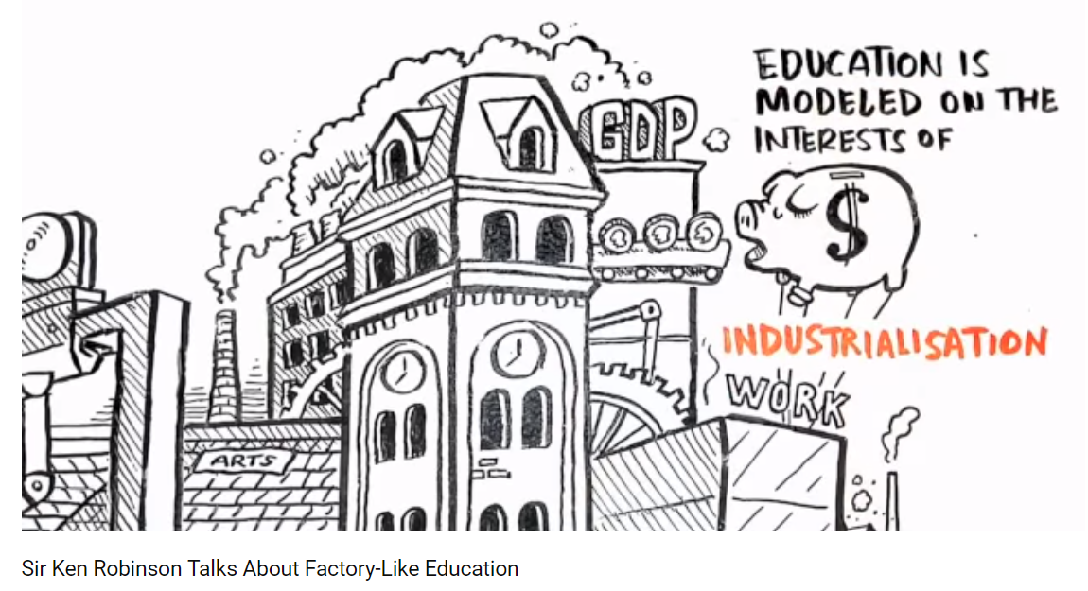
The Need for High School Redesign
Take a few minutes to read the article at your table.
Then we will watch a brief video.
As we read and watch reflect upon:
What were our public schools designed to produce?
How are they designed?
In what ways do the video clip and article resonate with you and your school community?
Notes:
https://www.youtube.com/watch?v=K9C0KNtqiHU&app=desktop

Slide 8
The Great American High School of the
20th Century
Helped our nation progress and was based on the desire to rapidly scale high schooling to all
Staffing, schedules, how adults where organized, and what students studies where all designed to enable the standardization needed for rapid growth and based on the premise that for most students, high school would be the end of their formal education
Examples: student—counselor ratios, teachers working independently

Slide 9
New Mission for Our High Schools in the New Century
Today all student’s need to graduate from high school prepared for post-secondary schooling and/or training.
This means that regardless of student’s prior schooling, motivation, or current level of need, high schools need to provide them with the supports, experiences, and instruction required for post-secondary educational success.
We will not achieve this mission if we don’t redesign our high schools.

Slide 10
To Redesign Our High Schools We Need to Examine Our Current Beliefs
We need to understand the our existing high schools in both obvious and subtle ways shape and limit our thinking of what is possible. They provide our mental models of what teaching and learning look like, and how students, teachers, and administrators should act.
For example, they lead us to believe that human interactions should be determined by roles, rather than relationships.

Slide 11
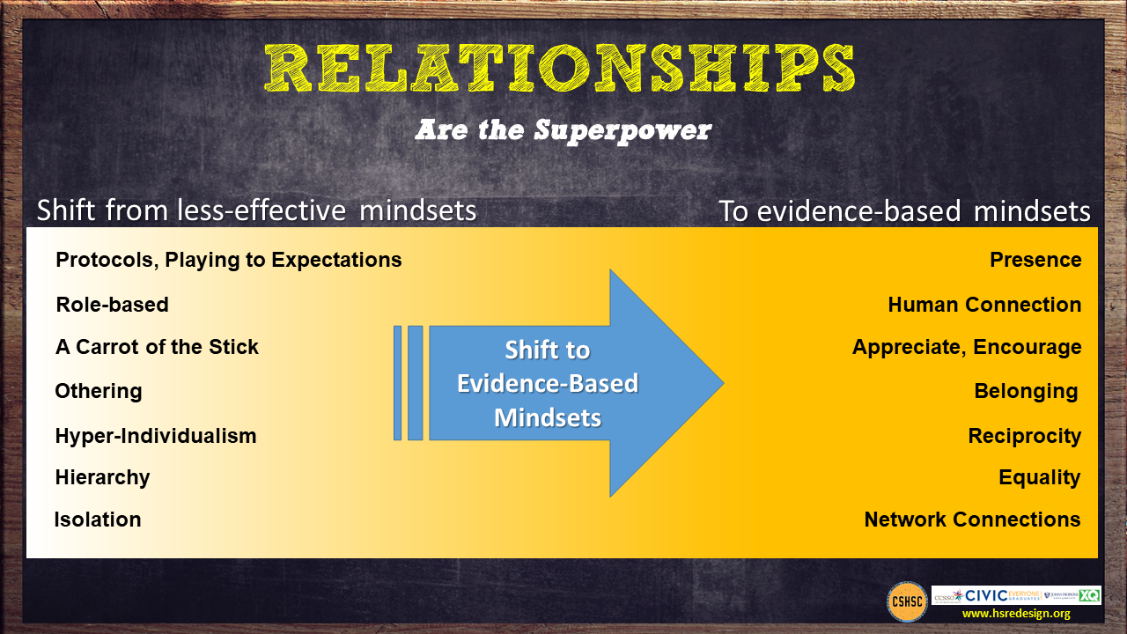

Slide 12
We Also Need to Understand that Educational Challenges are Not Equally Distributed Across all High Schools
We have concentrated our neediest high school students in subset of high schools that were not designed for the level and intensity of educational challenge they now face.
As a result, many of these high schools are still struggling despite nearly 20 years of high school reform efforts.
It’s not for a lack of trying or caring.

Slide 13

Poverty Complicates the Work in These Schools – Like a Hungry Bear That Steals Our Lunch
Poverty taxes school success by making it hard for students to attend everyday, focus in class and complete their assignments.
High School Redesign Needs to Take This Into Account

Slide 14
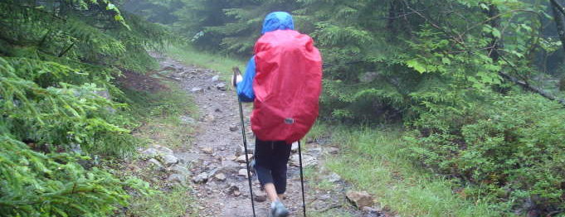
Redesigning High-Needs High Schools is Like
CLIMBING A MOUNTAIN
IN THE RAIN
IT IS DIFFICULT WORK
UNDER CHALLENGING
CONDITIONS

Slide 15
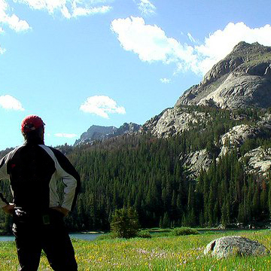
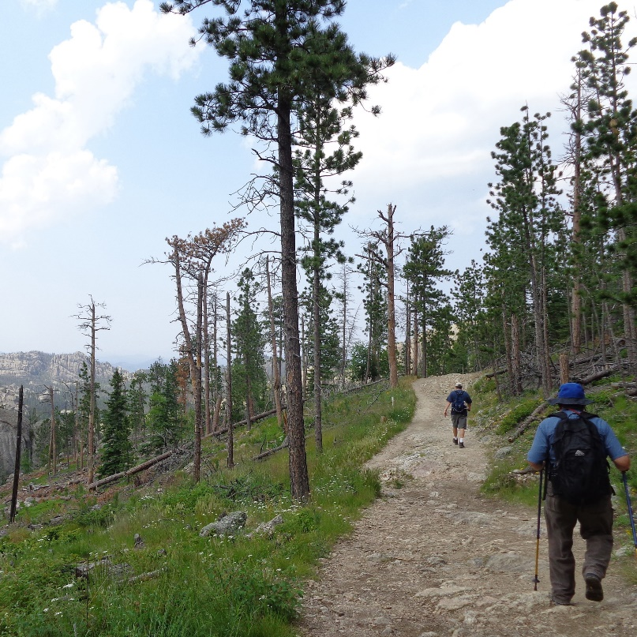

To Climb a Mountain in the Rain You Need
HOPE
PURPOSE
KNOW HOW

Slide 16
A New Approach is Needed
Hopeful, positive, future-orientated frame designing a school for the 21st century rather than being seen as failed school in need of reform
Goal is not a high school diploma but strong pathways through high school to postsecondary and adult success for all students
Evidence-based, but locally-customized/orientated—not one size or
one way for all
Break social isolation and share know-how via networks of schools facing similar challenges and technical assistance tightly aligned to community redesign vision and goals
Make redesigned high school the center of community economic development and social integration efforts

Slide 17

We have learned a lot about improving high needs high schools over the past 20 years.
Redesign Challenge:
Local customization built upon an evidence-based foundation

Slide 18
Exploration of the Evidence Base with focus on Four Levers of Improvement High Schools Can Impact/Control
Organizing adults and the school for success
Putting supporting all students’ success at the center of schools mission/actions
Improving teaching and learning
Providing universal access to postsecondary pathways, partners and preparatory experiences

Slide 19
For Each of These Levers/Drivers Over the Next Year Your School Team Will:
Examine evidence-based practices and structures which support their use.
Consider influencing factors.
Explore the mindset shifts the evidence suggests need to occur to create high schools that work in the 21st Century.
Understand the tensions that exist and balances that need to be maintained across, between, and within the evidence-based practices.
Use them to serve as the foundation of your high school redesign customized to your local circumstances.

Slide 20
Organizing Adults
“It’s Teams, Not Individuals”
FROM:
Isolated classrooms
Every person for him/herself
Individual perspective
Bureaucratic
Hierarchical
Compliance Driven
TO:
Integrated teams of adults
Relational trust
Team perspective
Human/End user
Distributed leadership
Commitment

Slide 21
Organizing Adults
Evidence-Based Practices
Supporting Structures
Teacher Teams
Student cohorts
Distributed Leadership
Interdisciplinary Teams
Leadership Development
Academies
Relationships and Trust
Collaborative Planning Time
Data Driven Decision Making
Personalized Learning Lanes
Influencing Factors
Student data/needs/voice
Teacher capacities
Community Opportunities
Notes:
Here we will go to work book for this page and look at design questions

Slide 22


Reynoldsburg City Schools
Notes:
Reynoldsburg City Schools—Academy Experience https://youtu.be/b5FlUW2iByE
Reynoldsburg City Schools—Freshman Experience https://youtu.be/2sc-kguw8wk

Slide 23
Organizing Adults Redesign Questions
As a design team read the guiding redesign questions on the bottom of page 11 and select two “ how might we…” questions you would like to explore as you begin to create your redesign plan.
Review the mindset shifts for Organizing Adults.
What mindset do you see as a strength for your school community?
What mindset might need to be given additional focus in order to surface existing assumptions and beliefs?

Slide 24
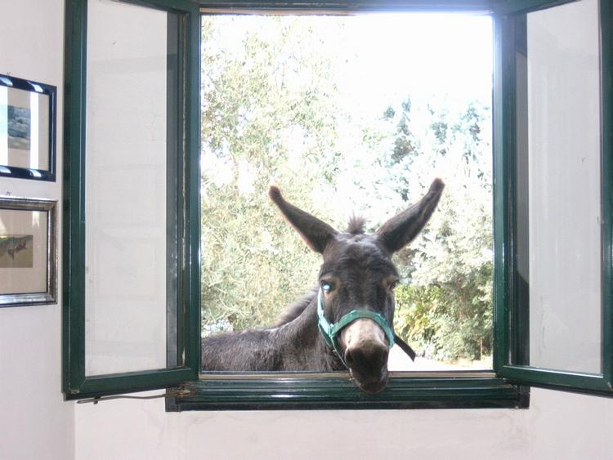
Time for a Break

