Slide 1
Students at the Center “Hope, Agency, Trust and Relationships”
FROM:
I am not a social worker
Those people
Data for accountability
Punitive
Deficit
Fixed mindset
Shame
Compliance
TO:
How can I help?
We are the people
Data for improvement
Restorative
Asset-based
Growth mindset
Resilience
Commitment

Slide 2
Students at the Center
Evidence-Based Practices
Supporting Structures
Positive Developmental Relationships with Adults
Ongoing structures/rituals that promote and celebrate student voice, engagement, and performance
Early Warning and Multi-Tiered Student Response Systems and Community Support
Academies/Student Cohorts
Interdisciplinary teams
Building Hope, Purpose, and Agency
Common Planning Time
Restorative Practices
Influencing Factors
Student data/needs/voice
Teacher capacities
Community Opportunities
Notes:
Sample Strategies Based on Evidence Base
Beginning in the freshman year, offer a comprehensive college and career planning program to students and families. (More robust with frequent touch points than current IGP)
Provide all students support to complete a comprehensive plan for success after high school.
Offer a dual enrollment program that allows student to take college courses for high school AND college credit.
Integration of academic and technical content.
Career awareness, job shadowing, intern and apprenticeships.

Slide 3

Student Voices: The Future of School
Notes:
https://vimeo.com/155339834

Slide 4
What Research Tells Us
Young people need caring, trusting, and supportive relationships with adults and with other young people.
Young people respond to high expectations.
Young people need opportunities to contribute (often referred to as “choice and voice”).
Young people need learning experiences that intentionally engage their interests, offer opportunities to succeed, and provide feedback to enable them to reflect on their accomplishments.

Slide 5
Review of Research Pieces
Each person will need a copy: How Students Thrive – Positive Youth Development in Practice
Self select one of the following topics:
High Expectations 14 - 18
Student, Voice, Choice and Contributions 19-22
Caring, Trusting and Supportive Relationships 8 – 13
*Please be sure at least one member of your table selects each of the topics – then move to expert groups.

Slide 6

Move to the area of the meeting room reading your selection.
High Expectations 14 - 18
Student, Voice, Choice and Contributions 19-22
Caring, Trusting and Supportive Relationships 8 – 13
Be sure to have one member of your design team at each selection.

Slide 7
In Expert Groups
Have a dialogue about two or three big ideas from your selection, and how it might appear in practice.
What do you believe might benefit others from your team as you design?

Slide 8
Reconvene as Table Group Discussion
Individuals share thoughts, insights, questions regarding their text piece.
Brainstorm available programs, approaches, work, and/or strategies that are currently supported on your campus.
Capture highlights on page 18 of the workbook.

Slide 9
Teaching & Learning “Supported, Engaged, and Challenged”
TO:
Collective efficacy
Assessment for learning
Learning scientists and activators
Intrinsic, Choice, Autonomy
Competency attainment of something worthwhile
Mistake = Learning
FROM:
Individual orientation
Assessment of learning
Stand and deliver
Extrinsic
Ritualized practice
Mistake = Bad

Slide 10
Brainstorm at Your Table
What are some of the mindset shifts you expect to see for Teaching and Learning?

Slide 11
Teaching and Learning
Evidence-Based Practices
Evidence Based Instructional Program aligned with College and Career Readiness
Creating Challenging AND Caring Classrooms
Follow the Evidence – Use the Learning Sciences
Formative Assessments to tailor instruction and supports
Integrating Social, Emotional and Academic Development
Supporting Structures
Professional Learning Communities
Instructional Coaches
Collaborative Planning in School Day
Standards Based Grading/ Competency-Based Learning
Influencing Factors
Student data/needs/voice
Teacher capacities
Community Opportunities
Notes:
Sample Strategies Based on Evidence Base
Beginning in the freshman year, offer a comprehensive college and career planning program to students and families. (More robust with frequent touch points than current IGP)
Provide all students support to complete a comprehensive plan for success after high school.
Offer a dual enrollment program that allows student to take college courses for high school AND college credit.
Integration of academic and technical content.
Career awareness, job shadowing, intern and apprenticeships.

Slide 12
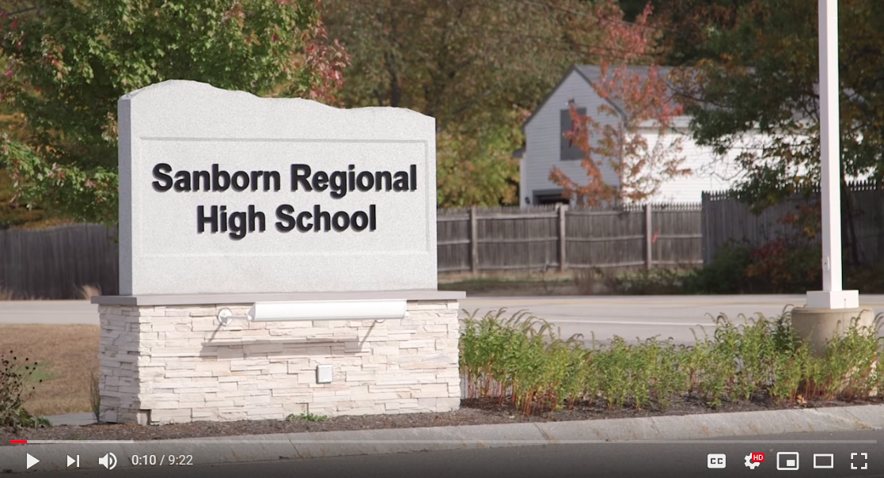
Competency-Based Learning Sanborn Regional High School
Notes:
https://www.youtube.com/watch?v=0o-tcOZAx_k

Slide 13
Postsecondary Pathways “Once an Endpoint, Now a Stepping Stone”
FROM:
Sorting and ranking
Compliance
Seat time
School as single purveyor of knowledge
TO:
Universal participation in a post secondary plan
Commitment
Relevance
Learning beyond school walls

Slide 14
Postsecondary Pathways
Evidence-Based Practices
Supporting Structures
Choice of pathway is up to the student and family
College and career planning programming beginning in 8th grade for students and family including supports for college admission process
All students are supported to complete a comprehensive plan for success after high school
Academies/Cohorts
Integration of technical and academic content
Competency-Based Learning
Apprentice/Internship/Job Shadow
Dual Enrollment – Early College – AP – IB
Influencing Factors
Student data/needs/voice
Teacher capacities
Community Opportunities
Notes:
Sample Strategies Based on Evidence Base
Beginning in the freshman year, offer a comprehensive college and career planning program to students and families. (More robust with frequent touch points than current IGP)
Provide all students support to complete a comprehensive plan for success after high school.
Offer a dual enrollment program that allows student to take college courses for high school AND college credit.
Integration of academic and technical content.
Career awareness, job shadowing, intern and apprenticeships.

Slide 15
Notes:
Sample Strategies Based on Evidence Base
Beginning in the freshman year, offer a comprehensive college and career planning program to students and families. (More robust with frequent touch points than current IGP)
Provide all students support to complete a comprehensive plan for success after high school.
Offer a dual enrollment program that allows student to take college courses for high school AND college credit.
Integration of academic and technical content.
Career awareness, job shadowing, intern and apprenticeships.

Slide 16
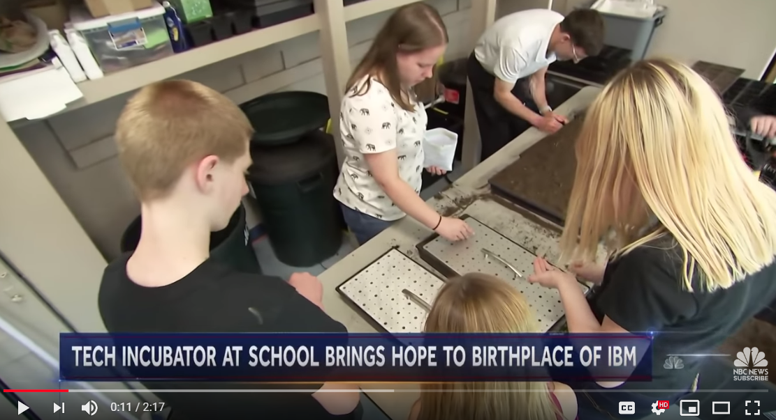
Tiger Ventures: Incubator for Start Ups
Notes:
https://youtu.be/yfzLNfpUSw0

Slide 17
Key Tensions to Balance: Student Supports
Authoritative
Supportive
Choice and Voice
Structured and Shaped

Slide 18
Getting Started
Have a Deep Understanding of Your Context
Know the Educational Challenges that Walks in Your Door
Seek Community Input
Tools and strategies to help are available on the Cross State High School Collaborative website http://www.hsredesign.org/
Use Guiding Questions to Help Shape Your Redesign Plan

Slide 19

We will reconvene after lunch Thanks!

Slide 22
Student Voice & Input

Slide 23

Block Party
Read your passage. Reflect on its meaning.
Stand up.
Find someone with another color passage that you have not yet talked with.
Introduce yourself. Share what you read and your response.
Switch roles.
When you hear the chime find a new partner.
Notes:
I will bring the block party quotes

Slide 24
Student Profiles
Notes:
We can give examples of the Student Profiles from Louisiana….and or the student totems – can suggest grades 9 and 12 as well

Slide 25
Student Surveys – Comparing Indicators
Survey respondents (students, teachers, community, others) considering the same phenomenon from their own point of view.
Example:
I am proud of our high school
Corwin/Quaglia School Voice and Aspirations 2016

Slide 26
Student Surveys – Comparing Indicators
Survey respondents (teachers/students) considering the same phenomenon from opposite points of view.
Example:
Teachers respond to: “I respect students”
Students respond to: “Teachers respect students”
Corwin/Quaglia School Voice and Aspirations 2016

Slide 27
Student Surveys – Comparing Indicators
Survey respondents (teachers/students) considering the same phenomenon from different roles.
Example:
Teachers respond to: “I feel comfortable asking questions during staff meetings.”
Students respond to: “I feel comfortable asking questions during class.”
Corwin/Quaglia School Voice and Aspirations 2016

Slide 28
Ask ’Em
When might we ask students what is important and meaningful in their world?
Whom might they like to help?
How might areas of our curriculum allow for connections with our community?
Opportunities exist in great abundance – time is the perceived barrier.
Student Voice From Invisible to Invaluable

Slide 29

Notes:
Here we can also give our example of how it might look as a lesson – Student Voice 78 – page 82 might also show video page 82 Student Voice
https://www.youtube.com/watch?v=zwwqxa_dR8E&feature=player_embedded

Slide 30
How can we access the mutual intelligence and wisdom we need to create innovative paths forward for our high schools and the communities they serve?
Redesigning, Reimagining School with Community Members’ Contributions

Slide 31

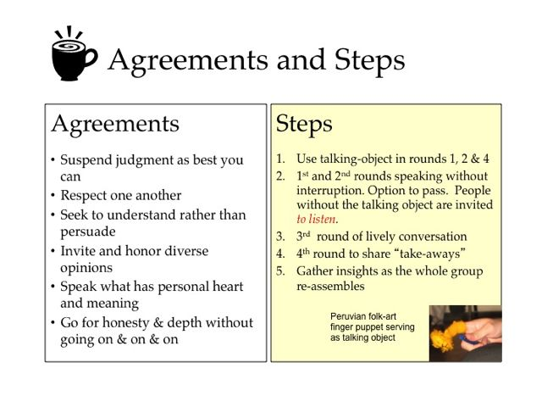

The CSHSC website features a section on Conversation Cafes with a seven-video series.
Notes:
Print the how to conversation café handout
https://www.youtube.com/watch?v=cgQMrqEOJcU

Slide 32
Round 1 – Articulate the Big Why
Why are we bringing people together?
What need or needs might this conversation fulfill?

Slide 33
Round 2 – Clarify Possible Outcomes
What do we believe is possible from this community conversation?
What might we consider successful?

Slide 34
Design Time
With your team – determine how you will gain student, staff and community input in your design plan.
Who else might you want to join to help achieve our purpose?
What additional perspectives might contribute valuable insights?
Who might receive real benefit from being a part of the designing process?
Consider what might be the right questions to ask?
How might you create spaces to think and explore together?

