Slide 1

New Mexico High School Redesign Teams
Cohort II
Cross State High School Collaborative
September23 , 2019
Everyone Graduates Center
Johns Hopkins University

Slide 2
Welcome
Michelle Starnes
HSRN Program Manager
Priority Schools Bureau
New Mexico Public Education Department

Slide 3
Who are We?
The Cross State High School Collaborative is a project consisting currently of seven participating states: Illinois, Louisiana, Massachusetts, Mississippi, New Mexico, New York, and Ohio partnering with the CCSSO, Everyone Graduates Center at JHU and Civic Enterprises. Collectively, we are dedicated to using ESSA to redesign high needs high schools to support their communities in the 21st Century.

Slide 4
Joining a Founding cohort of high schools in New Mexico
Belen
Bernalillo
Española Valley
Rocinante
Miyamura
Gilbert Sena
Health Leadership
Las Montañas

Slide 5
Who are Our Teams?
Your team will take a few minutes to share some of your high school’s “signature strengths”?
You will select one of the “gifts” provided on the table for your team or create your own.
Then we will have a connection circle to introduce each member of the team.

Slide 6
Choose a Gift for Your Team
An apple tree whose fruit has the power to grant a wish to whoever eats it
A cloak that turns the wearer invisible, or design your own
An empty train that can travel anywhere in the world

Slide 7
Connection Circle

Slide 8
What are we doing?
Introductions across the cohort as we begin to build a first sense of team building and knowing each other.
Develop a basic understanding of the Cross State High School Collaborative’s Evidence Based High School Redesign and Four Levers: Organizing Adults, Students at the Center, Teaching & Learning, and Postsecondary Pathways
Create a clear, shared understanding of the opportunity and explore how context matters greatly in school redesign –
Determine how to develop an accurate and shared understanding with a plan for needs assessment that includes authentic student voice and community input

Slide 9
Working Norms
Fully participate
Ensure all are heard with one voice at a time
Minimize distractions by placing cell phone on mute and stepping out for essential communication
Recognize / share the wealth of experience, expertise and understanding among the group
Honor time
Have fun

Slide 10
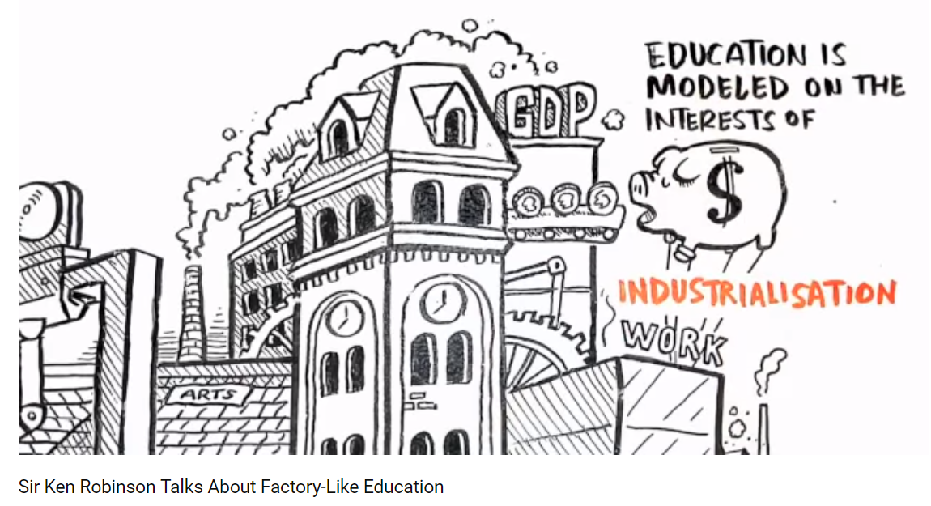
Why are we doing it this way?
Take a few minutes to read the article at your table.
Then we will watch a brief video.
As we read and watch reflect upon:
What were our public schools designed to produce?
How are they designed?
In what ways do the video clip and article resonate with you and your school community?
Notes:
https://www.youtube.com/watch?v=K9C0KNtqiHU&app=desktop

Slide 11
The Great American High School of the
20th Century
Helped our nation progress and was based on the desire to rapidly scale high schooling to all
Staffing, schedules, how adults where organized, and what students studies where all designed to enable the standardization needed for rapid growth and based on the premise that for most students, high school would be the end of their formal education
Examples: student—counselor ratios, teachers working independently

Slide 12
New Mission for Our High Schools in the New Century
Today all students’ need to graduate from high school prepared for post-secondary schooling and/or training.
This means that regardless of students’ prior schooling, motivation, or current level of need, high schools need to provide them with the supports, experiences, and instruction required for post-secondary educational success.
We will not achieve this mission if we don’t redesign our high schools.

Slide 13
To Redesign Our High Schools We Need to Examine Our Current Beliefs
We need to understand the our experiences with our existing high schools, in both obvious and subtle ways, shape and limit our thinking of what is possible. They provide our mental models of what teaching and learning look like, and how students, teachers, and administrators should act.
For example, they lead us to believe that human interactions should be determined by roles, rather than relationships.

Slide 14
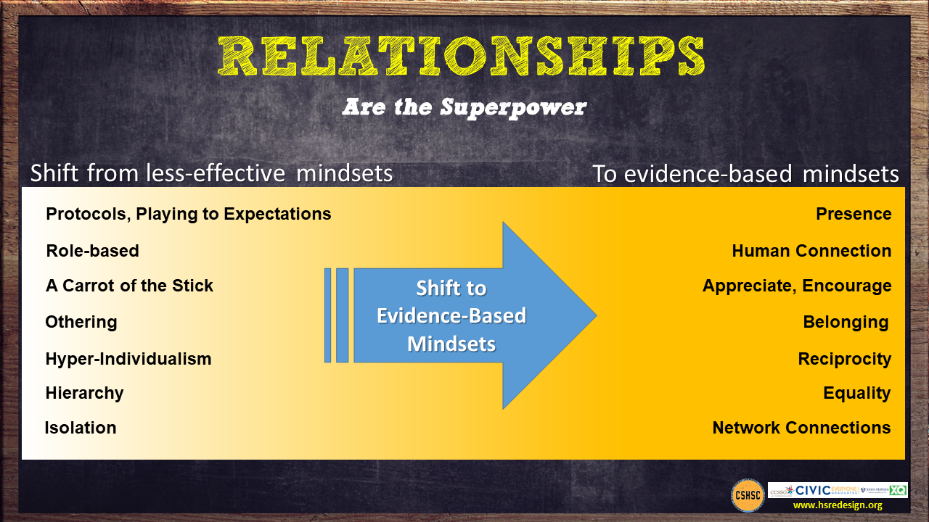

Slide 15
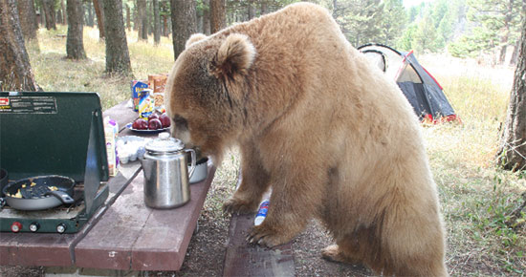
Poverty Complicates the Work in These Schools – Like a Hungry Bear That Steals Our Lunch
Poverty taxes school success by making it hard for students to attend everyday, focus in class and complete their assignments.
High School Redesign Needs to Take This Into Account

Slide 16
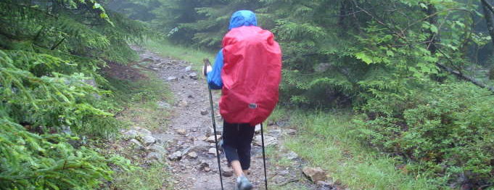
Redesigning High Schools is Like
CLIMBING A MOUNTAIN
IN THE RAIN
IT IS DIFFICULT WORK
UNDER CHALLENGING
CONDITIONS

Slide 17
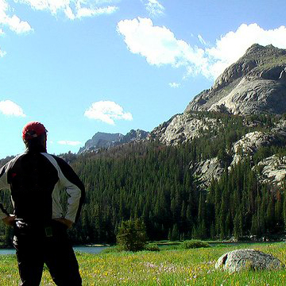
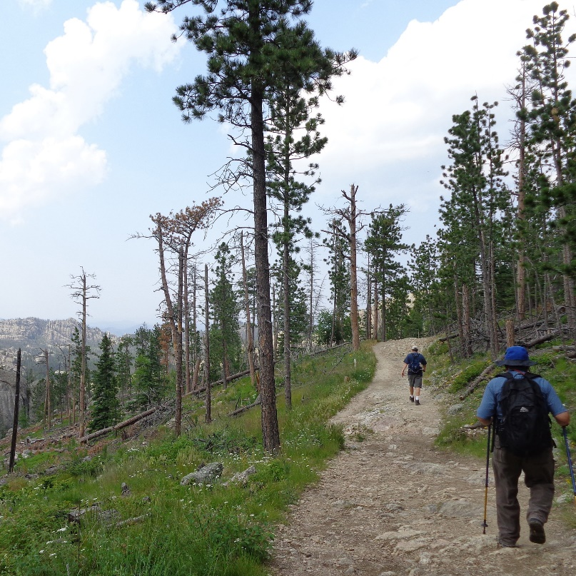

To Redesign High School You Need
HOPE
PURPOSE
KNOW HOW

Slide 18
A New Approach is Needed
Hopeful, positive, future-orientated frame designing a school for the 21st century
Goal is not a high school diploma but strong pathways through high school to postsecondary and adult success for all students
Evidence-based, but locally-customized/orientated—not one size or
one way for all
Break social isolation and share know-how via networks of schools facing similar challenges and technical assistance tightly aligned to community redesign vision and goals
Make redesigned high school the center of community economic development and social integration efforts

Slide 19

We have learned a lot about improving high needs high schools over the past 20 years.
Redesign Challenge:
Local customization built upon an evidence-based foundation

Slide 20
Four Levers of Improvement High Schools Can Impact/Control
Organizing adults and the school for success
Putting supporting all students’ success at the center of schools mission/actions
Improving teaching and learning
Providing universal access to postsecondary pathways, partners and preparatory experiences

Slide 21




Over the Next Year for Each of These Levers/Drivers Your School Team Will:
Examine evidence-based practices and structures which support their use.
Explore the mindset shifts the evidence suggests need to occur.

Slide 22
Organizing Adults
“It’s Teams, Not Individuals”
FROM:
Isolated classrooms
Every person for him/herself
Individual perspective
Bureaucratic
Hierarchical
Compliance Driven
TO:
Integrated teams of adults
Relational trust
Team perspective
Human/End user
Distributed leadership
Commitment

Slide 23
Organizing Adults
Evidence-Based Practices
Supporting Structures
Teacher Teams
Student cohorts
Distributed Leadership
Interdisciplinary Teams
Leadership Development
Academies
Relationships and Trust
Collaborative Planning Time
Data Driven Decision Making
Personalized Learning Lanes
Influencing Factors
Student data/needs/voice
Teacher capacities
Community Opportunities
Notes:
Here we will go to work book for this page and look at design questions

Slide 24
Table Activity
Select one of the articles provided highlighting work from two of the Founder Schools.
As you read, think about how the organization of adults might enhance/support the vision for their school.

Slide 25
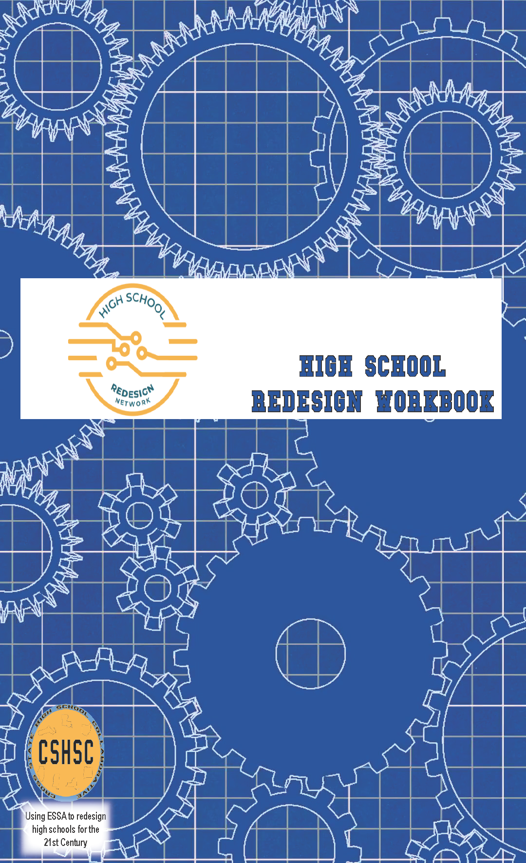
Organizing Adults Redesign Questions
As a design team read the guiding redesign questions on the bottom of page 11 and select two “ how might we…” questions you would like to explore as you begin to create your redesign plan.
Review the mindset shifts for Organizing Adults.
What mindset do you see as a strength for your school community?
What mindset might need to be given additional focus in order to surface existing assumptions and beliefs?

Slide 26
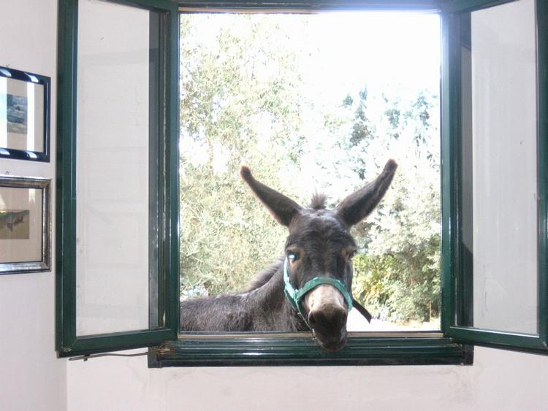
Time for a Break

Slide 27
Your Campus – Balancing Evidence Based Practices
Continued

Slide 28
Teaching & Learning
“Supported, Engaged, and Challenged”
TO:
Collective efficacy
Assessment for learning
Learning scientists and activators
Intrinsic, Choice, Autonomy
Competency attainment of something worthwhile
Mistake = Learning
FROM:
Individual orientation
Assessment of learning
Stand and deliver
Extrinsic
Ritualized practice
Mistake = Bad

Slide 29
Brainstorm at Your Table
What are some of the mindset shifts you expect to see for Teaching and Learning?

Slide 30
Teaching and Learning
Evidence-Based Practices
Evidence Based Instructional Program aligned with College and Career Readiness
Creating Challenging AND Caring Classrooms
Follow the Evidence – Use the Learning Sciences
Formative Assessments to tailor instruction and supports
Integrating Social, Emotional and Academic Development
Supporting Structures
Professional Learning Communities
Instructional Coaches
Collaborative Planning in School Day
Standards Based Grading/ Competency-Based Learning
Influencing Factors
Student data/needs/voice
Teacher capacities
Community Opportunities
Notes:
Sample Strategies Based on Evidence Base
Beginning in the freshman year, offer a comprehensive college and career planning program to students and families. (More robust with frequent touch points than current IGP)
Provide all students support to complete a comprehensive plan for success after high school.
Offer a dual enrollment program that allows student to take college courses for high school AND college credit.
Integration of academic and technical content.
Career awareness, job shadowing, intern and apprenticeships.

Slide 31
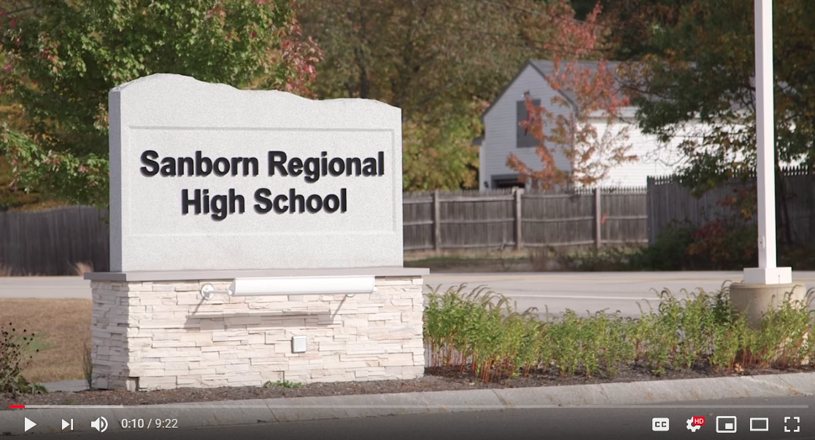
Competency-Based Learning
Sanborn Regional High School
Notes:
https://www.youtube.com/watch?v=0o-tcOZAx_k

Slide 32
Postsecondary Pathways
“Once an Endpoint, Now a Stepping Stone”
FROM:
Sorting and ranking
Compliance
Seat time
School as single purveyor of knowledge
TO:
Universal participation in a post secondary plan
Commitment
Relevance
Learning beyond school walls

Slide 33
Postsecondary Pathways
Evidence-Based Practices
Supporting Structures
Choice of pathway is up to the student and family
College and career planning programming beginning in freshman year for students and family including supports for college admission process
All students are supported to complete a comprehensive plan for success
after high school
Academies/Cohorts
Integration of technical and
academic content
Competency-Based Learning
Apprentice/Internship/Job Shadow
Dual Enrollment – Early College –
AP – IB
Influencing Factors
Student data/needs/voice
Teacher capacities
Community Opportunities
Notes:
Sample Strategies Based on Evidence Base
Beginning in the freshman year, offer a comprehensive college and career planning program to students and families. (More robust with frequent touch points than current IGP)
Provide all students support to complete a comprehensive plan for success after high school.
Offer a dual enrollment program that allows student to take college courses for high school AND college credit.
Integration of academic and technical content.
Career awareness, job shadowing, intern and apprenticeships.

Slide 34
Evidence Based Practice
An Example from Miyamura
College and career planning programming beginning in 9th grade for students and family including supports for college admission process

Slide 35
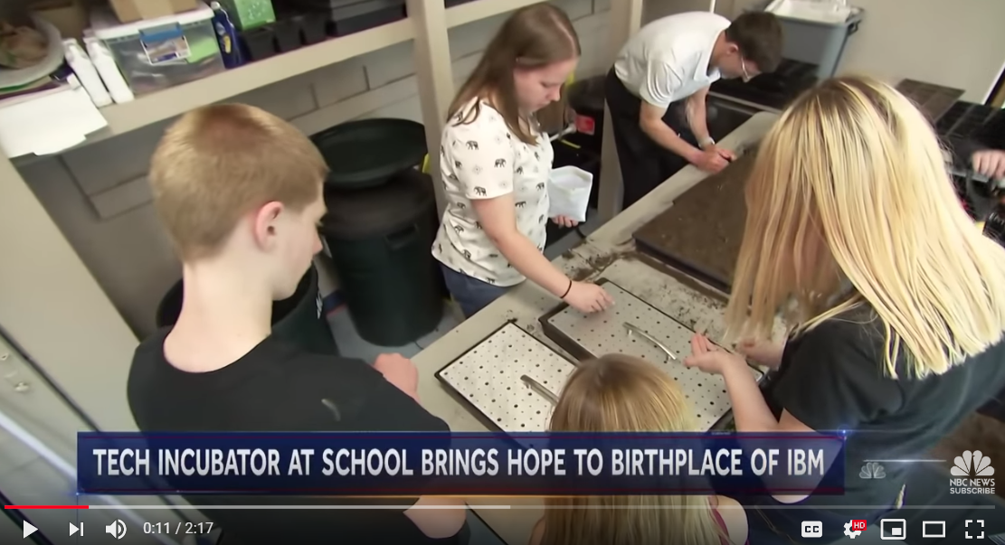
Tiger Ventures: Incubator for Start Ups
Notes:
https://youtu.be/yfzLNfpUSw0

Slide 36
Key Tensions to Balance: Student Supports
Authoritative
Supportive
Choice and Voice
Structured and Shaped

Slide 37
Getting Started
Have a Deep Understanding of Your Context
Know the Educational Challenges that Walks in Your Door
Seek Community Input
Tools and strategies to help are available on the Cross State High School Collaborative website http://www.hsredesign.org/
Use Guiding Questions to Help Shape Your Redesign Plan

Slide 38

We will reconvene after lunch Thanks!

Slide 39
Design the Journey of Discovery

Slide 42
Student Voice & Input

Slide 43
Students at the Center
“Hope, Agency, Trust and Relationships”
FROM:
I am not a social worker
Those people
Data for accountability
Punitive
Deficit
Fixed mindset
Shame
Compliance
TO:
How can I help?
We are the people
Data for improvement
Restorative
Asset-based
Growth mindset
Resilience
Commitment

Slide 44
Students at the Center
Evidence-Based Practices
Supporting Structures
Positive Developmental Relationships
with Adults
Ongoing structures/rituals that promote and celebrate student voice, engagement,
and performance
Early Warning and Multi-Tiered Student Response Systems and Community Support
Academies/Student Cohorts
Interdisciplinary teams
Building Hope, Purpose, and Agency
Common Planning Time
Restorative Practices
Influencing Factors
Student data/needs/voice
Teacher capacities
Community Opportunities
Notes:
Sample Strategies Based on Evidence Base
Beginning in the freshman year, offer a comprehensive college and career planning program to students and families. (More robust with frequent touch points than current IGP)
Provide all students support to complete a comprehensive plan for success after high school.
Offer a dual enrollment program that allows student to take college courses for high school AND college credit.
Integration of academic and technical content.
Career awareness, job shadowing, intern and apprenticeships.

Slide 45

Student Voices: The Future of School
Notes:
https://vimeo.com/155339834

Slide 46
What Research Tells Us
Young people need caring, trusting, and supportive relationships with adults and with other young people.
Young people respond to high expectations.
Young people need opportunities to contribute (often referred to as “choice and voice”).
Young people need learning experiences that intentionally engage their interests, offer opportunities to succeed, and provide feedback to enable them to reflect on their accomplishments.

Slide 47

Block Party
Read your passage. Reflect on its meaning.
Stand up.
Find someone with another color passage that you have not yet talked with.
Introduce yourself. Share what you read and your response.
Switch roles.
When you hear the chime find a new partner.
Notes:
I will bring the block party quotes

Slide 48
Student Profiles
Notes:
We can give examples of the Student Profiles from Louisiana….and or the student totems – can suggest grades 9 and 12 as well

Slide 49
Student Surveys – Comparing Indicators
Survey respondents (students, teachers, community, others) considering the same phenomenon from their own point of view.
Example:
I am proud of our high school
Corwin/Quaglia School Voice and Aspirations 2016

Slide 50
Student Surveys – Comparing Indicators
Survey respondents (teachers/students) considering the same phenomenon from opposite points of view.
Example:
Teachers respond to: “I respect students”
Students respond to: “Teachers respect students”
Corwin/Quaglia School Voice and Aspirations 2016

Slide 51
Student Surveys – Comparing Indicators
Survey respondents (teachers/students) considering the same phenomenon from different roles.
Example:
Teachers respond to: “I feel comfortable asking questions during staff meetings.”
Students respond to: “I feel comfortable asking questions during class.”
Corwin/Quaglia School Voice and Aspirations 2016

Slide 52
Ask ’Em
When might we ask students what is important and meaningful in their world?
Whom might they like to help?
How might areas of our curriculum allow for connections with our community?
Opportunities exist in great abundance – time is the perceived barrier.
Student Voice From Invisible to Invaluable

Slide 53

Notes:
Here we can also give our example of how it might look as a lesson – Student Voice 78 – page 82 might also show video page 82 Student Voice
https://www.youtube.com/watch?v=zwwqxa_dR8E&feature=player_embedded

Slide 54
How can we access the mutual intelligence and wisdom we need to create innovative paths forward for our high schools and the communities they serve?
Redesigning, Reimagining School with Community Members’ Contributions

Slide 55

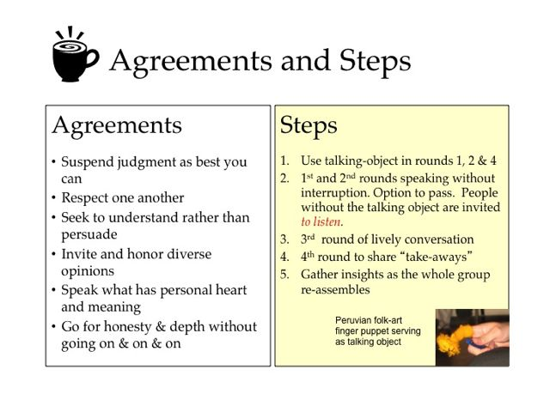

The CSHSC website features a section on Conversation Cafes with a seven-video series.
Notes:
Print the how to conversation café handout
https://www.youtube.com/watch?v=cgQMrqEOJcU

Slide 56
Round 1 – Articulate the Big Why
Why are we bringing people together?
What need or needs might this conversation fulfill?

Slide 57
Round 2 – Clarify Possible Outcomes
What do we believe is possible from this community conversation?
What might we consider successful?

Slide 58
Design Time
With your team – determine how you will gain student, staff and community input in your design plan.
Who else might you want to join to help achieve our purpose?
What additional perspectives might contribute valuable insights?
Who might receive real benefit from being a part of the designing process?
Consider what might be the right questions to ask?
How might you create spaces to think and explore together?

