Slide 1

STUDENTS AT THE CENTER
School Climate
Built on safety, trust, and student voice.
Positive Relationships Development
Restorative Practices
Promote Purpose, Hope, and Agency
Early Warning Systems
And a multi-Tiered student response and community partnership
ALIGNING OUR INTENTIONS
There is no one-size fits all approach when redesigning Schools
Notes:
In the spirit of Aligning Our Intentions and Actions
There is no one-size fits-all approach to redesigning schools
Evidence-based research continues to stress the important work of aligning our intentions and actions in two ways:
Incorporating Student Voice
Cultivating Agency

Slide 2
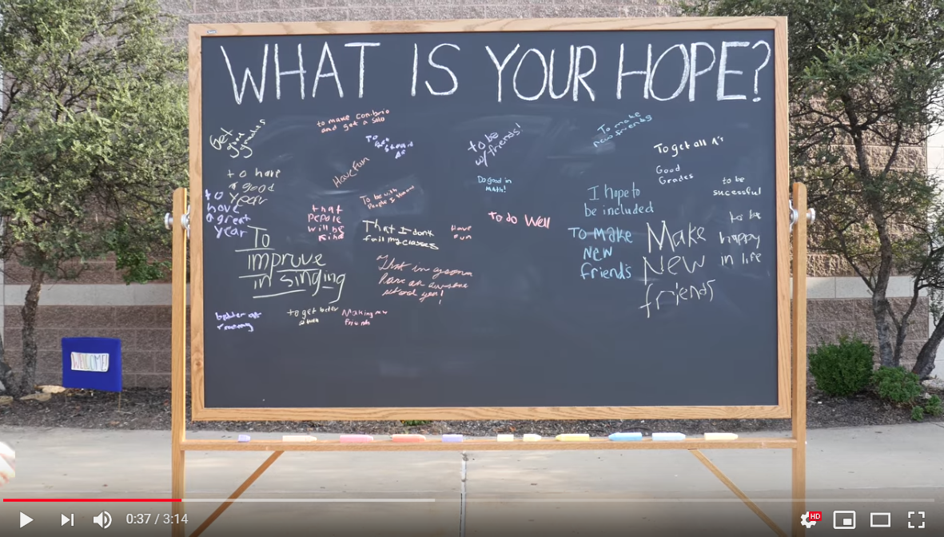
At the start of the school year, high school students and teachers express positive and shared hopes for the school year.
Students and teachers want similar outcomes when it comes to hope, well-being, engagement, and academic success
https://www.youtube.com/watch?v=dlcU5uHMdTM

Slide 3
During the School Year, HS Students’ and Teachers’ Actions Tell a Different Story
When HS students were asked to express their current emotion
39% said tired
29% said stressed
26% said bored
Student apathy, lack of motivation, and behavior are often cited as factors underlying teacher stress, burnout, lack of satisfaction, and turnover

Slide 4
The Hopes HS Students Present at the Start of the Year More Closely Resemble Their Elementary Than Their High School Experience
2016 Gallup Student Poll Engagement Items
% that strongly agree: Grade 5 Grade 11
Do best 35 17
Schoolwork important 66 28
Feel safe 62 30
Have fun 47 16
Best friend 84 57
Good work 50 30
Learned something interesting 59 32
Adults care 67 24
Excited about future 71 44
GALLUP STUDENT POLL, 2016

Slide 5

The Result?
High rates of student and teacher absenteeism, particularly in high-needs and high-poverty schools
High rates of student suspension
Clear evidence that high rates of student and teacher absenteeism, and behavioral challenges in class, lead to less learning and poorer school experiences for all

Slide 6
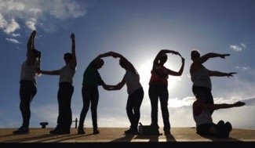
Hope is Important to Student, School and Life Success
Hope involves taking positive thoughts about the future, putting lots of resources and hard work behind them, and gauging your progress until it happens.
Hope drives attendance, credits earned, and GPA in high school.
Hope varies by place, not by grade. Those that feel the most hopeless are the lowest income male students in cities with high inequality and low social mobility.
Students are generally confident in their future, but lack necessary strategies to reach the big goals of graduation and employment.
46% are not confident they can find many ways to get good grades.

Slide 7
So, why do students and teachers want similar outcomes but often get different results?

Slide 8


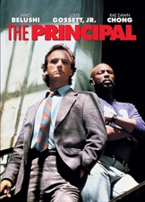
Intentions and Actions are Not Aligned
Movies like Lean on Me, Dangerous Minds, and The Principal in the ’80s and ’90s help shaped the perception of what is wrong with schools
Focus on being hard and punishing students
Belief that schools and students need to be held more accountable
Deficit language, culture, family, and community
Idea that one charismatic leader can come in and save the school
The inner city as the “other”
These ideas produced policies like zero-tolerance, fostered a need to blame someone, and gave rise to what some researchers call a school-to-prison pipeline
The evidence base of what works does not support these ideas

Slide 9
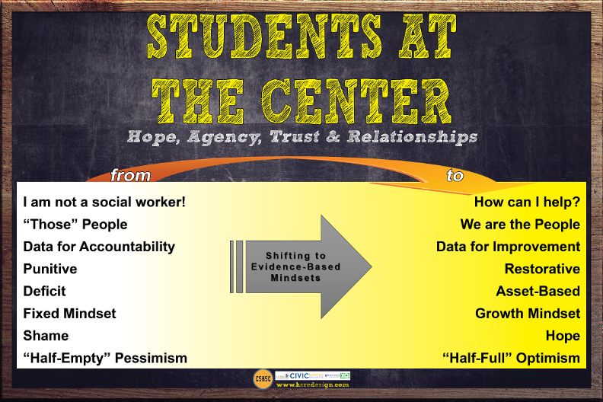

Slide 10
STUDENTS AT THE CENTER
Hope, Agency, Trust & Relationships
Evidenced-Based Practices
Supporting Structures
Positive Developmental Relationships with Adults
Early Warning and Multi-Tiered Student Response Systems & Community Support
Building Hope, Purpose, and Agency & Social Emotional Learnings
Restorative Practices
Student Voice
Celebrations
Rituals, Routines, Surveys, Student Advisory, Student Leadership
Academies, Student Cohorts
Interdisciplinary Teams, Common Practice Time
Report Card Conferences
Advisory, POD, Crew, PACK
Freshman Seminar
Success Mentors
Influencing Factors
Student Data, Student Needs, Student Voices
Teacher Capacities
Community Opportunity

Slide 11
What Do We Know About Restorative Practices?
Notes:
After they have a chance to share give time to read the two paragraphs in Building a Resotrative Classroom Teacher’s Guide page iii-

Slide 12
The Fundamental Hypothesis
Restorative Practices’ hypothesis is that human beings are happier, more cooperative and productive, and more likely to make positive changes in their behavior when those in positions of authority do things with them, rather than to them or for them.
Notes:
Google Aristotle
(paraphrase slide)
Restorative practices emerge from work in social and restorative justice. The need for supports and structures to build/re-build relationships is vital in all of these systems to address the challenges that are ahead together. (next slide sir)

Slide 13
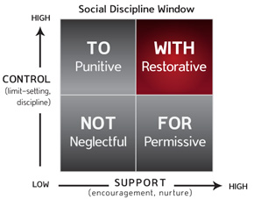
CONTROL
HIGH
Notes:
I want to start with some definitions and understandings that will help to build some connections.
(paraphrase slide)
Restorative practices emerge from work in social and restorative justice. The need for supports and structures to build/re-build relationships is vital in all of these systems to address the challenges that are ahead together. (next slide sir)

Slide 14

If a Picture is Worth a Thousand Words…
What concept of Justice do you think this image communicates?
Notes:
In the spirit of Aligning Our Intentions and Actions
There is no one-size fits-all approach to redesigning schools
Evidence-based research continues to stress the important work of aligning our intentions and actions in two ways:
Incorporating Student Voice
Cultivating Agency

Slide 15
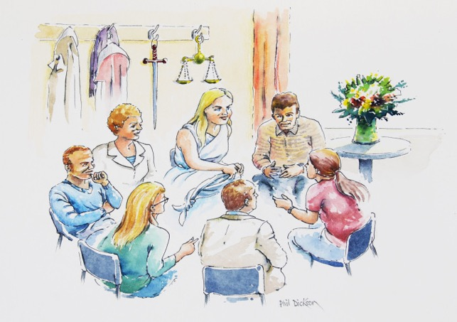
If a Picture is Worth a Thousand Words…
What concept of Justice do you think this image communicates?
How would you illustrate Restorative Justice?
Notes:
In the spirit of Aligning Our Intentions and Actions
There is no one-size fits-all approach to redesigning schools
Evidence-based research continues to stress the important work of aligning our intentions and actions in two ways:
Incorporating Student Voice
Cultivating Agency

Slide 16

Keeping Students at the Center
Circles: Connections-Belonging and Voice
Restorative Practices

Slide 17
Video
Creating a Safe Space for Students to Reflect
https://www.bing.com/videos/search?q=Restorative+Circles+Teacher+Channel&&view=detail&mid=4854806FCAB1D8FB16234854806FCAB1D8FB1623&&FORM=VRDGAR

Slide 18

Connection Circles
Objective: Practice equal voice and empathy in the group by having each participant answer a relationship-building question.
Instructions: Participants sit in one large group circle. The facilitator holds a talking piece of his/her choosing. The talking piece should have some sort of significance or meaning for the facilitator. The facilitator first establishes the ground rules of the circle.
Ground Rules:
Confidentiality
You can pass, but we will come back to you, you do not have to answer the question
Person with the talking piece gets everyone’s full attention
Once the ground rules have been established, the facilitator will ask a question to the group and will start the circle by either passing the talking piece right or left or asking someone to volunteer to get the circle started. Participants will then each answer the question that has been posed.
Person

Slide 19

Connection Circle
If you could go back in history and spend a day with anyone, who would it be and what would you do together for the day?
Notes:
Point out Section 4 and the Circles Handout

Slide 20
Cultivating Agency
Agency: the capacity and propensity to take purposeful initiative—the opposite of helplessness
Young people with high levels of agency do not respond passively to their circumstances
The development of agency may be as important an outcome of schools as the skills we measure with standardized testing

Slide 21
Table Review of Research Pieces
Each person will need a copy How Students Thrive – Positive Youth Development in Practice
Self select one of the following topics
High Expectations 14 - 18
Student, Voice, Choice and Contributions 19-22
Caring, Trusting and Supportive Relationships 8 – 13
* Please be sure at least one member of your table selects each of the topics

Slide 22

In Expert Groups
Have a dialogue about two or three big ideas of your topic and the tensions that may need to be balanced to support student success.

Slide 23

Reconvene as Table Group Discussion
Individuals share thoughts, insights, questions regarding their text piece.
On chart paper, brainstorm available programs, approaches, work and/or strategies that would be valuable to share across this high school network that are currently supported with in your school.
Notes:
Here lets also point out the Louisiana Portfolio document

Slide 24

Design Time:
STUDENTS AT THE CENTER
How might we make room for and listen to students’ voice
in our redesign efforts?
How might we shape school experiences to enable students to experience hope, agency, and joy?
How might we embrace Restorative Practices?
How might we learn to balance student choice and voice with structure and support?
Listed in High School Redesign Workbook

Slide 25
Before We Meet Again
Addressing Academics and SEL Together Pages 14-15
Social-Emotional Development Cannot Be Color-Blind. Pages 16-17
Making Trade-offs to Support SEAD. Pages 18-19
How might the guiding questions included for each passage impact your redesign plan?
Discuss as a redesign team.

