Slide 1

New Mexico High School Redesign Teams Cohort 2 November 6, 2019

Slide 2
Working Norms
Fully participate
Listen with respect to maximize learning from each other- one voice at a time to ensure all are heard
Return attention to large group when you hear the chime
To minimize distractions leave cell phone/ iPad/ laptop sound on silent and step out for essential communications
Recognize / share the wealth of experience, expertise and understanding among the group
Honor time
Have fun

Slide 3
Empathy Map
You engaged with freshmen and seniors by interviewing and immersing yourselves in the users’ shoes through shadowing a student(s) for the day. Create a quadrant on your chart paper.
As members of your team review their notes from the interviews and student shadowing experience.
You will list on Post-it notes:
Say – What are some quotes and defining words students said?
Do – What actions or behaviors did you notice?
Think – What might your students be thinking? What does this tell you about their beliefs?
Feel – What emotions might your subject be feeling?
Notes:
They will each have a copy of the Empathy Map Method Card

Slide 4
Identify Insights
An insight is a remarkable realization - they often grow from contradictions between two difference quadrants.
Write down any potential insights/tensions/contradictions you discover.

Slide 5
Storyboard and Capture
Unpack observations and share individual stories about the staff and community fieldwork you engaged in to gain insights about your high school redesign.
As each team ember shares – other team members should headline quotes – surprises/ interesting tidbits
One headline per Post-it

Slide 6
Group to Illuminate Themes or Patterns
Capture any specific needs that surface

Slide 7

Organizing Adults

Slide 8
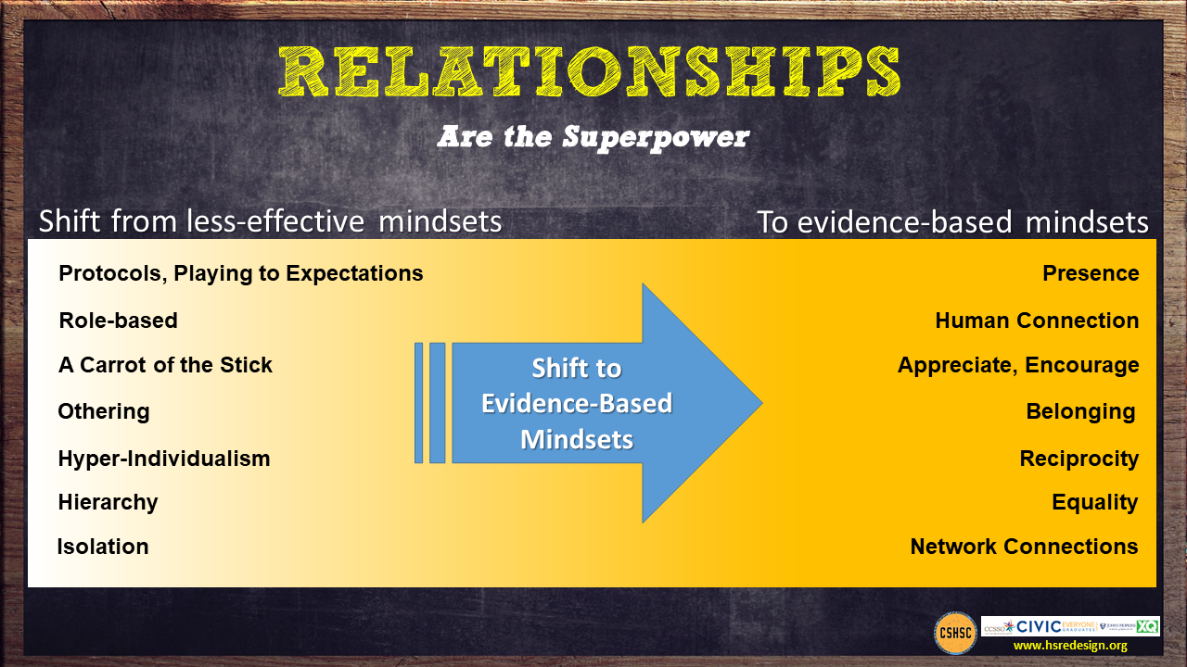

Slide 9
Purpose for this Work Session
Explore insights the existing evidence base offers as we consider ways we might Organize Adults differently to shift the context in which teachers and students operate day to day .
Review teacher teaming, common planning, and distributed leadership models.
Examine innovative schedules as examples of how to align the schedule to the priorities, values and intentions of the redesign plan.
As school teams, develop an initial vision of structures and practices we might put in place at our high school that honor the importance of connections and interdependencies through relationships that help our school community thrive.

Slide 10
What Mindsets Might These Individuals Hold That Might be Limiting Them from Their Intended Outcomes?
Video removed

Slide 11
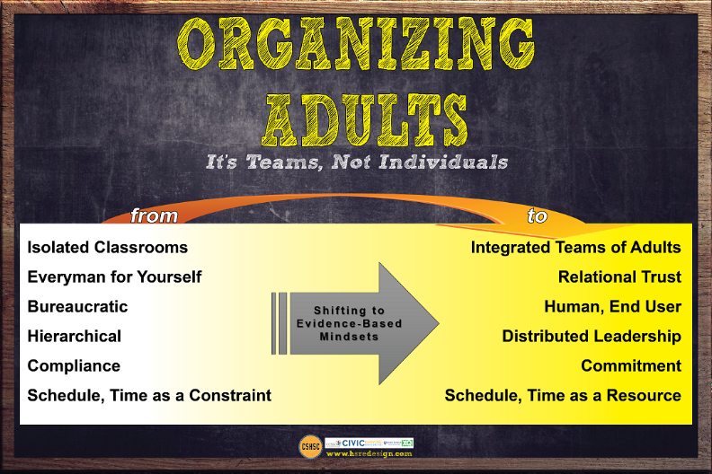

Slide 12
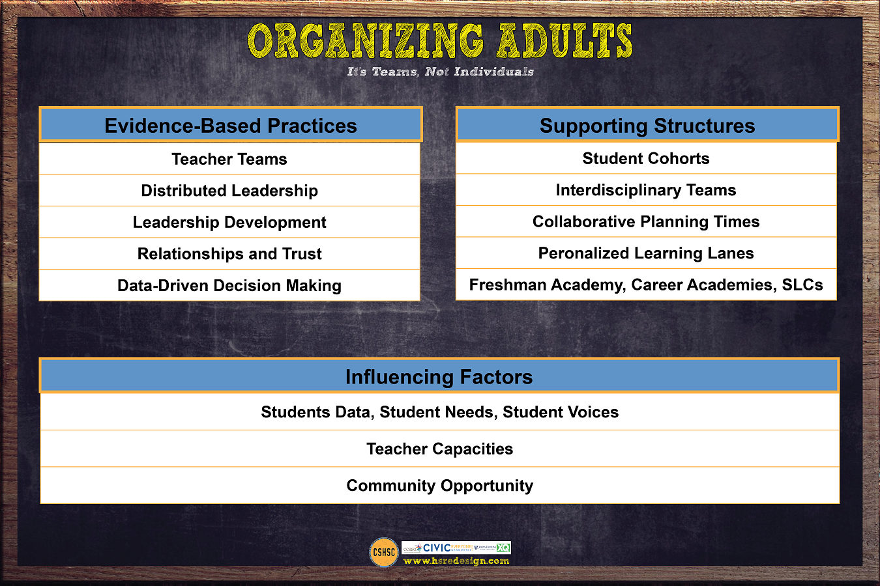

Slide 13
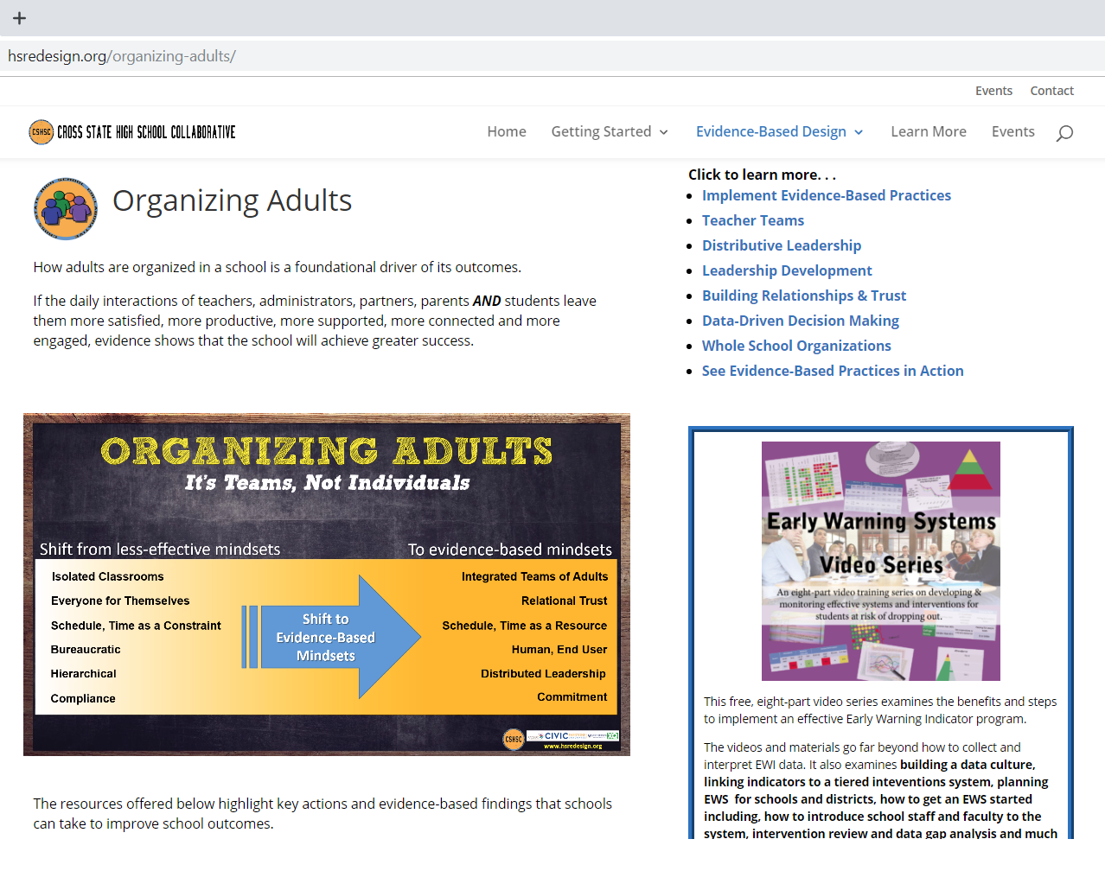
hsredesign.org
Organizing Adults
What the Evidence Says?
How to Implement?

Slide 14
Choice Board for Learning Stations
Having It Both Ways: Building the Capacity of Individual Teachers and Their Schools. School Organization and Teacher Teams – Blue
Collaboration is the Way We Work, Not an Activity – Teacher Team Case Study – Pink
Common Planning: A Linchpin Practice in Transforming Secondary Schools – What high school reform practices does common planning support? Yellow

Slide 15
Select one of the articles from the options provided.
There will be two stations for each article to keep groups smaller.
Stack pack and move to that area of the meeting room.
Be sure to have one member of your team at each selection.

Slide 16
Text Protocol Say Something
Meet the members of your group. Decide on an amount of time for reading your text.
One person will be the timekeeper.
Read the article individually – annotate or highlight if you like with any ideas you agree with, ideas you might argue with, ideas you would like more clarity around.
Form a circle and each person will have an opportunity to “say something” about the article.
One person talks at a time and the chance to say something proceeds around the group until everyone has a chance to be heard.

Slide 17
Return to School Design Team
Each member will share:
The main idea of the article they reviewed.
One observation, inference, connection or question they have about the content.

Slide 18

Why Distributed Leadership?
Leadership is the professional work of everyone in the school. (Lambert, 2003)
Powerful Leadership is distributed because the work of instructional improvement is distributed. (Elmore, 2003)
Teachers’ high levels of academic optimism were positively and significantly associated with planned approaches to leadership distribution, and conversely, low levels of academic optimism were negatively and significantly associated with unplanned and unaligned approaches to leadership distribution. (Mascall B., Leithwood K, Strauss T., Sacks R. 2009)
Building a broad base of capacity is not possible if control is limited to a few individuals.

Slide 19

Innovative Schedules

Slide 20
Block Party - Your Schedule is Your Life!
Read your passage. Reflect on its meaning.
Stand up.
Find someone with another color passage.
Introduce yourself. Share what you read and your response.
Switch roles.
When you hear the chime find a new partner.

Slide 21
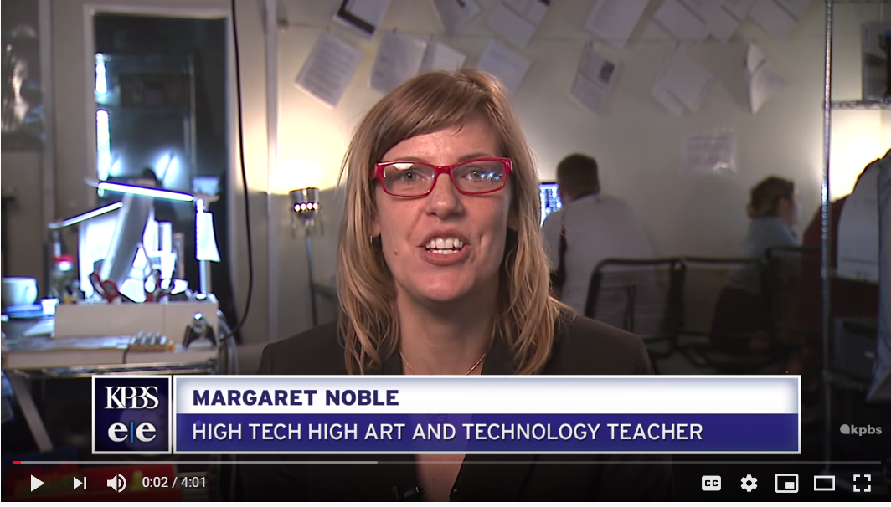
What Kinds of Schedules Would Support This Type of Learning?
Kids at Work

Slide 22
Briefly Review the Schedules Listed Below
as a School Team:
Upper St. Clair High School
Scheduling for Impact 21 - 22
Brooklyn Generations HS New York
Innovative Approaches for HS Schedules 15-16
Design Tech High School San Francisco
Innovative Approaches…12-15
Madeira School
Innovative Approaches 23 -25
Decide on one you would like to look at more carefully.
Consider how that schedule would interact with the evidence based practices of teacher teams, distributed leadership, relationships and trust and data driven decision making.

Slide 23
How Might We Provide for Collaboration to Happen Effectively?
Common planning for adults sharing students
Parallel scheduling
Building cohorts of subs – roving coverage
Adjusted start and end times
Shared classes by grade level or course content
Banked time to create space for early dismissals or teacher work days
Extended time for collaboration in in-service and faculty meeting schedules.
Intensives

Slide 24
Design Time – Organizing Adults
What resonates with your team from the ideas in organizing adults?
What might be key collaborative interactions in your school community? What are your hopes relating to those interactions?
How might the path of support for those collaborative interactions be created? What supports, resources, and structures can be offered?
When thinking about interdependence as a school, what are two or three areas, practices, rituals that come to mind as areas of strength?

