Slide 1

High School Redesign Network Convening
Postsecondary Pathways Work Session
November 7, 2019

Slide 2
Agreements for Today’s Time Together
Fully participate
Listen with respect to maximize learning from each other- one voice at a time to ensure all are heard
To minimize distractions leave cell phone/ iPad/ laptop sound on silent and step out for essential communications
Recognize / share the wealth of experience, expertise and understanding among the group
Honor time
Have fun

Slide 3
A Glimpse of How One School is Creating Postsecondary Opportunities. Tiger Ventures

Slide 4
What we have learned about predictors of Postsecondary Success?

Slide 5
What Predicts Postsecondary Outcomes of Boston Public School Graduates?
For four-year institutions – the Boston Opportunity Indicators worked very well
Attendance of 94% or more
GPA of 2.7 or greater
Taking the MassCore and enrolling in at least one AP course
All are strongly predictive of postsecondary enrollment and success in four-year institutions
Collectively they show which BPS graduates have odds between 10% and 80% of earning a BA in six years

Slide 6
Four-Year Degree Outcomes by Indicator Combination

Slide 7
What is the Story with Two-Year Institutions
Boston Opportunity Indicators are not good predictors of enrollment and attainment in two-year institutions
40% of BPS HS grads from class of 2010 enrolled in two-year institution, but only 6% earned a degree
Only 16% of the BPS HS grads who enrolled in two-year institutions earned a two-year degree within 7 years of graduation

Slide 8
How might we incorporate evidence-based practices and structures that intentionally support universal student participation in a successful postsecondary pathway?
Notes:
Purpose for this work session

Slide 9
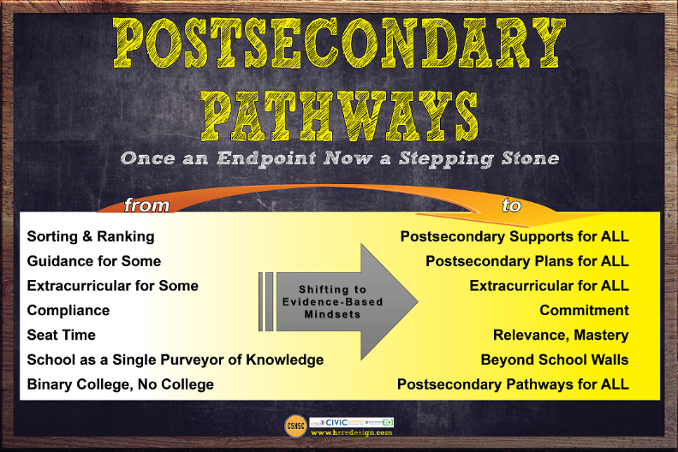

Slide 10
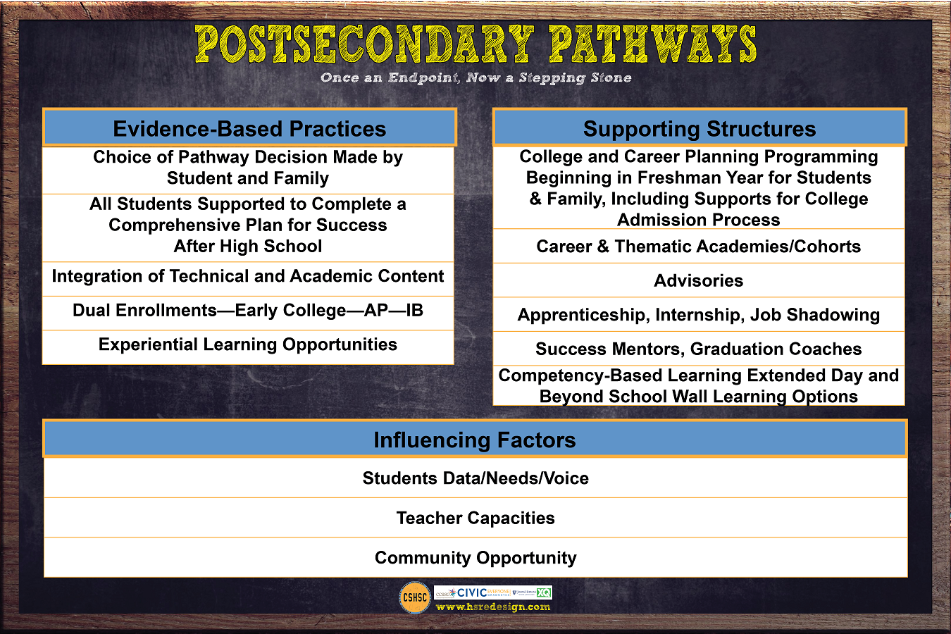

Slide 11
Core Principles of Postsecondary Pathways
Pathways keep students’ options open.
The choice of which pathway is up to the student and family.
Pathways are sometimes organized by cohort or academy affording students more personal and academic support.
Integrated curriculum with real application allows for relevance.
Collaboration between the school employers, community partners and postsecondary education allow for clear paths.
Authentic bridges exist between high school and paths.
High school is a beginning not an end.

Slide 12
Sample Strategies Based on the Evidence Base
Beginning in the freshman year, offer a comprehensive college and career planning program to students and families.
Provide all students support to complete a comprehensive plan for college and career success.
Offer a dual enrollment program that allows student to take college courses for high school AND college credit.
Integration of academic and technical content.
Career awareness, job shadowing, internships and apprenticeships.

Slide 13
It Takes a Village
The Village is the external powers that reflects or rejects what students think about themselves and their prospects for college and life well beyond it.

Slide 14
Prior to the Postsecondary Pathways Session
School teams will assign each member to a role of:
Counselor,
Parent 1,
Parent 2,
Teacher 1, and
Teacher 2
Individuals will read their role vignette prior to coming to this session.
Determine one person who will capture insights and big ideas on chart paper.

Slide 15
Village Roundtable
Round One
Each member of the school team will share their role assignment and answer the question –
What might this individual see as bright spots in our school’s current practices to support a comprehensive plan for each student for postsecondary success? What might they add?
Recorder will capture on chart paper.

Slide 16
What Ideas Does this Raise in Connection with Our Redesign and Structure of Postsecondary Pathways?

Slide 17
Gallup Poll

Slide 18
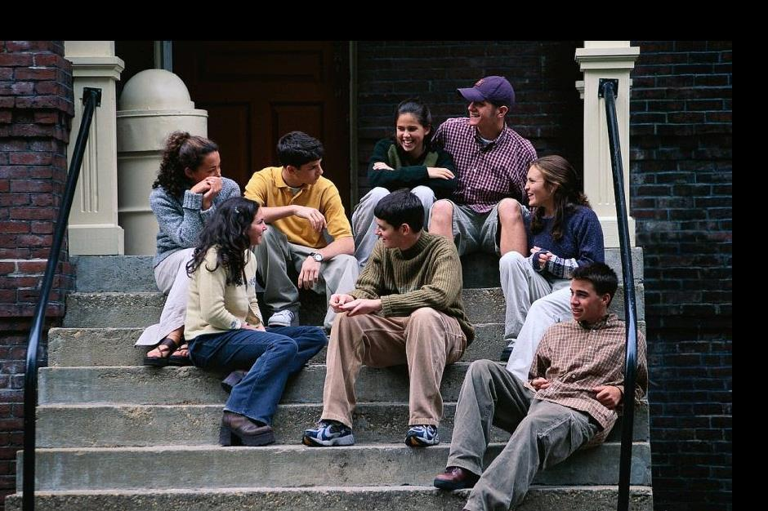
Individual Next Step Plan
https://webnew.ped.state.nm.us/bureaus/college-career-readiness/next-step-plan/
Notes:
Here we will use gallup data – 4 page report – post secondary plan connection to hope – need that as hand out in this section packet

Slide 19
Eye Contact Partners
Make eye contact with someone in the room you do not know.
Pair off.
Introduce yourselves.
Decide who will be student (you pick the grade) who will be adult.
Role play a 3-minute conversation to review / create the student next step plan graduation plan.
Return to your school team.

Slide 20
Debrief as School Team
It what ways was the “sample” next step plan template similar to what you have in place?
What was it like to engage in a conversation around the next step plan?
What current structures are in place at your school that bring the next step plan to life for students?
What are your hunches about student and adult understanding about how to be sure actions and the next step plan are aligned.

Slide 21
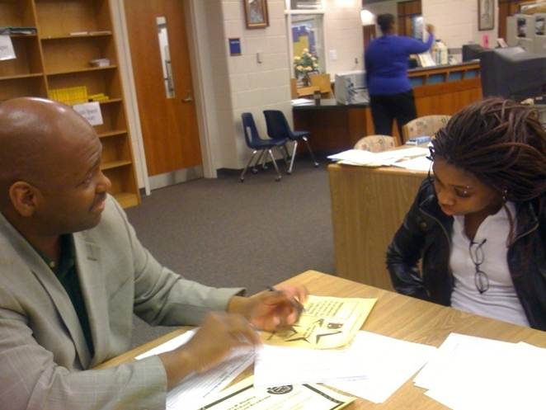
Adult/Student Conferences
How might we use a structure like this to support additional adult capacity with students and their individual graduation plans?
Notes:
Check this link

Slide 22
Designing Tools to Support Conversations with Students About Individual Graduation Plans
Might any of these tools be adapted to support conversations?
How and when might we design opportunities for these conversations to occur to help shape the path for students?

Slide 23
Integration of Academic and Technical Content

Slide 24
How Might this Structure/Strategy Impact
Quality of Coursework—How students cognitively engage with their schoolwork?
Quality of Relationships—What drives students to attend, focus, believe, and try
Equitable Access to Strong and Supported Pathways to Post-Secondary Success including Shaped Experiences (e.g. extra-curricular) —Where equity often falls short
Continuous improvement systems

Slide 25
Apprenticeships and Internships

Slide 26
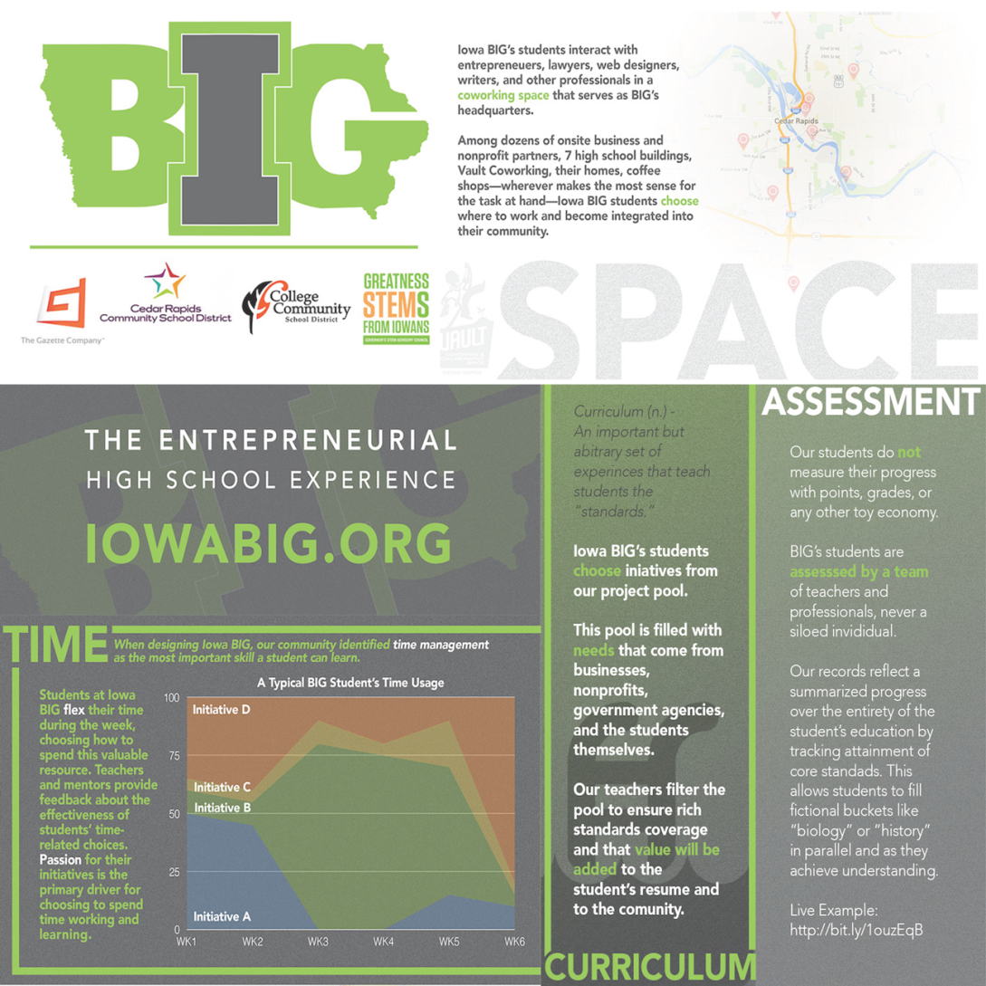
IOWA BIG
Notes:
Students voice on learning….

Slide 27
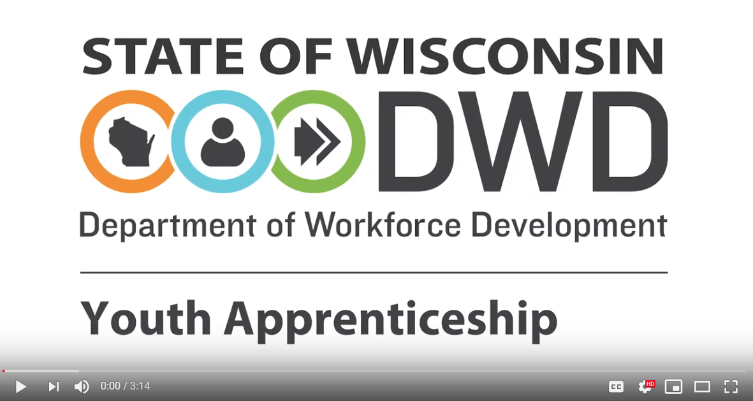

High School Apprenticeships
Watch 3 minute video below:
https://www.youtube.com/watch?v=M-EpD8cZbKU#action=share
Review resources on the Wisconsin Youth Apprenticeship website
https://dwd.wisconsin.gov/youthapprenticeship/

Slide 28
Design Time

Slide 29
Design Time – Postsecondary Pathways
What kinds of experiences are happening in your school/community/region that enable students to explore college and career options, develop their talents and passions and deepen their connections to their community?
What are some strategies you may have in place to build upon or wish to explore?
How might this redesign help young people envision a future beyond their immediate circumstances and expand their possibilities for students to reach those futures?

