Slide 1

New Mexico High School Redesign Network Convening
Teaching and Learning
November 7, 2019

Slide 2
Agreements for Today’s Time Together
Fully engage
Honor time
Recognize/share the wealth of experience, expertise and understanding among the group
Have fun

Slide 3
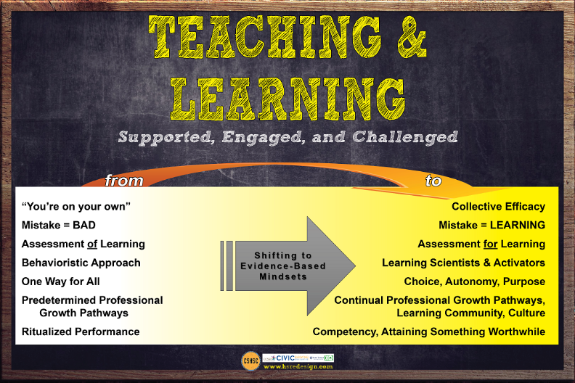

Slide 4
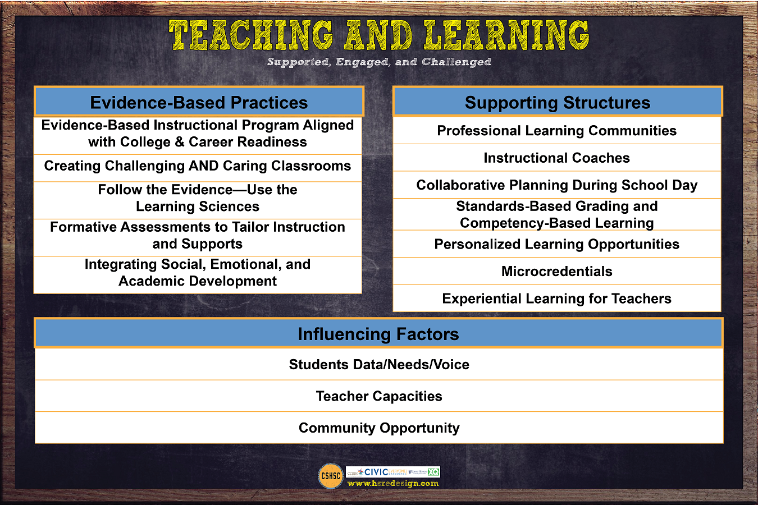

Slide 5
Rigor and Relevance

Slide 6
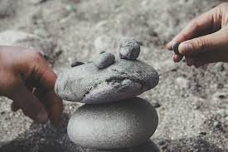
Identifying What Matters

Slide 7


Our Own Definitions of Rigor & Relevance
Make a list and prioritize
This Photo by Unknown Author is licensed under CC BY-NC-ND

Slide 8
Label Your Collection of Rocks
Label your rocks with what you value most deeply about rigor and relevance, using the size of the rock to indicate its importance.

Slide 10

Four Corners
1
2
Rigorous Learning Pages 2-3
Rigorous Learning Pages 4-5
4
3
Jefferson County HS, Louisville, GA
Rigorous Learning Pages 6-7

Slide 11

Reflections
TAKE ACTION!
1
3
2
4
Rigorous Learning Pages 4-5
Rigorous Learning Pages 2-3
Rigorous Learning Pages 6-7
What components of the readings would make it into your film?
Jefferson County HS, Louisville, GA

Slide 12
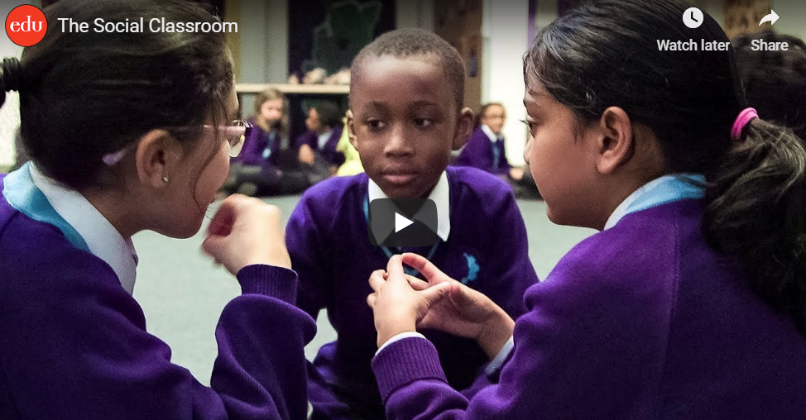
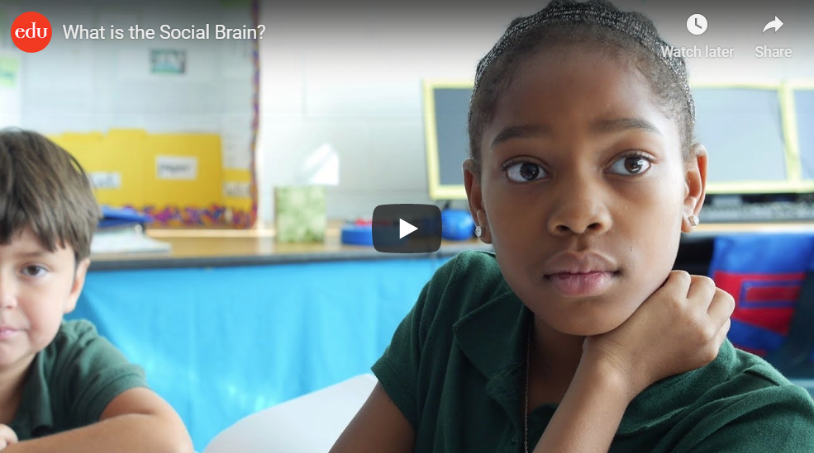
Learning is Social
https://www.edutopia.org/video/social-classroom
https://www.edutopia.org/video/what-social-brain

Slide 13
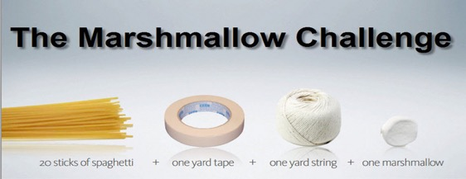
Informally group yourselves in groups of 4 or 5.
Task: Build the tallest free-standing tower that will support the weight of one regular-sized marshmallow. You may use as many or as few of the materials as you want.
Time: 12 minutes

Slide 14


Debrief of Marshmallow Tower Challenge
How did we perform as a team?
Evidence of collaboration
Possible reasons for encountered challenges
Identify strategies to contribute to future collaborative work

Slide 15
The Suspects - Who are You?
Select pre made labels from the sheet to attach
Characteristics to the back of your suspect card.
You may use blank labels to fill in additional traits.
As a group, compare your suspect cards.
What types of scaffolds might this particular group of students benefit from?

Slide 16

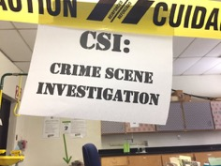
Review the Evidence
The Group Contract
Assign Group Leaders
Project Pacing Charts
Group Observation Checks
Formative Group Evaluations
What else?

Slide 17

Creating Challenging and Caring Classrooms
Case Study and Table Discussion
Notes:
Rigorous standards and work on curriculum is a first step, but improvements in educational attainment require substantial changes in instructional practice beyond increasing instructional rigor. Otherwise, increasing the challenge of the curriculum may have no positive consequences for students’ educational readiness, and even bring declines. It is the combination of challenging work together with greater attention to classroom control and student support that leads students to gain the knowledge and skills necessary for success in college and the workplace-Allensworth, E., Gwynne, J., Pareja, A., Sebastian, J & Stevens, D. (September 2014) Research Brief from Uchicago CCSR

Slide 18
Case Studies
Divide your table in half.
Half will read Ms. Wallace’s Classroom and the remaining half will read Ms. Lee’s and Mr. Gibbs Classroom.
After reading the case studies:
What ideas are emerging around how adopting of rigorous curriculum might be supported through classroom climate and academic supports that might be built in your redesign plan?
Notes:
Increasing the challenge of the curriculum in high Schools is unlikely to improve student achievement without concurrent improvements in teachers’ abilities around classroom management and academic support.
Asking students to do more challenging work can have both beneficial and adverse effects, depending on the elements of the classroom instructional environment.

Slide 19

Key Findings
Students Learn the Most in Classrooms That are Both Very Orderly and Challenging
01
In Disorderly Classrooms, Students Do Not Learn
much Even if the Academic Demands are High
02
03
Order is Harder to Maintain When Work Becomes More Challenging, Particularly in Classrooms with Low-Achieving Students
04
Academic Challenge can Lead to Lower Grades, Unless Accompanied by Sufficient Support

Slide 20
Design Time
How might our school provide rigorous teaching and learning experiences?
How might we design to incorporate approaches that accommodate for differences in individual students skills, strengths, interest?
How might we design learning opportunities that honor social aspects of learning?

