Slide 1
Cross-State High School Redesign Collaborative
January 16, 2020

Slide 2

Welcome from Everyone Graduates Center
It’s our Third Year Together-Joy
Focus for our Gathering - Implementation and Sustainability: Reframing them in the Context of Redesign
Who is in the Room?

Slide 3
A Few Things to Think About While We Are Here
How do we tell our Story? Interviews? Short Videos? Surveys?
Cross-State Site Visits-Identifying Schools in your state, other schools might visit
Our Next Meeting-When?, Where?, What Focus?

Slide 4
Today’s Agenda
Welcome and Frame
Connection Circle
Learning with School Teams
Learning with Partner Organizations
Learning with State Departments
Exploring and Improving Progress Monitoring Mindsets and Value of Common Model
Surveys, rubrics, artifacts, audits, data records
Summative Dialogue for Common Ground

Slide 5
Greeting and Learnings from Louisiana
Raphael Curtis

Slide 6
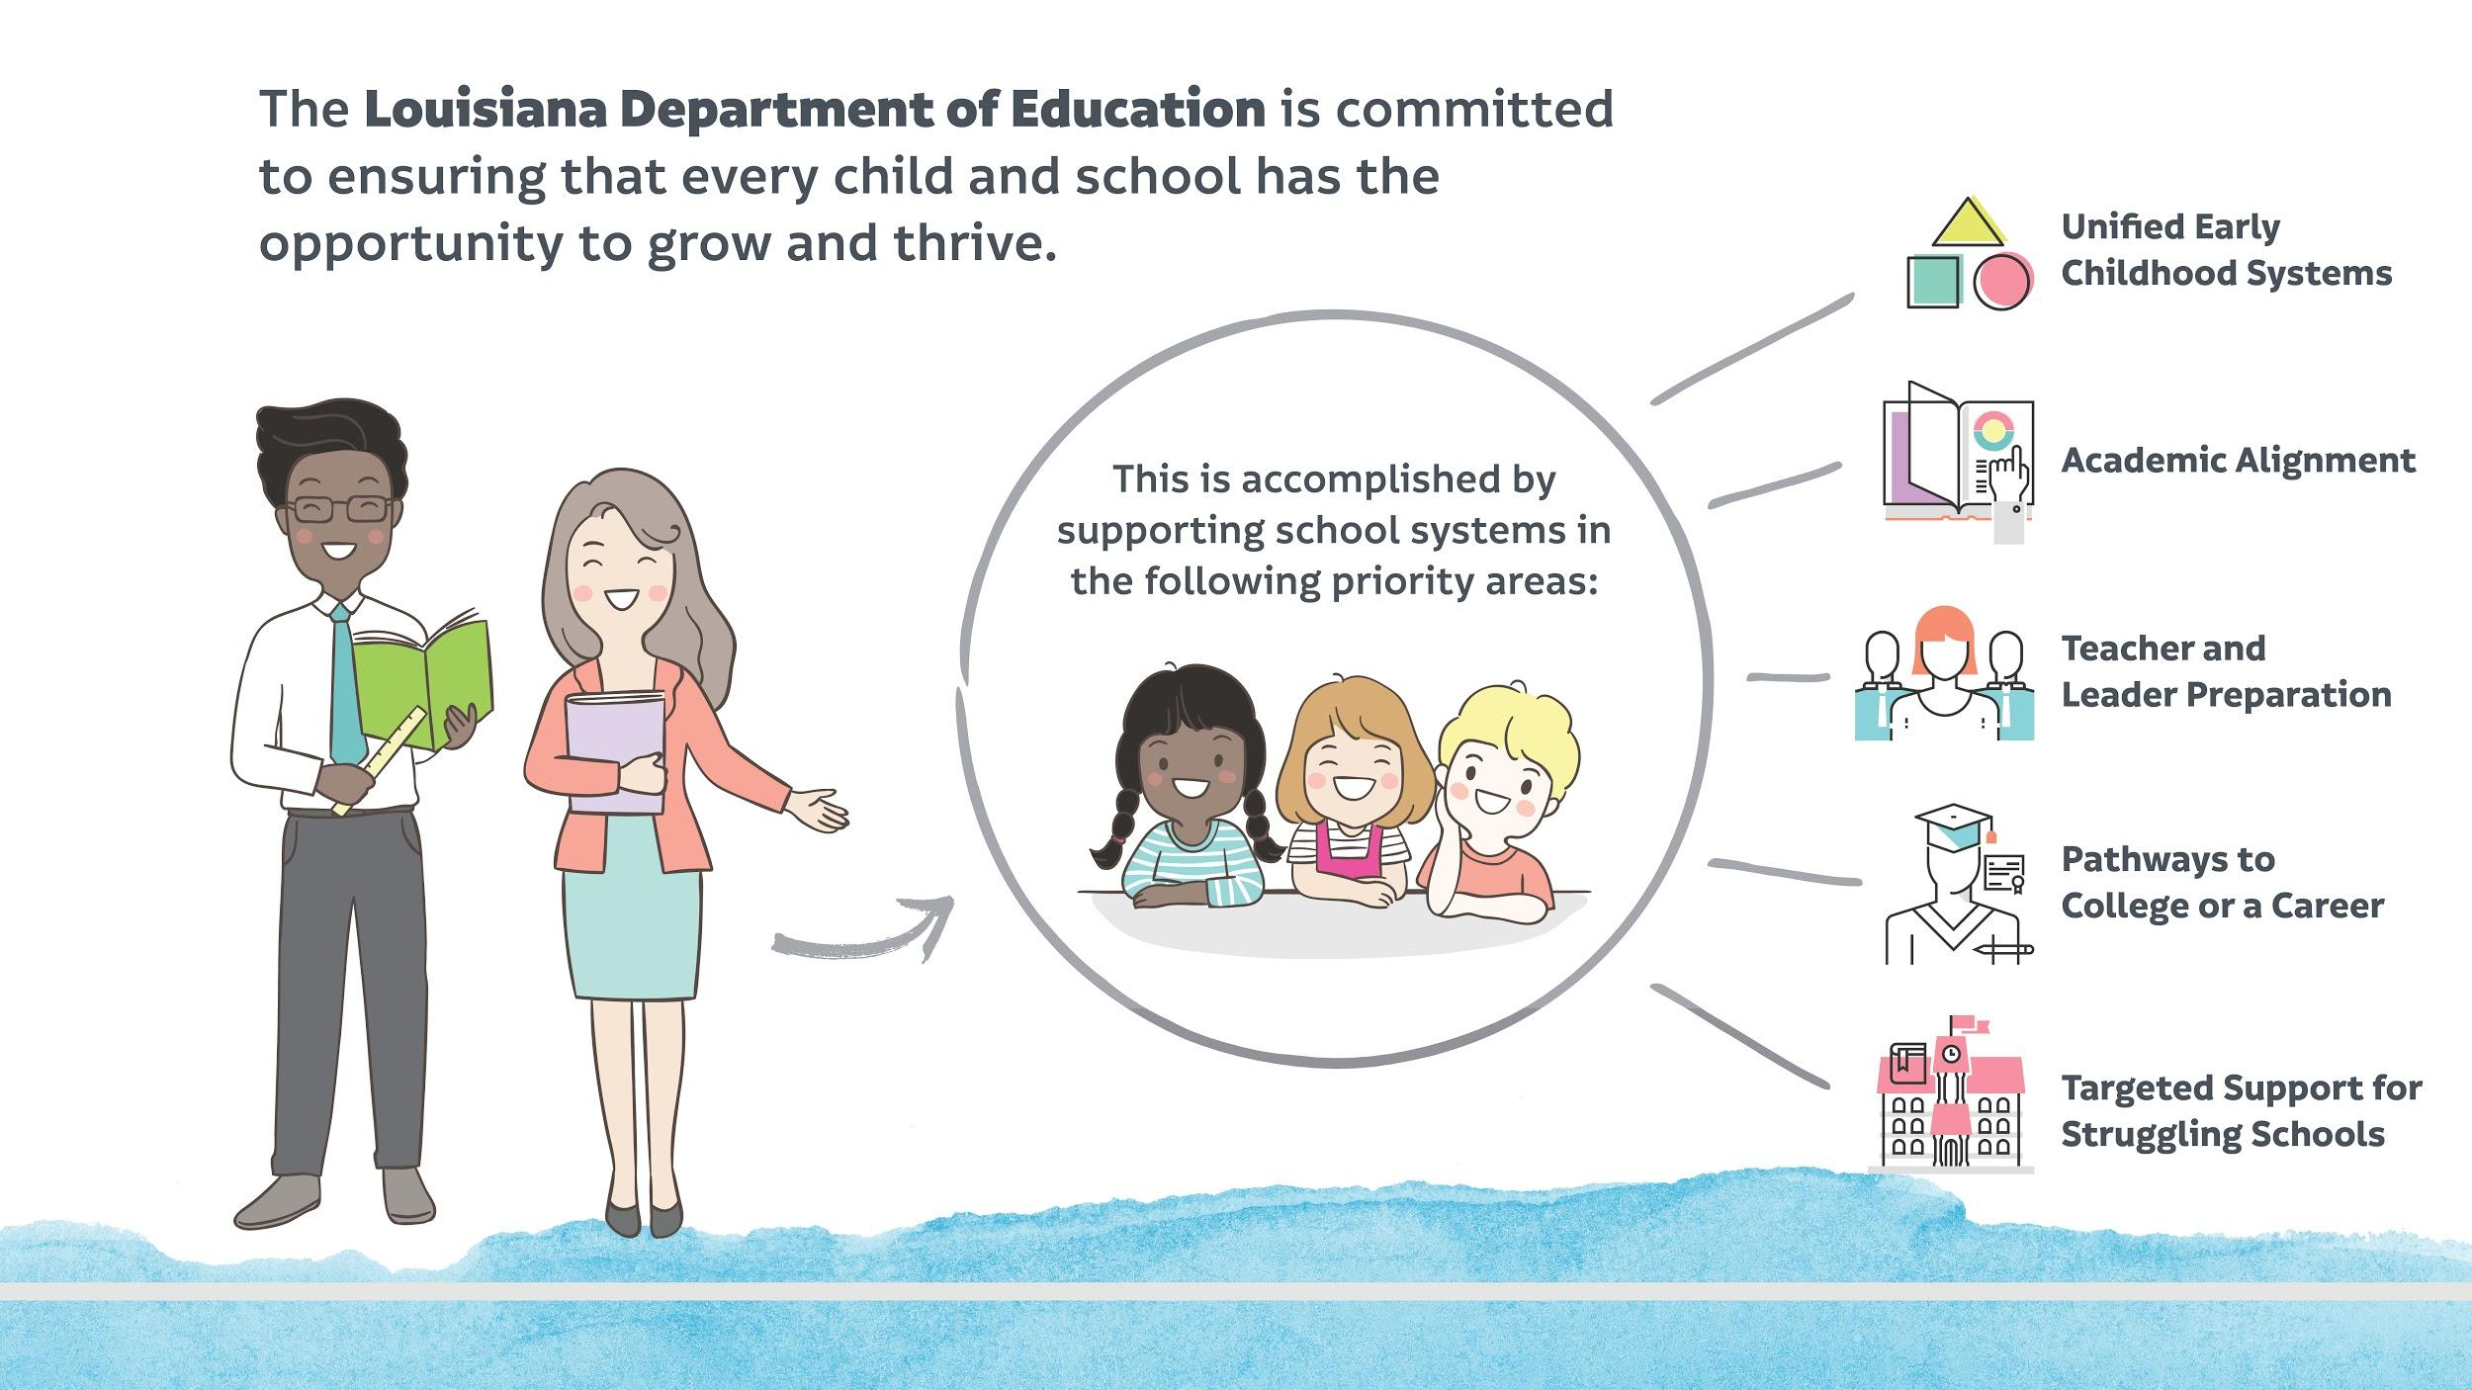

Slide 8
College and Career Readiness: Major Initiatives
Providing high school graduates the skills to become productive citizens is essential for Louisiana’s future economy.
High School Foundational Skills
Transitional 9th Grade is designed to ensure a successful transition for struggling students from 8th to 9th grade.
Johns Hopkins Redesign Schools and 9th Grade Academies are providing student support structures for persistence.
Individual Student Graduation Planning is assisting parents and students in exploring educational and career possibilities.
Quality Diplomas
Jump Start 2.0 is preparing students to be workforce ready in with a high wage/high demand industry-based credential (IBC).
Louisiana STEM Pathways are preparing students in critical STEM fields.
Course Choice/Supplemental Course Allocation is providing an allocation for student course offerings that are individualized to the needs of secondary students and provided outside the traditional school.
Advanced Placement, International Baccalaureate, CLEP, Dual Enrollment opportunities for early college credit experiences.
Extension Portfolio
Financial Aid Planning/FAFSA completion is providing every graduate a funded post-secondary opportunity.
Grade 13 Extension Academies providing a debt free, accelerated, dual enrollment college and/or workforce experience for a period of no more than five years of high school.

Slide 9
Norms
Fully Participate
Set tech to silent and step out for needed communication
Have Fun
Honor Time
Take a Stance of Curiosity

Slide 10

Connection Circle
Would you share your name, role and one thing
during this redesign process that turned out to be an unexpected gift……

Slide 11
Northdale Superintendent’s Academy High School Redesign Team

Slide 12
Exploring and Improving Progress Monitoring Mindsets & the Value of a Common Model

Slide 13
How might we design metrics/navigation guides that best serve students and adults in the school communities we support?
Notes:
Maybe here is where we introduce navigation guidance

Slide 14
How might we reflect on metrics/navigation guides as a method to design our services to districts and schools?

Slide 15
How might we know/show that high school redesign efforts are having positive impacts on students and teachers in ways the empower schools to move forward and not detract from their redesign efforts?

Slide 16
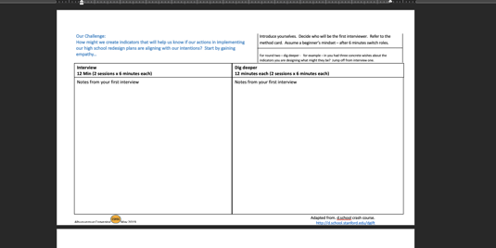
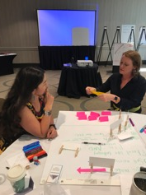
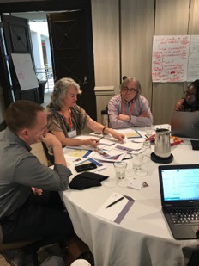
Updates from ideas that surfaced in May Convening.. Interviews and Design Time

Slide 17
The Challenge of Doing No Harm: Thoughts and responses to pre-read: Metric-driven harm: An exploration of unintended consequences of performance measurement.

Slide 18
When Metrics Go Off Course
Focusing on things that are easily measured may promote superficial not substantive change
A focus on short term, measurable performance often neglects small but important improvements with long term consequences
External measures often discount agency and sense of internal worth – thus increasing dynamics of scarcity and blame rather than supporting communities with strong relational trust

Slide 19
When Metrics Work
Help us steer and develop our redesign/improvement efforts
Alert our attention to things that matter (which we might miss without them)
Are actionable in the near term-now that we know current state we can do something to change it
Are not viewed as judgmental

Slide 20
Our Opportunity
High School Redesign allows the creation of new progress monitoring metrics WITH schools to make sure they are the right ones and can be reported in ways that have meaning (make sense) to them
Would there be value for this collaborative to co-create progress measure examples that steer and develop rather than protect and control?

Slide 21
Principles We Might Consider
Principle – Self-Direction-Value comes in measure of self and using to determine course of action
Principle - Actionable Insight. How might this measure help to focus my attention/capacity
Principle - Coherence between and among multiple perspectives
Principle - Restorative….supports course response….not “game” system
Principle – Adaptive-constantly evolving to meet needs of current circumstance
Principle – Proximity-directly examines the actions/outcomes we care about e.g. caring and challenging classroom looks at student and teacher view

Slide 22
Additional considerations to consider…
Build in fault tolerance
High yield – Low lift
Formative Assessment ….second nature – habitual – indistinguishable – just part of the school breathes….
Practical application for common measures….aspect of how might we think differently when we are looking for information….

Slide 23
Today’s Explorations
Performances/Rubrics
Allow the individual/school to be internally directed and to co-create goals and measures of progress
Brief Surveys/ABC data
Allow for multiple cycles of inquiry and action
In all cases – reflection and responses driven closes to end user

Slide 24
Collaborative Discussions, Part 2
Short, replicable surveys & descriptive rubrics

Slide 25
Two ways to measure impact
Short, replicable surveys
Descriptive rubrics
Notes:
Performances/Rubrics
Allow the individual/school to be internally directed and to co-create goals and measures of progress
Brief Surveys
Allow for multiple cycles of inquiry and action
In all cases – reflection and responses driven closes to end user

Slide 26
Big Idea
A few questions
Low lift (brief, free)
Give repeatedly to demonstrate change over time
Opportunity to iterate and adapt
End-user centered

Slide 27
Prototype #1
This model:
Collects rapid, actionable data on student experiences during class
Short, practical measure
Are your actions making a positive difference?
Connect to resources for evidence-based strategies
Generates reports showing change over time
Assesses three learning conditions:
Teacher Caring
Feedback for Growth
Meaningful Work
Notes:
The three questions for each learning condition developed by PERTS in collaboration with Professors Carol Dweck and Camille Farrington, and they were refined through interviews teachers and cognitive interviews with students.
A recent set of pre-registered analyses confirmed that these new, practical measures are significant predictors of students’ academic outcomes (p < 0.001), and this relationship held even controlling for race, gender, and grades in other classes. For example, students who rated learning conditions in their math class as positive were 30% more likely to earn an A or B in that math class.

Slide 28
Explore & Discuss
Explore
Divide your team among the three learning conditions (prioritize if fewer than 3 people comprise your team).
Read through Engagement Project description.
Reference your learning condition in the Guide to Learning Conditions.
Discuss
To which principles of navigation and adaptation tools does this prototype connect?
What might be unintended consequences of having this in place?
Notes:
How should people be grouped?
Since every class is different and every teacher is different, evidence-based recommendations are just the starting point.
Teachers use cycles of inquiry and action to refine recommendations and find what works for them and their students.

Slide 29
Notes:
Depending on grouping, share with table then share out, or share among state team? Or share among learning conditions group

Slide 30
Two ways to measure impact
Short, replicable surveys
Descriptive rubrics
Notes:
Performances/Rubrics
Allow the individual/school to be internally directed and to co-create goals and measures of progress
Brief Surveys
Allow for multiple cycles of inquiry and action
In all cases – reflection and responses driven closes to end user

Slide 31
Big Idea
Vivid language
Promote coherent understanding and expression of current reality and future vision
Ability to self assess
Formative

Slide 32
Triad Brainstorm – 5 minutes
When might a descriptive rubric be used to measure progress?

Slide 33

Prototype #2
New England Secondary School Consortium’s Global Best Practices Self-Assessment Tool for Secondary Learning

Slide 34
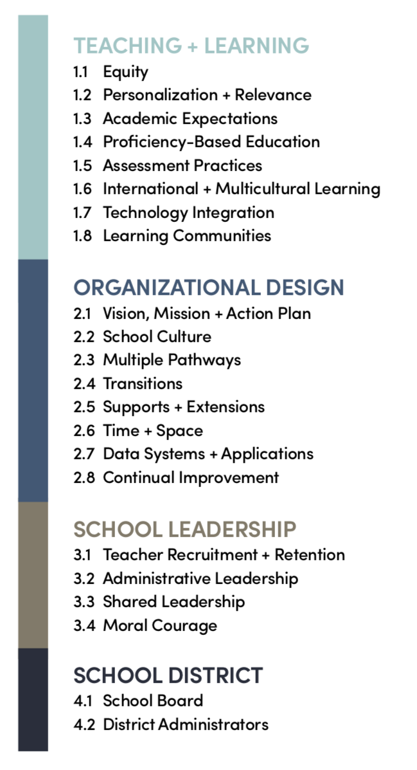

Slide 35
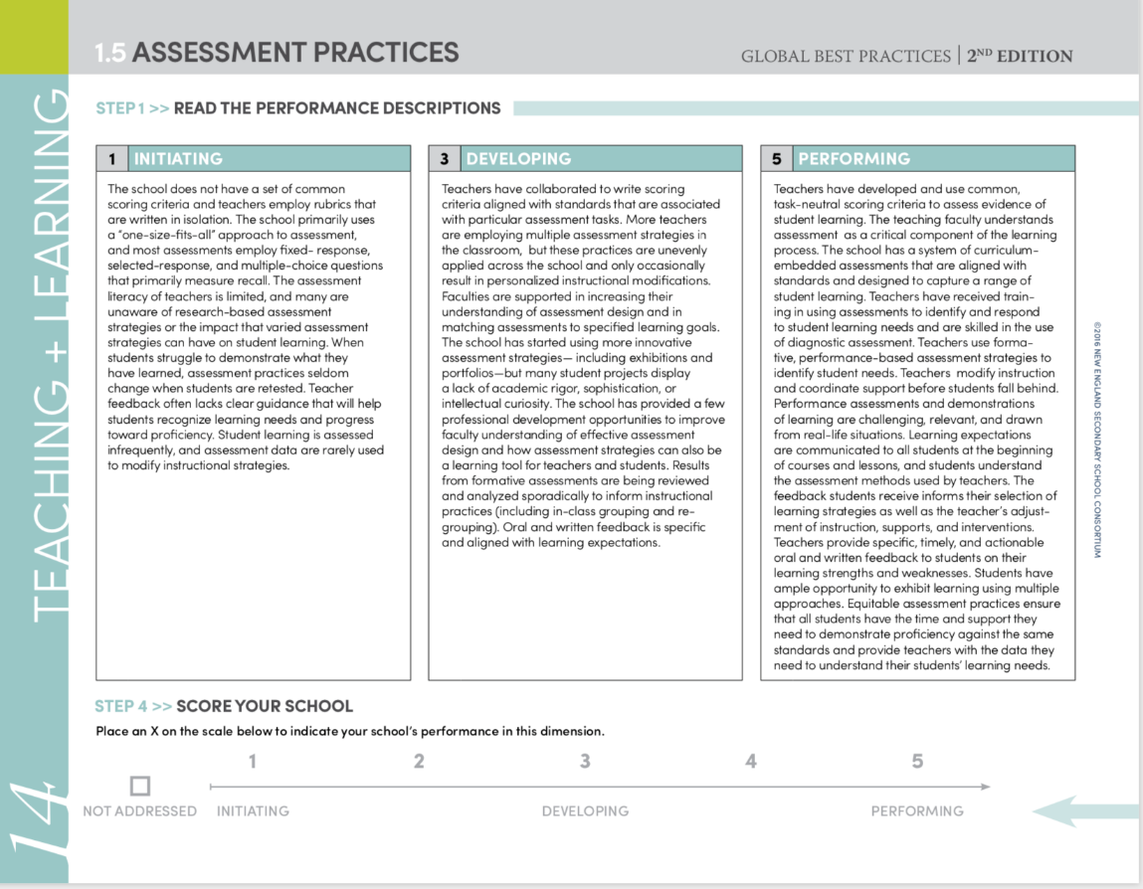
Explore
With one school in mind, review the assessment practices rubric strand, including the sample strategies and evidence.
With one school in mind, determine a rating and supporting information/evidence.

Slide 36
Discuss
To which principles of progress measurement does this prototype connect?
What might be unintended consequences of having this in place?

Slide 37

Time for a check in!
Pick a device and complete the following short survey:
shorturl.at/mW067

Slide 39
Collaborative Discussions Part 3/4 Exploring and Improving Progress Monitoring Prototypes: Student-centered activities with tangible artifacts and Data Records and Audits
January 16, 2019

Slide 40


Student-centered activities with tangible artifacts
Identifying an exact metric is challenging and it is on-going process
Documenting provides opportunities for evidence-based reflection
Acknowledging and refining to create forms of evidence showing that Visibility supports Measurement
Notes:
As we continue the work we may need to focus on honing our skills in designing new and creative ways to elicit evidence of learning and engagement in the re-design process. This means moving beyond documenting, measuring, and interpreting evidence to attend to the principles that might get us closer to having schools where instruction and assessment reflect our most important values.

Slide 41
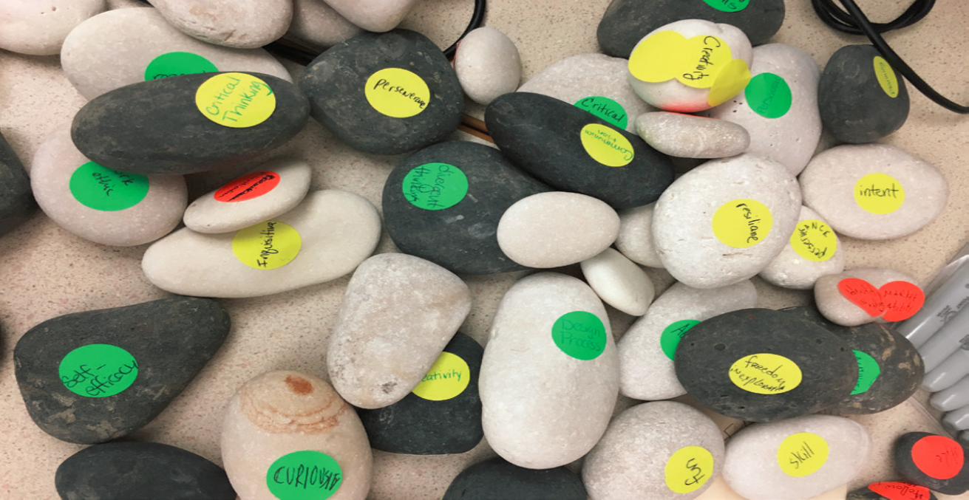
Label your collection of rocks with your New Year’s resolutions using the size of the rock to indicate its importance

Slide 42
Learnings…thoughts about this activity? If we were to come back together in three months, would you opt to change/refine your resolutions?

Slide 43
Principles driving student-centered activities
Caring / Challenging classroom - How are the students experiencing the classrooms? Teachers?
Value comes in measure of self.
Offers actionable insight. How might this measure help focusing my attention/capacity?
Coherence between and among multiple perspectives
Constantly evolving to meet needs of current circumstance

Slide 45
Table Talk
Due to the lack of abundance at our schools it is not necessarily the default that everyone has access to everything.
Often only the individual student knows.
What types of experiences, opportunities, or participant might be worth counting/auditing to let us know if we are making progress toward our vision?

Slide 46
Data Records/EWS

Slide 47
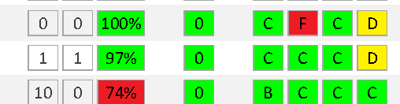
Early Warning Systems Combine Data and Human Systems
Indicators
Multi-Tiered
Student Support System
Reliable and valid
Predictive
Unique information for action
Tiered interventions (individual, targeted, whole school)
System for monitoring & follow-up
Reflective processes
Facilitation and Teams
Notes:
The Early Warning System combines the data system that accurately identifies students, has teacher access to student information, and the intervention system that identifies the appropriate resource and is able to act in a reasonable amount of time. Some of these are human elements, school structures, while others may be technology, data systems but both are essential to make this system work.
My part of the presentation will focus on the early warning data systems and how we work with them in order to use the information with school staff members to make decisions and improve practice.

Slide 48
Principles in EWS that afford surfacing of Data and Trends that support Needed Shifts in School Practices
Caring / Challenging classroom - How are the students experiencing the classrooms? Teachers?
Value comes in measure of self.
Offers actionable insight. How might this measure help to focus my attention/capacity
Coherence between and among multiple perspectives
Restorative….supports course response….not “game” system
Constantly evolving to meet needs of current circumstance
Proximity

Slide 49
Should we Develop A Common Set of CSHC Progress Monitoring/Navigation Guide Tools?
Which are aligned with a shared set of principles?
Which schools could align with their HS Redesign and Implementation Plans to give navigation guidance and insight into progress in enacting their theory of action
Which districts/states could extract insights from and use to align their supports?

Slide 50
Possibilities Include
Short Surveys of students and teachers
Self Rated Rubrics
Artifacts
Predictive Indicators-ABC’s
Count and Disaggregate Critical Opportunities
Other?

Slide 51
Should we develop a set which are aligned with a shared set of principles which districts/states could extract insights from and use to align their supports? To be useful and used in your school / state what would they have to be/do

Slide 52
Chalk Talk
How has your perception around metrics shifted?
To what extend given the current context might your schools
Benefit from tools to tell a broader narrative
Benefit from tools that allow for iterating and adapting
What mindsets and values would you like to see in a common model?

