Slide 1


New Mexico
High School Redesign Network

Slide 2

Notes:
Weeds are resilient

Slide 3
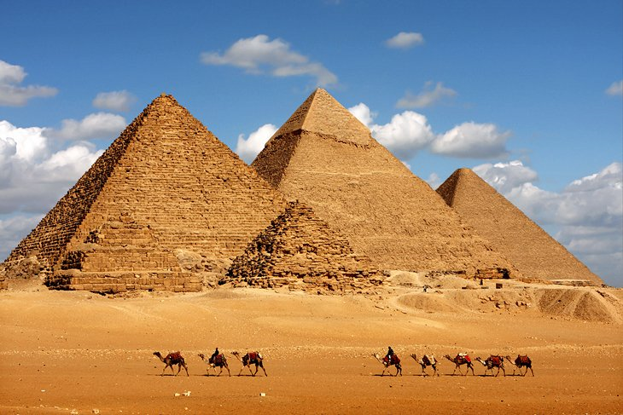

Sustainability
The ability to be maintained at a certain rate or level
Notes:
Meeting the needs of the present, without compromising future need, 4500 years ago, The Giza Pyramids, 85 years to build, withstood time – but for what intention now do they serve? Burial religious rituals

Slide 4
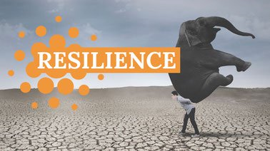

The capacity to recover quickly from difficult situations
Notes:
Tackling and overcoming changes without being overwhelmed by them
Design to endure physical, social and economic shocks and stresses

Slide 5
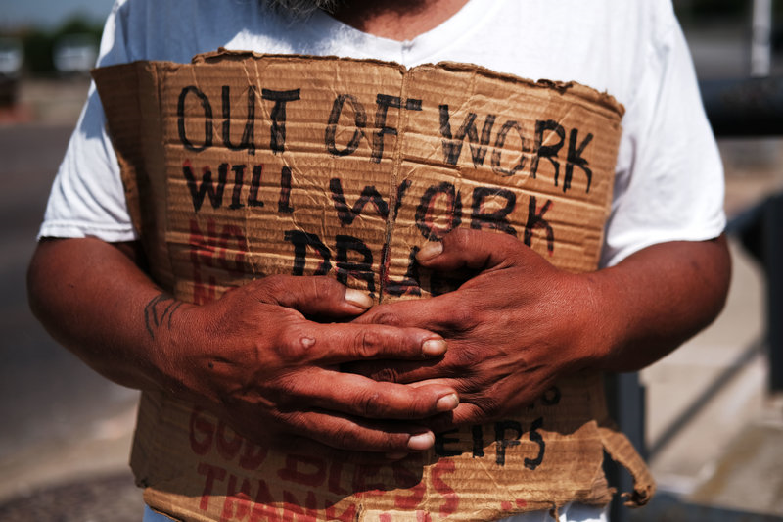
Meant to last
Just Cause vs End Goal
Child poverty in New Mexico 30%
Lyndon B. Johnson’s declaration
Notes:
NM< ranked worst in the nation child poverty, national average is 21% - ending poverty declares a loss or a victory. A Just Cause declares advancement which takes on other layers / adjust vision statement to skill building in lieu of putting an end to something

Slide 6
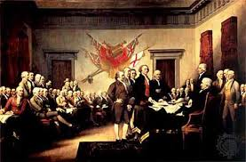
Ideal Future State
Just Cause – “We hold these truths to be self-evident, that all men are created equal.”
Short term – those who led against Great Britain
240 years – leaders, landscape, culture
100 Civil War-end to slavery
1920 Women’s suffrage
1965 the Voting Rights Act
Notes:
Just cause – meant to last – not “win” but to advance : carrying on the legacy of our vision, positive, specific alternative vision for the future
personally relate as people and easily committed to memory
AS Rebels, we are Fighting for lasting inspiration
Victories and goals met will serve as an inspiration for us to keep moving forward

Slide 7

The Power of Resilience
https://www.youtube.com/watch?v=isfw8JJ-eWM
Notes:
Ted Talks The Power of Resilience by Dr. Sam Goldstein, professor at the Univ of Utah, 50 books, 24 textbooks on school psychology and child development

Slide 8
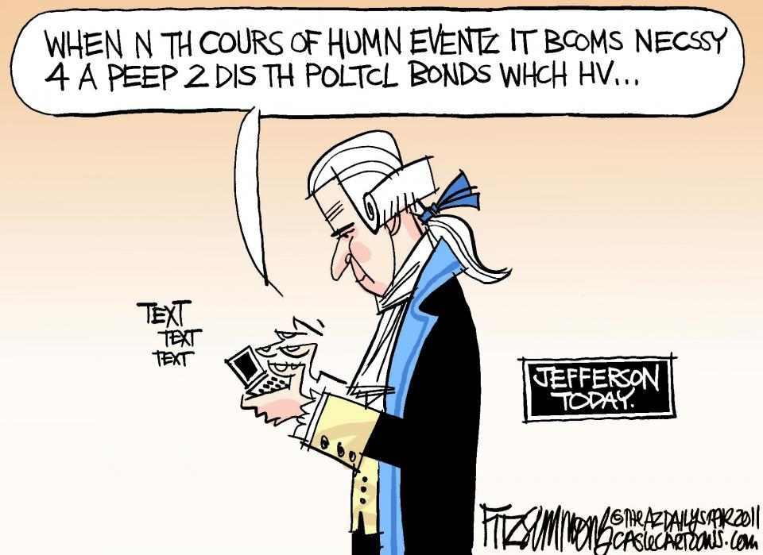

Slide 9


The Focus
By collaborating beyond the school walls with families, employers, community partners and postsecondary education providers…
The Result
A community fabric is woven by multiple stakeholders to support a redesigned high school experience that will enable all students to graduate with a strong and supported pathway to postsecondary success.
Notes:
“if” “Then” slide. Provides the focus for the presentation.

Slide 10
Postsecondary Pathways https://www.hsredesign.org/postsecondary/ T
The Evidence
“The resources here offer an evidence and research base which identify core principles to consider when redesigning the high school experience to enable all students to graduate with a strong and supported pathway to postsecondary success. As you design pathways they should reflect high school as a beginning and not an ending.”
Notes:
https://www.hsredesign.org/postsecondary/. Point out “Cote Principals” as identified on the website.

Slide 11
Postsecondary Pathways https://www.hsredesign.org/postsecondary/
The evidence indicates that the core principals are:
Provide universal access and use of postsecondary preparations and guidance supports
Keep students’ options open
Keep the choice of which pathway with students and their families
Collaborate beyond the school walls with families, employers, community partners and postsecondary education providers
Notes:
https://www.hsredesign.org/postsecondary/. Point out Bullet #4 as one of the core principals for postsecondary pathways.

Slide 12
Engaging Stakeholders as Partners in the Redesign Process
Students
Parents
Business and Business Groups
Faith Based Organizations
Civic Organizations
Government (including Public Education Department, Elected Officials, and Military)
Postsecondary Institutions
Community and Non-Profits Agencies
Professionals and Volunteers
Philanthropic and Community Foundations
Notes:
Ask participants to take out a sheet of paper and list as many partnership “types” that they can envision. Have everyone stand up with their completed list in hand. Begin listing the slide bullets one at a time. If a participant does bot have one of the “types” listed when the bullet is displayed, then that person sits down. Determine who had the most comprehensive list(s) and reward with an incentive from NM.

Slide 13
Value Added Stakeholder Engagement – Statewide Common Values
By identifying and building strong relationships with the right partners, schools can open up new opportunities for student learning.*
Schools are embedded within networks— educational, cultural, professional, and social. *
When we bridge the divide between school and community, students gain— and so do their communities. *
When they unite behind young people, communities can do much more than schools can do alone. *
*XQ Knowledge Module No. 7 Networks & Partnerships
Notes:
Partnerships are built upon providing support for students and student success. That partnerships are are a helping hand and not a handout. When there is a complex and difficult challenge to embrace, you improve chances of success by involving others and not taking on the challenge by yourself. Inclusivity is always better than exclusivity. Build off of your own network, the work will soon follow its own path.

Slide 14
Hands-on Leadership
Why not support our schools and the High School Redesign Network effort by engaging stakeholders (Statewide) as partners in the initiative?
Why not develop opportunities for schools to network with partners within their proximity?
Why not maintain regular communication with our Statewide partners to keep them informed of the High School Redesign Network successes and opportunities?
Why not engage our partners’ interest and expertise at the Statewide level to inform the Redesign work and provide advocacy for the initiative?
Notes:
Talk about the geography of the state and the isolation of the schools involved in HSRN. These are the questions that we discussed that lead us to the idea of recruiting stakeholders as State-level partners. Provide anecdotal stories of recruiting partners including: Kevin Begay, Annie Wilmon, Dan Garcia, and William Marks and Representative Williams-Stapleton. Talk about the connections made at the convening. Our anticipated follow up with Kevin Behay and his superior at the Navajo Nation.

Slide 15

Next Steps
Remain vigilant in the watch for untapped or isolated resources in the State that could enrich learning for students.
Be assertive and strategic in our efforts to recruit and include stakeholders as partners in the statewide effort.
Thoughtfully and deliberately plan for opportunities to network partnership opportunities and schools.
Keep communication flowing with state partners. Enlist their support as ambassadors of the initiative. Engage partners in the work! Seek their input and apply it appropriately.
https://youtu.be/8CT41uUw8Fc Stanford Social Innovation Review & FSG
Notes:
Comments about each bullet – Wrap up with the short video.

Slide 16
New Mexico Public Education Department Thank you!
Michelle L. Starnes Tom Savage
Priority Schools Bureau Priority Schools Bureau
High School Redesign Program Manager High School Redesign Network Specialist
New Mexico Public Education Department New Mexico Public Education Department
(505) 490-3692 (505) 620-3223
Michelle.Starnes@state.nm.us Savagetom@icloud.com

