Slide 1


New York State High School Redesign Cross State High School Collaborative
Friday, January 10, 2020
Everyone Graduates Center
Johns Hopkins University

Slide 2
Welcome & Vision-Setting
Laura Tedesco & Stephen Earley
New York State Education Department

Slide 3
Who are We?
The Cross State High School Collaborative is a project consisting currently of seven participating states: Illinois, Louisiana, Massachusetts, Mississippi, New Mexico, New York, and Ohio partnering with the CCSSO, Everyone Graduates Center at JHU, and Civic Enterprises. Collectively, we are dedicated to using ESSA to redesign high needs high schools to support their communities in the 21st Century.

Slide 5
2020 Timeline
January 10, 2020 | 1st Professional Learning Session with Johns Hopkins and NYSED (Syracuse) – “Introduction to HS Redesign”
February 13 & 14, 2020 | Individual calls with schools to support needs assessment work (Principal, District Contact, Johns Hopkins and NYSED)
March 3 & 4, 2020 | 2nd Professional Learning Session with Johns Hopkins and NYSED (NYC, exact location TBD) – “Learn About Evidence Base for HS Redesign”
Late March | Support meeting (onsite) – Design guidance
April/May 2020 | Additional assistance (virtual) as needed
June 2020 | Schools submit HS Redesign plan to NYSED
July 2020 | Support meeting (onsite or virtual) – Feedback on HS redesign plan
Summer 2020 | 3rd Professional Learning Session with Johns Hopkins and NYSED (Buffalo, exact location TBD) – “Initial Launch, Training, and Capacity Building”

Slide 6
Who are Our Teams?
Your team will take a few minutes to share some of your high school’s “signature strengths.”
Then we will have a connection circle to introduce each member of the team.

Slide 7


Slide 8
What are we doing today?
Building a sense of team and community across the cohort as we begin to know each other
Exploring the opportunity to redesign using an evidence-based framework and examining how context matters greatly in high school redesign
Developing an accurate, shared understanding of school needs and how to inform high school redesign with student and community voice
Connecting as school teams to identify priorities and begin to create team structures and initial work plans, including messaging to stakeholders

Slide 9
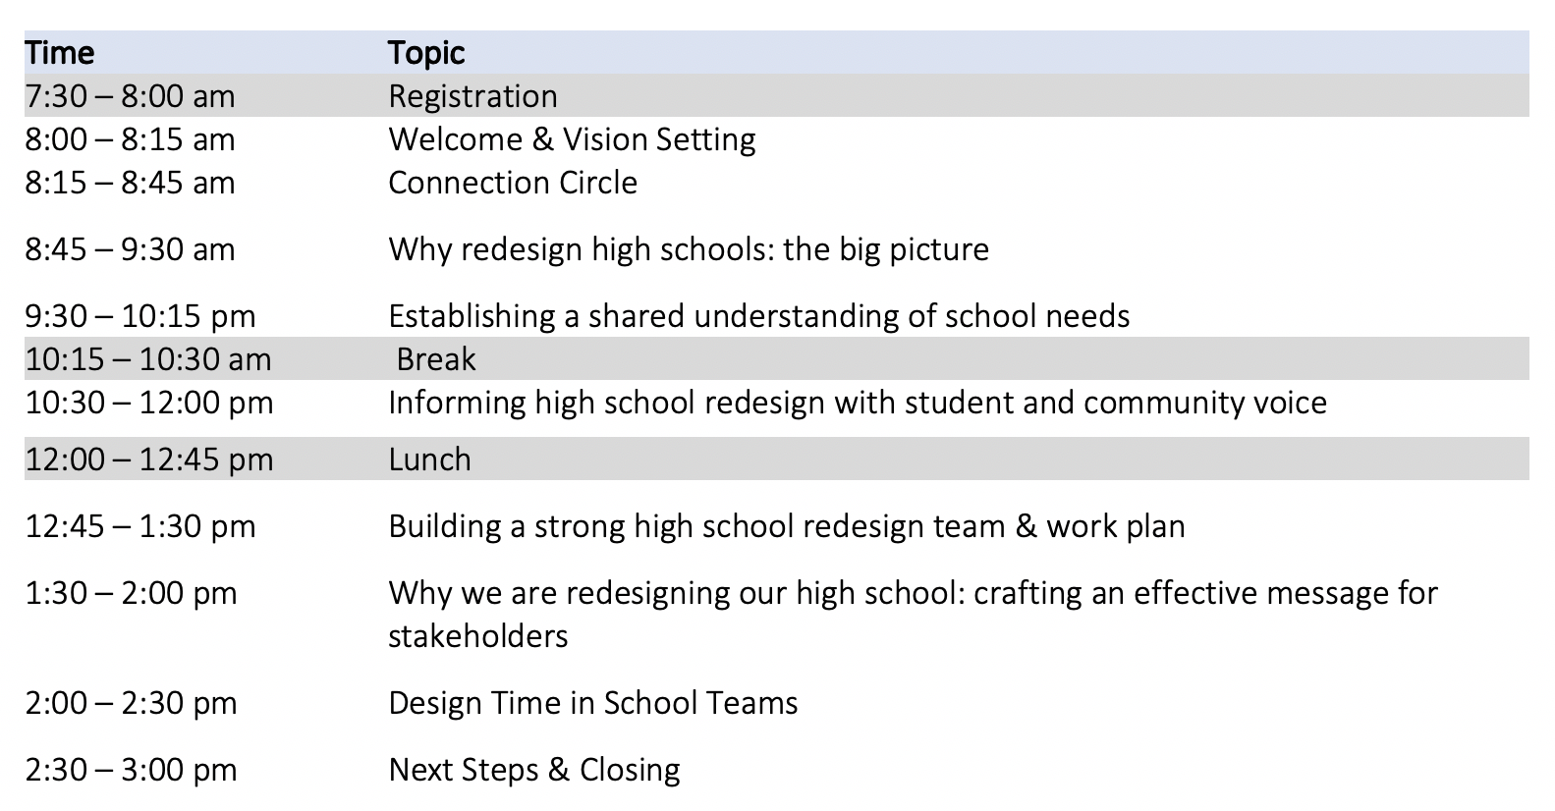
How will we accomplish this today?

Slide 10
Working Norms
Fully participate
Ensure all are heard with one voice at a time
Minimize distractions by placing cell phone on mute and stepping out for essential communication
Recognize / share the wealth of experience, expertise and understanding among the group
Honor time
Have fun

Slide 11
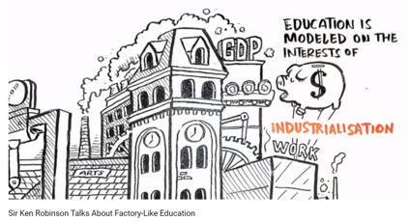
Why Redesign High Schools?
Take a few minutes to read the article at your table.
Then we will watch a brief video.
As we read and watch, reflect upon:
What were our public schools designed to produce?
How are they designed?
In what ways do the video clip and article resonate with you and your school community?
Notes:
https://www.youtube.com/watch?v=K9C0KNtqiHU&app=desktop

Slide 12
The Great American High School of the 20th Century
Helped our nation progress and was based on the desire to rapidly scale high schooling to all
Staffing, schedules, how adults were organized, and what students study were all designed to enable the standardization needed for rapid growth and based on the premise that for most students, high school would be the end of their formal education
Examples: student to counselor ratios, teachers working independently

Slide 13
New Mission for Our High Schools in the New Century
Today all students’ need to graduate from high school prepared for post-secondary schooling and/or training.
This means that regardless of students’ prior schooling, motivation, or current level of need, high schools need to provide them with the supports, experiences, and instruction required for post-secondary educational success.
We will not achieve this mission if we don’t redesign our high schools.

Slide 14
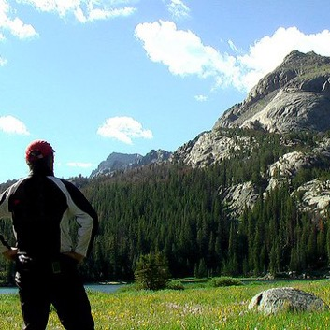
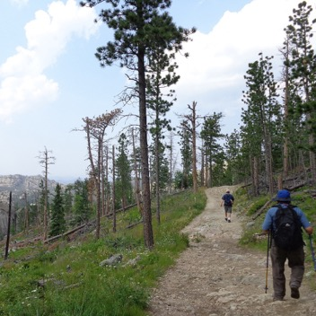

To Redesign High School You Need
HOPE
PURPOSE
KNOW HOW

Slide 15
To Redesign Our High Schools We Need to Examine Our Current Beliefs
We need to understand the way our experiences with our existing high schools, in both obvious and subtle ways, shape and limit our thinking of what is possible. They provide our mental models of what teaching and learning look like, and how students, teachers, and administrators should act.
For example, they lead us to believe that human interactions should be determined by roles, rather than relationships.

Slide 16
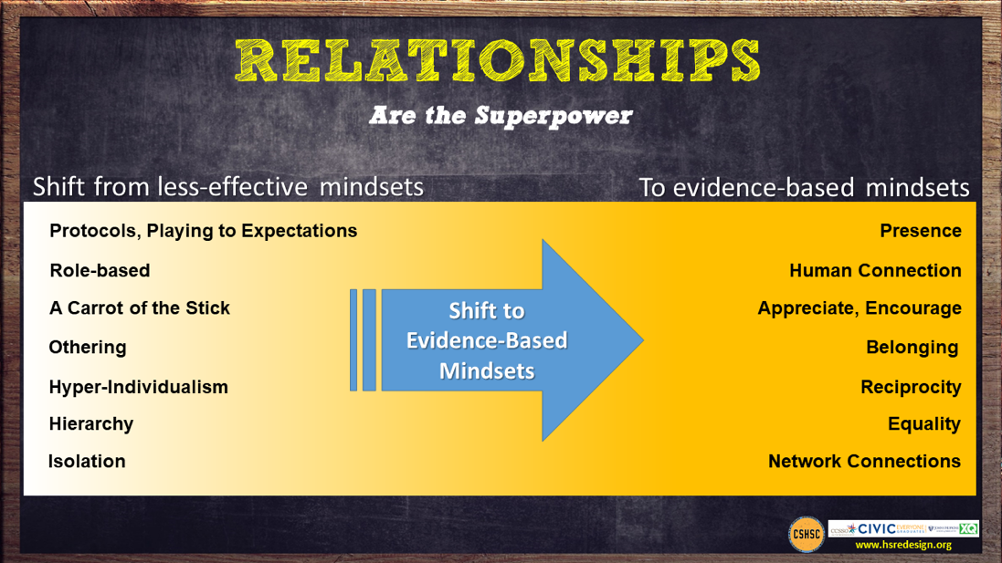

Slide 17
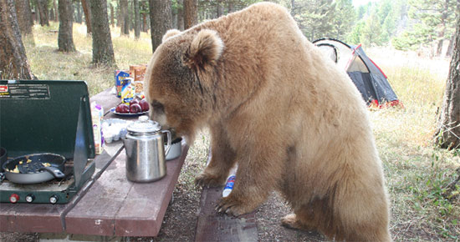
Poverty complicates the work – it’s relentless like a hungry bear trying to eat our lunch.
Poverty taxes school success by making it hard for students to attend everyday, focus in class, and complete their assignments.
High School Redesign Needs to Take This Into Account

Slide 18
A New Approach is Needed
Hopeful, positive, future-orientated frame designing a school for the 21st century
Goal is not a high school diploma but strong pathways through high school to postsecondary and adult success for all students
Evidence-based, but locally-customized/orientated—not one size or one way for all
Break social isolation and share know-how via networks of schools facing similar challenges and technical assistance tightly aligned to community redesign vision and goals
Make redesigned high school the center of community economic development and social integration efforts

Slide 19

We have learned a lot about improving high schools over the past 20 years. Redesign Challenge: Local customization built upon an evidence-based foundation

Slide 20
Four Levers of School Design/Improvement High Schools Can Impact/Control
Organizing adults and the school for success
Putting supporting all students’ success at the center of schools mission/actions
Improving teaching and learning
Providing universal access to postsecondary pathways, partners, and preparatory experiences

Slide 21




Over Six Months, Your School Team Will:
Build a shared understanding, informed by student and community input and a needs assessment, of what you want your redesigned high school to achieve
Examine evidence-based practices and structures for each redesign lever
Explore the associated mindset shifts the evidence suggests need to occur.
Customize them to your local circumstances and needs to create your high school redesign plan

Slide 22

A Tool that Can Help
CSHSC NY State HS Redesign Workbook

Slide 24
Establishing a shared understanding of school needs
Connecting the evidence base to the redesign workbook

Slide 25
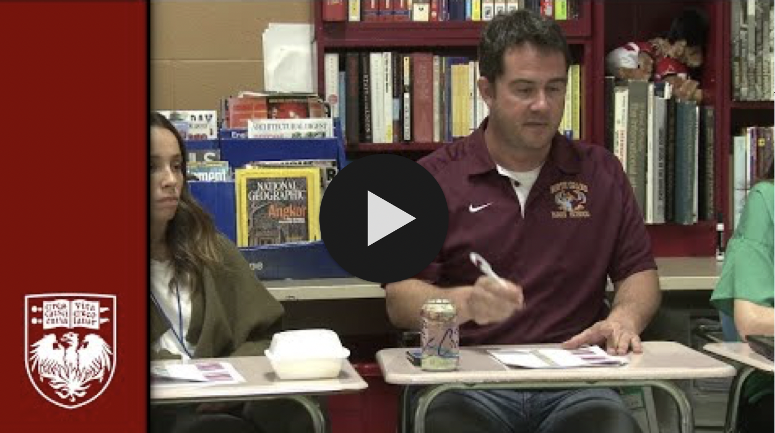
Notes:
https://www.youtube.com/watch?v=ThYfd_uGcS0&feature=youtu.be

Slide 26
Table Discussion
What did you notice in the video? What resonated with you?
How might adults be organized at this high school in order to facilitate this type of dialogue regularly?

Slide 27
Organizing Adults: “It’s Teams, Not Individuals”
FROM:
Isolated classrooms
Every person for him/herself
Individual perspective
Bureaucratic
Hierarchical
Compliance Driven
TO:
Integrated teams of adults
Relational trust
Team perspective
Human/End user
Distributed leadership
Commitment

Slide 28
Organizing Adults
Evidence-Based Practices
Supporting Structures
Teacher Teams
Student cohorts
Distributed Leadership
Interdisciplinary Teams
Leadership Development
Academies
Relationships and Trust
Collaborative Planning Time
Data Driven Decision Making
Personalized Learning Lanes
Influencing Factors
Student data/needs/voice
Teacher capacities
Community Opportunities
Notes:
Here we will go to work book for this page and look at design questions

Slide 29
Organizing Adults Redesign Questions
As a design team read the guiding redesign questions on the bottom of page 11 and select two “ how might we…” questions you would like to explore as you begin to create your redesign plan.
Review the mindset shifts for Organizing Adults.
What mindset do you see as a strength for your school community?
What mindset might need to be given additional focus in order to surface existing assumptions and beliefs?

Slide 30
Teaching & Learning: “Supported, Engaged, and Challenged”
TO:
Collective efficacy
Assessment for learning
Learning scientists and activators
Intrinsic, Choice, Autonomy
Competency attainment of something worthwhile
Mistake = Learning
FROM:
Individual orientation
Assessment of learning
Stand and deliver
Extrinsic
Ritualized practice
Mistake = Bad

Slide 31
Brainstorm at Your Table
What are some of the mindset shifts you expect to see for Teaching and Learning?

Slide 32
Teaching and Learning
Evidence-Based Practices
Evidence Based Instructional Program aligned with College and Career Readiness
Creating Challenging AND Caring Classrooms
Follow the Evidence – Use the Learning Sciences
Formative Assessments to tailor instruction and supports
Integrating Social, Emotional and Academic Development
Supporting Structures
Professional Learning Communities
Instructional Coaches
Collaborative Planning in School Day
Standards Based Grading/ Competency-Based Learning
Influencing Factors
Student data/needs/voice
Teacher capacities
Community Opportunities
Notes:
Sample Strategies Based on Evidence Base
Beginning in the freshman year, offer a comprehensive college and career planning program to students and families. (More robust with frequent touch points than current IGP)
Provide all students support to complete a comprehensive plan for success after high school.
Offer a dual enrollment program that allows student to take college courses for high school AND college credit.
Integration of academic and technical content.
Career awareness, job shadowing, intern and apprenticeships.

Slide 33
Key Tensions to Balance: Student Supports
Authoritative
Supportive
Choice and Voice
Structured and Shaped

Slide 34
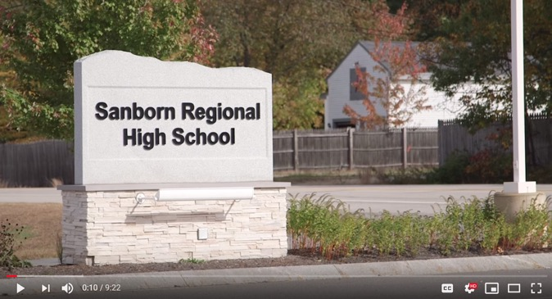
Competency-Based Learning at Sanborn Regional High School
Notes:
https://www.youtube.com/watch?v=0o-tcOZAx_k

Slide 35
Postsecondary Pathways “Once an Endpoint; Now a Stepping-Stone.”
FROM:
Sorting and ranking
Compliance
Seat time
School as single purveyor of knowledge
TO:
Universal participation in a post secondary plan
Commitment
Relevance
Learning beyond school walls

Slide 36
Postsecondary Pathways
Evidence-Based Practices
Supporting Structures
Choice of pathway is up to the student and family
College and career planning programming beginning in freshman year for students and family including supports for college admission process
All students are supported to complete a comprehensive plan for success after high school
Academies/Cohorts
Integration of technical and academic content
Competency-Based Learning
Apprentice/Internship/Job Shadow
Dual Enrollment – Early College – AP – IB
Influencing Factors
Student data/needs/voice
Teacher capacities
Community Opportunities
Notes:
Sample Strategies Based on Evidence Base
Beginning in the freshman year, offer a comprehensive college and career planning program to students and families. (More robust with frequent touch points than current IGP)
Provide all students support to complete a comprehensive plan for success after high school.
Offer a dual enrollment program that allows student to take college courses for high school AND college credit.
Integration of academic and technical content.
Career awareness, job shadowing, intern and apprenticeships.

Slide 37
Table Activity
Select one of the profiles provided highlighting pathways work at New York high schools.
As you read, think about how the organization of adults might enhance/support the vision for their school.

Slide 38
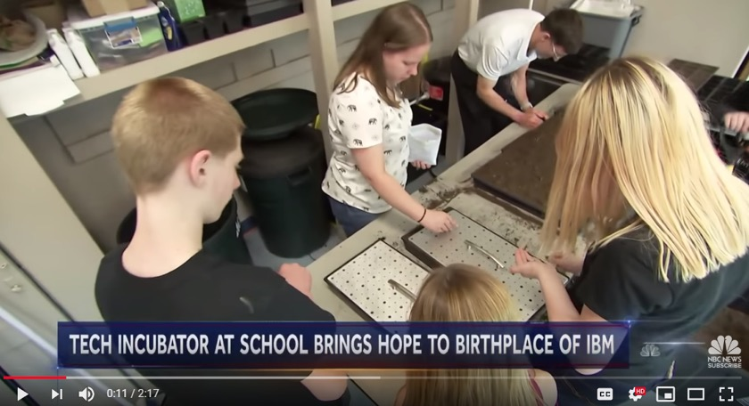
Tiger Ventures: Incubator for Start Ups
Notes:
https://youtu.be/yfzLNfpUSw0

Slide 39
Informing High School Redesign with Student & Community Voice
Strategies for facilitating meaningful dialogue

Slide 40
Getting Started
Have a deep understanding of your context
Know the educational challenges that walk in your door
Seek community input
Tools and strategies to help are available on the Cross State High School Collaborative website: http://www.hsredesign.org/
Use guiding questions to help shape your redesign plan

Slide 41

Student Voices: The Future of School
Notes:
https://vimeo.com/155339834

Slide 42
What Research Tells Us
Young people need caring, trusting, and supportive relationships with adults and with other young people.
Young people respond to high expectations.
Young people need opportunities to contribute (often referred to as “choice and voice”).
Young people need learning experiences that intentionally engage their interests, offer opportunities to succeed, and provide feedback to enable them to reflect on their accomplishments.

Slide 43
Students at the Center “Hope, Agency, Trust and Relationships”
FROM:
I am not a social worker
Those people
Data for accountability
Punitive
Deficit
Fixed mindset
Shame
Compliance
TO:
How can I help?
We are the people
Data for improvement
Restorative
Asset-based
Growth mindset
Resilience
Commitment

Slide 44
Students at the Center
Evidence-Based Practices
Supporting Structures
Positive Developmental Relationships with Adults
Ongoing structures/rituals that promote and celebrate student voice, engagement, and performance
Early Warning and Multi-Tiered Student Response Systems and Community Support
Academies/Student Cohorts
Interdisciplinary teams
Building Hope, Purpose, and Agency
Common Planning Time
Restorative Practices
Influencing Factors
Student data/needs/voice
Teacher capacities
Community Opportunities
Notes:
Sample Strategies Based on Evidence Base
Beginning in the freshman year, offer a comprehensive college and career planning program to students and families. (More robust with frequent touch points than current IGP)
Provide all students support to complete a comprehensive plan for success after high school.
Offer a dual enrollment program that allows student to take college courses for high school AND college credit.
Integration of academic and technical content.
Career awareness, job shadowing, intern and apprenticeships.

Slide 45

Block Party
Read your passage. Reflect on its meaning.
Stand up.
Find someone with another color passage that you have not yet talked with.
Introduce yourself. Share what you read and your response.
Switch roles.
When you hear the chime, find a new partner.
Notes:
I will bring the block party quotes

Slide 46
Some Opportunities to Assess Needs
Shadow a student
Interview individual students, teachers, families, community
Focus groups of students, teachers, families, community
Surveys
Analyze demographic, academic, behavioral, attendance, perception, etc. data
Resource mapping of local partners, support providers, businesses
Audit access to advanced coursework and extracurriculars
Review postsecondary outcomes of recent graduating classes
Map existing opportunities for pathway access/success
Review data with equity lens
World Café with community stakeholders
Review of policies and procedures at district/school level
Root cause analysis
Understand teacher retention, experience, and capacity

Slide 47
Student Profiles
Notes:
We can give examples of the Student Profiles from Louisiana….and or the student totems – can suggest grades 9 and 12 as well

Slide 48
Student Surveys – Comparing Indicators
Survey respondents (students, teachers, community, others) considering the same phenomenon from their own point of view.
Example:
I am proud of our high school
Corwin/Quaglia School Voice and Aspirations 2016

Slide 49
Student Surveys – Comparing Indicators
Survey respondents (teachers/students) considering the same phenomenon from opposite points of view.
Example:
Teachers respond to: “I respect students”
Students respond to: “Teachers respect students”
Corwin/Quaglia School Voice and Aspirations 2016

Slide 50
Student Surveys – Comparing Indicators
Survey respondents (teachers/students) considering the same phenomenon from different roles.
Example:
Teachers respond to: “I feel comfortable asking questions during staff meetings.”
Students respond to: “I feel comfortable asking questions during class.”
Corwin/Quaglia School Voice and Aspirations 2016

Slide 51
Ask ’Em
When might we ask students what is important and meaningful in their world?
Whom might they like to help?
How might areas of our curriculum allow for connections with our community?
Opportunities exist in great abundance – time is the perceived barrier.
Student Voice From Invisible to Invaluable

Slide 52

Notes:
Here we can also give our example of how it might look as a lesson – Student Voice 78 – page 82 might also show video page 82 Student Voice
https://www.youtube.com/watch?v=zwwqxa_dR8E&feature=player_embedded

Slide 53
How can we access the mutual intelligence and wisdom we need to create innovative paths forward for our high schools and the communities they serve?
Redesigning & Reimagining School with Community Members’ Contributions

Slide 54


The CSHSC website features a section on Conversation Cafés with a seven-video series.
Notes:
Print the how to conversation café handout
https://www.youtube.com/watch?v=cgQMrqEOJcU

Slide 55
Round 1 – Articulate the Big Why
Why are we bringing people together?
What need or needs might this conversation fulfill?

Slide 56
Round 2 – Clarify Possible Outcomes
What do we believe is possible from this community conversation?
What might we consider successful?

Slide 57
We will reconvene after lunch. Thanks!

Slide 58
Building a strong high school redesign team & work plan
Focusing and organizing for effective teamwork

Slide 59
Building a Strong Team
What we need to get to a point where shared vision is possible
Stages of co-creating shared vision
Structures & systems for working together effectively

Slide 60
Building a Strong Team
What we need to get to a point where shared vision is possible
Trust, safety, connection, vulnerability
Stages of co-creating shared vision
Structures & systems for working together effectively

Slide 62
Key Ingredients
Establish trust & safety
Embrace discomfort & vulnerability
DISTRIBUTE Leadership & Empower others

Slide 63
Notes:
Say/do, think/feel
Observable behaviors, versus the invisible forces that drive them

Slide 64
Graphic Organizer
Ingredients | Real-life examples | Real-life non-examples | Drivers (what brought about these examples & non-examples?)
Environment of trust & safety among staff
Embracing of discomfort, vulnerability, & high-candor feedback
Distributed leadership & empowerment of others

Slide 65
Notes:
Mental contrasting present moment to future ideal
An awareness of what is vs. a vision of what could be
Here is where we are vs. here is where we are going

Slide 66
Check-in
What we need to get to a point where shared vision is possible
Trust, safety, connection, vulnerability
Stages of co-creating shared vision
Telling, selling, testing, consulting, co-creating
Structures & systems for working together effectively

Slide 67
Notes:
Handout with explanations of each stage

Slide 68
Reflect & Discuss
Independently, select at which stage(s) of the shared vision you believe your school is operating.
As a team, discuss the stage(s) each member selected and why.
Articulate what your team may need to do together to access other stage(s).

Slide 69
Check-in
What we need to get to a point where shared vision is possible
Trust, safety, connection, vulnerability
Stages of co-creating shared vision
Telling, selling, testing, consulting, co-creating
Structures & systems for working together effectively
Time and space, representation and roles, communication and information

Slide 70
Supplying the Expedition: Leading for Creativity

Slide 71
Time and space
How might we intentionally create the conditions for creative, high-impact collaboration around redesign?
Notes:
“Building purpose in a creative group is not about generating a brilliant moment of breakthrough, but rather about building systems that can churn through lots of ideas in order to help unearth the right choices.” p 219

Slide 72
A few thoughts
Multiple perspectives on team
Embrace incremental evolution of ideas
Have a bias toward action – prototype and iterate
Fault tolerance
Culture of learning
Regular time supportive of deep work, meeting place, artifacts of progress and learning
Flexible individual and small group work

Slide 73
Representation and roles
How might we be more intentional about recognizing and communicating why individual and collective skills and experience are essential to engaging with the design challenge?
Notes:
Minority viewpoints stimulate divergent attention and thought
Different ways to approach problems, think, communicate, and innovate

Slide 74
Table Discussion
Which unique strengths, talents, perspectives, and skills are represented on your assembled team?
Who is missing?

Slide 76
Communication and information systems
Multifaceted communications plan
Google Keep, Google everything, Asana, Slack
Goal is building collective knowledge, memory, and understandings of the challenges and change efforts
Notes:
10x as clear about your priorities as you think you need to be.

Slide 77
Team Brainstorm
Calendar meeting dates and brainstorm team member roles
Deliverable: Capture key ideas on chart paper/digitally.

Slide 78
Team Brainstorm
What hopes and goals for discovery does your team have for the next 7 weeks related to stakeholder engagement and school needs assessment?
Deliverable: Capture key ideas on chart paper/digitally.

Slide 79
Team Brainstorm
Identify priorities (top 3) & next steps for creating team structures and systems to support progress toward goals
Deliverable: Capture key ideas on chart paper/digitally.

Slide 80
Crafting an effective message for stakeholders
Why we are redesigning our high school

Slide 81
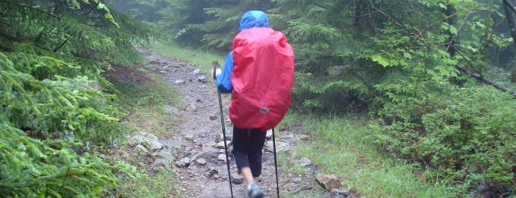
Redesigning High Schools is Like
CLIMBING A MOUNTAIN
IN THE RAIN
IT IS DIFFICULT WORK
UNDER CHALLENGING
CONDITIONS

Slide 82
To Redesign High School You Need
HOPE
PURPOSE
KNOW HOW

Slide 83
A New Approach is Needed
Hopeful, positive, future-orientated frame designing a school for the 21st century
Goal is not a high school diploma but strong pathways through high school to postsecondary and adult success for all students
Evidence-based, but locally-customized/orientated—not one size or one way for all
Break social isolation and share know-how via networks of schools facing similar challenges and technical assistance tightly aligned to community redesign vision and goals
Make redesigned high school the center of community economic development and social integration efforts

Slide 84
Key Insights
Holding space
Once-in-a-lifetime opportunity
Distributing leadership, ownership, and inspiration
Energy, individualization, future orientation
Notes:
What is our dream school? Not tinkering at the edges
What will students, teachers, community members, industry leaders, etc. say in 10 years about this school?

Slide 85
Design Time
As a team, craft a message about your high school’s redesign, intended to reach stakeholders, broadly or more specifically.
Be prepared to share your message and the why behind it.

Slide 86
Closing & Next Steps
Laura Tedesco & Stephen Earley
New York State Education Department
Notes:
Email – time slot for needs assessment support calls
February 13th and 14th

Slide 87
Upcoming…
Thursday, February 13th & Friday, February 14th
Needs assessment support calls with NYSED & JHU
Expect an email with the opportunity to reserve a convenient 45 minute time slot

