Slide 1
Organizing Partner Connections at the State, District, and Local Level
Notes:
00-02

Slide 2
Objectives
Collaborate, explore, and share strategies and approaches to recruiting external partners to increase the resiliency of high school redesign efforts
Some examples of types of partners: higher education, business, social service providers, implementation support and capacity partners, governmental (other agencies and inter-agency)
  Who else?
Notes:
02-03

Slide 3
Notes:
03-06
“There are no individuals, there aren’t even separate species. Everything in the forest is the forest”
Branches that fuse
Roots that fuse, root synapses, brains underground
Learn to save water
Send danger signals, get wasps to come save them from attacks
Aid sick trees
Grow branches just up to each others
Memory
Friends, children, sacrifice

Slide 4
Taken from the field of complexity science, “emergence” is a term that is used to describe events that are unpredictable, which seem to result from the interactions between elements, and which no one organization or individual can control.
Stanford Social Innovation Review, 2013
Notes:
06-08
The process of evolution exemplifies emergence. As one animal successfully adapts to its environment, others mutate in ways that overcome the advantages the first animal has developed. There is no ultimate “solution” beyond the process of continual adaptation within an ever-changing environment.

Slide 5
Notes:
08-10

Slide 6
Bigger questions
What are the work, college, and other connections that will organize the greater community toward supporting high school redesign?
What role can the state play in fostering connections?
Notes:
10-11
Drawing from principles of collective impact, but without bridging to that territory, how could we strike a balance

Slide 7
Broader Brainstorm
As a state team, brainstorm organizations and individuals that make up the following broader categories:
  Workforce
  Higher education
  Community partners
  Student support providers
  School implementation/
  capacity support partners
  Inter or intra agency partners
Notes:
11-17

Slide 8
Triad Discussion
Stand up, and form groups with representatives from at least 2 states.
In the context of your state’s brainstorm, share the extent to which partners have been engaged to support school- and district-based work.
What has worked well? Who was the lead connector?
Notes:
17-25

Slide 9
Notes:
25-27

Slide 10
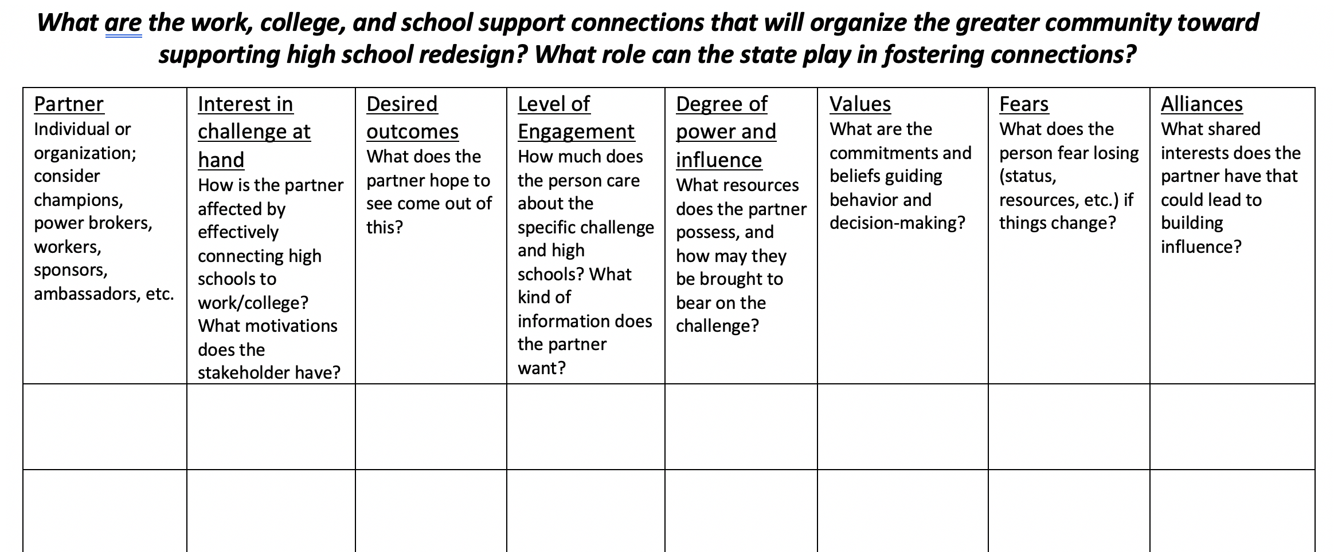
Stakeholder Graphic Organizer
Notes:
27-47
2 min to walk through/directions
8 minutes independent
10 minutes compare and discuss in state teams

Slide 11
Notes:
47-48
Aspirations, structures and connections, principles for communication

Slide 12
Table Discussion
How might we more intentionally organize partner connections, considering aspirations and organizing principles/structures?
Notes:
48-58
Discussion prompt – taken more broadly or specifically
58-68
Sharing/discussion

Slide 13
Rethinking organization
Shared values
Common language
Co-created vision
Process of aligning intentions and actions
Notes:
68-70
The solutions we have come to expect in the social sector often involve discrete programs that address a social problem through a carefully worked out theory of change, relying on incremental resources from funders, and ideally supported by an evaluation that attributes to the program the impact achieved. Once proven, these solutions can scale up by spreading to other organizations.
The problem is that such predetermined solutions rarely work under conditions of complexity—conditions that apply to most major social problems—when the unpredictable interactions of multiple players determine the outcomes. And even when successful interventions are found, adoption spreads very gradually, if it spreads at all. SSIR

Slide 14
Supporting structures
Calendars
Contracts, agreements, implementation plans, scopes of work
Rubrics, tools, milestones, benchmarks
Notes:
70-71

Slide 15
Notes:
71-73
Bird communication – small set of vivid signals, pay attention to neighbors, communicate constantly – receive and express

Slide 16
“Collective vision building is a deepening, reinforcing process of increasing clarity, enthusiasm, communication, and commitment. As people talk, try things out, inquire, re-try—all of this jointly—people become more skilled, ideas become clearer, shared commitment gets stronger.”
- Michael Fullan
Notes:
73-75

