Slide 1
Collaborative Discussions, Part 2
Short, replicable surveys & descriptive rubrics

Slide 2
Two ways to measure impact
Short, replicable surveys
Descriptive rubrics
Notes:
Performances/Rubrics
Allow the individual/school to be internally directed and to co-create goals and measures of progress
Brief Surveys
Allow for multiple cycles of inquiry and action
In all cases – reflection and responses driven closes to end user

Slide 3
Prototype #1
This model:
Collects rapid, actionable data on student experiences during class
Connects to a library of resources for evidence-based strategies
Generates reports showing change over time
Short, practical measures assess three learning conditions:
Teacher Caring
Feedback for Growth
Meaningful Work
Notes:
The three questions for each learning condition developed by PERTS in collaboration with Professors Carol Dweck and Camille Farrington, and they were refined through interviews teachers and cognitive interviews with students.
A recent set of pre-registered analyses confirmed that these new, practical measures are significant predictors of students’ academic outcomes (p < 0.001), and this relationship held even controlling for race, gender, and grades in other classes. For example, students who rated learning conditions in their math class as positive were 30% more likely to earn an A or B in that math class.

Slide 4
Explore & Discuss
Explore
Divide your team among the three learning conditions (prioritize if fewer than 3 people comprise your team).
Read through Engagement Project description
Reference your learning condition in the Guide to Learning Conditions.
Discuss
What do you like about the model? What are you hesitant about?
To which principles of progress measurement does this prototype connect?
What might be unintended consequences of having this in place?
Notes:
How should people be grouped?
Since every class is different and every teacher is different, evidence-based recommendations are just the starting point.
Teachers use cycles of inquiry and action to refine recommendations and find what works for them and their students.

Slide 5
Notes:
Depending on grouping, share with table then share out, or share among state team? Or share among learning conditions group

Slide 6
Two ways to measure impact
Short, replicable surveys
Descriptive rubrics
Notes:
Performances/Rubrics
Allow the individual/school to be internally directed and to co-create goals and measures of progress
Brief Surveys
Allow for multiple cycles of inquiry and action
In all cases – reflection and responses driven closes to end user

Slide 7
Triad Brainstorm – 5 minutes
When might a descriptive rubric be used to measure progress?

Slide 8

Prototype #2
New England Secondary School Consortium’s Global Best Practices Self-Assessment Tool for Secondary Learning

Slide 9
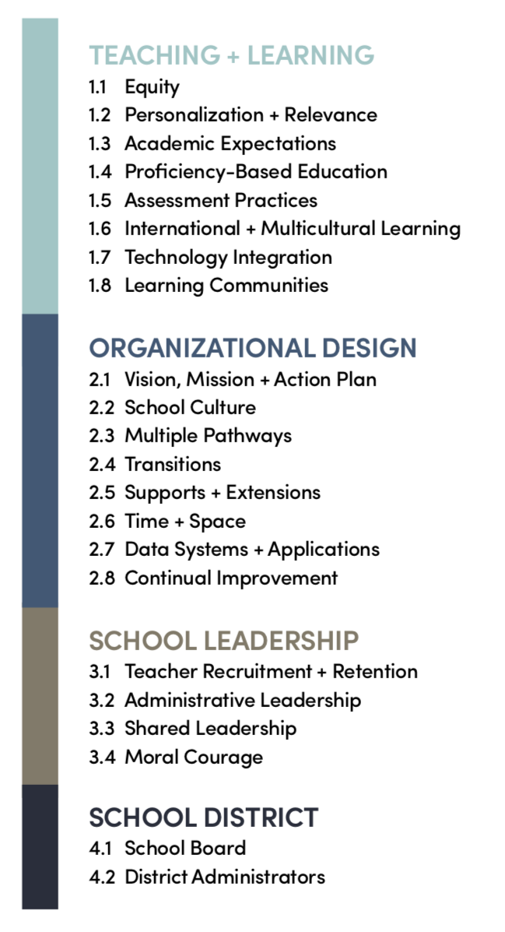

Slide 10
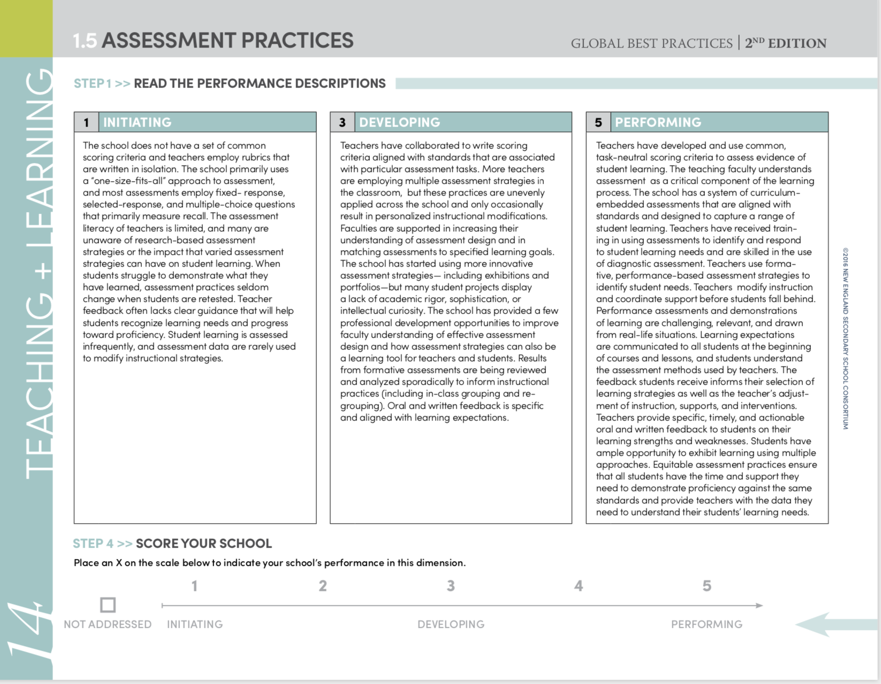
Explore
With one school in mind, review the assessment practices rubric strand, including the sample strategies and evidence.
With one school in mind, determine a rating and supporting information/evidence.

Slide 11
Discuss
What do you like about the model? What are you hesitant about?
To which principles of progress measurement does this prototype connect?
What might be unintended consequences of having this in place?

Slide 12

Time for a check in!
Pick a device and complete the following short survey:
shorturl.at/aegCE

