Slide 1

Using Graduation Requirements and Credit Flexibility in Redesign
Cassie Palsgrove – Program Administrator
Ohio Department of Education

Slide 2

Each Child, Our Future calls for a student-centered system that addresses the needs of an increasingly diverse student population and prepares students for a rapidly changing workplace.

Slide 3
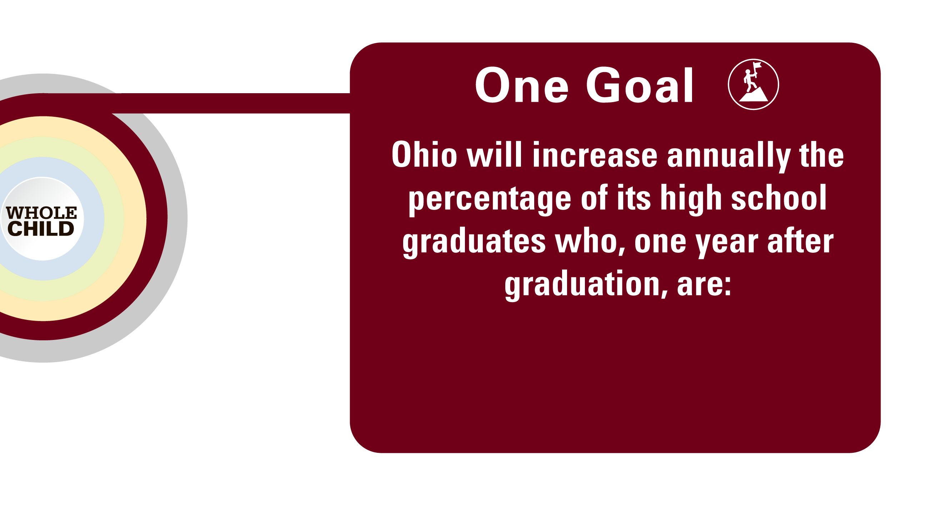

Slide 4
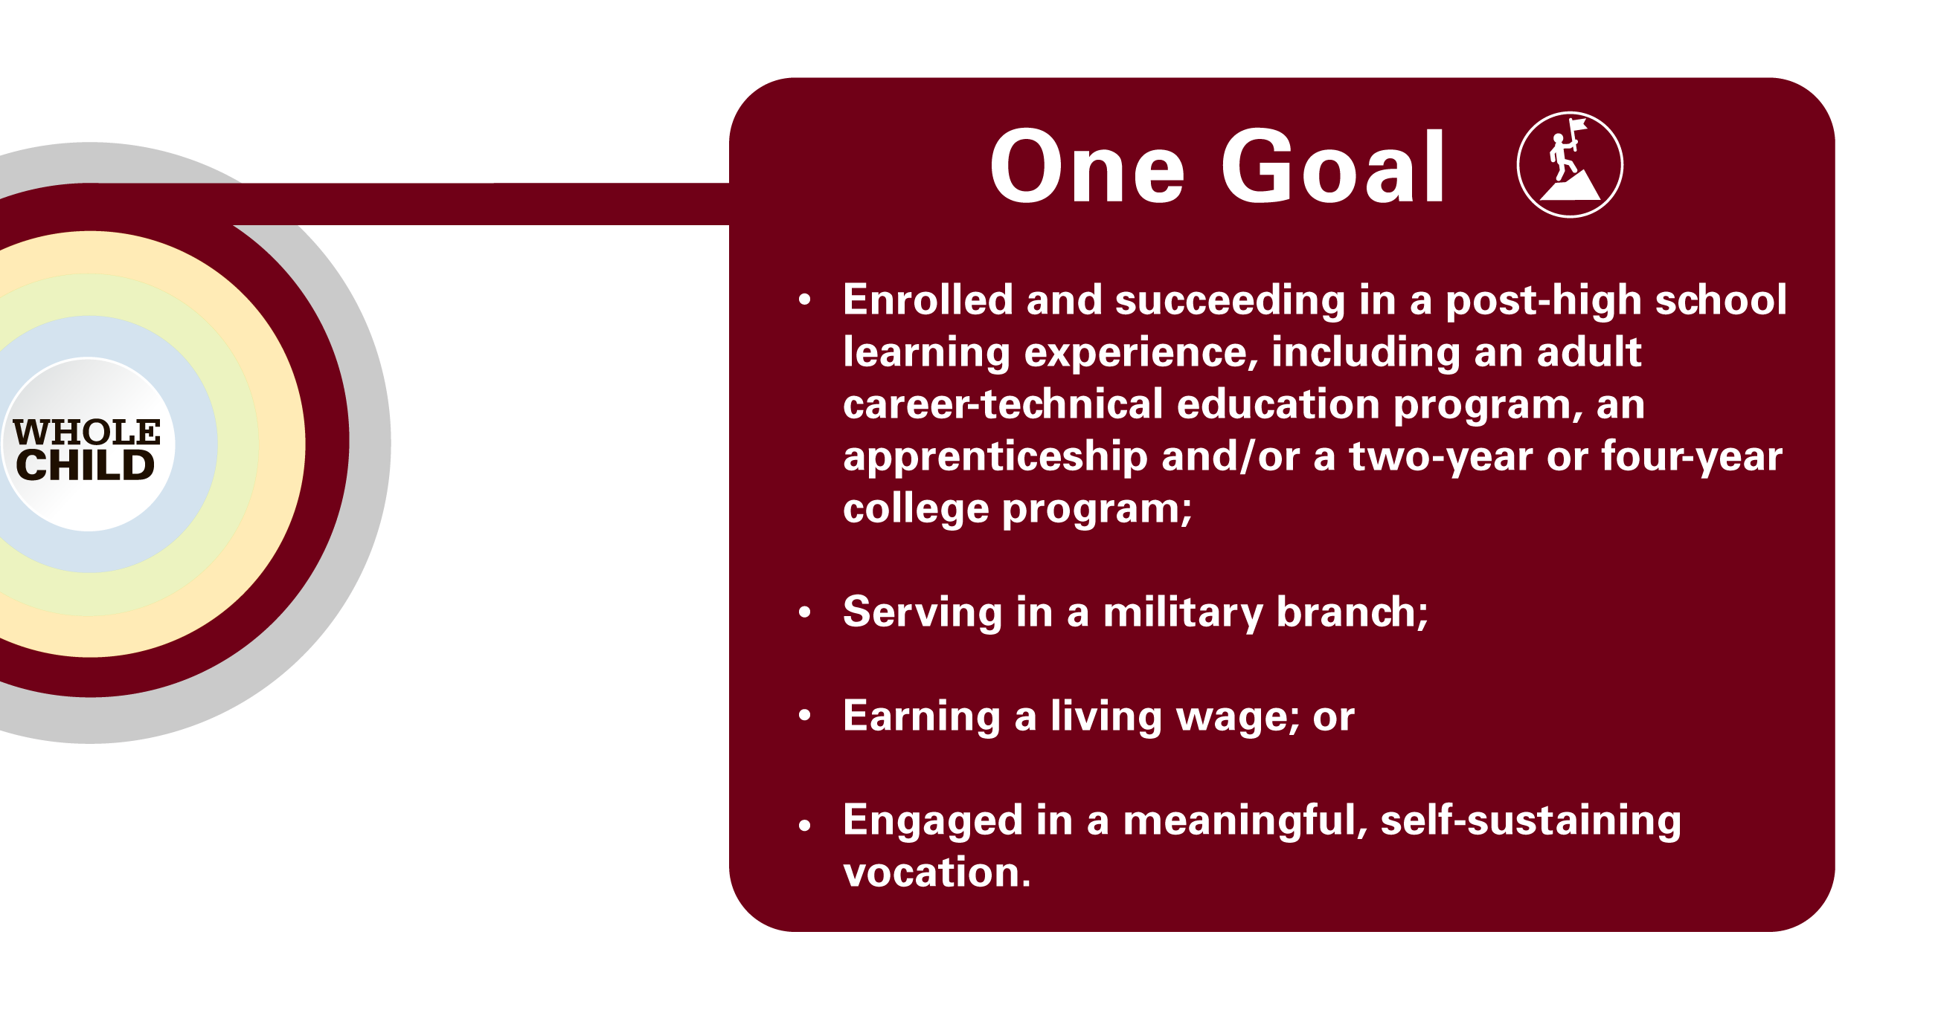

Slide 5
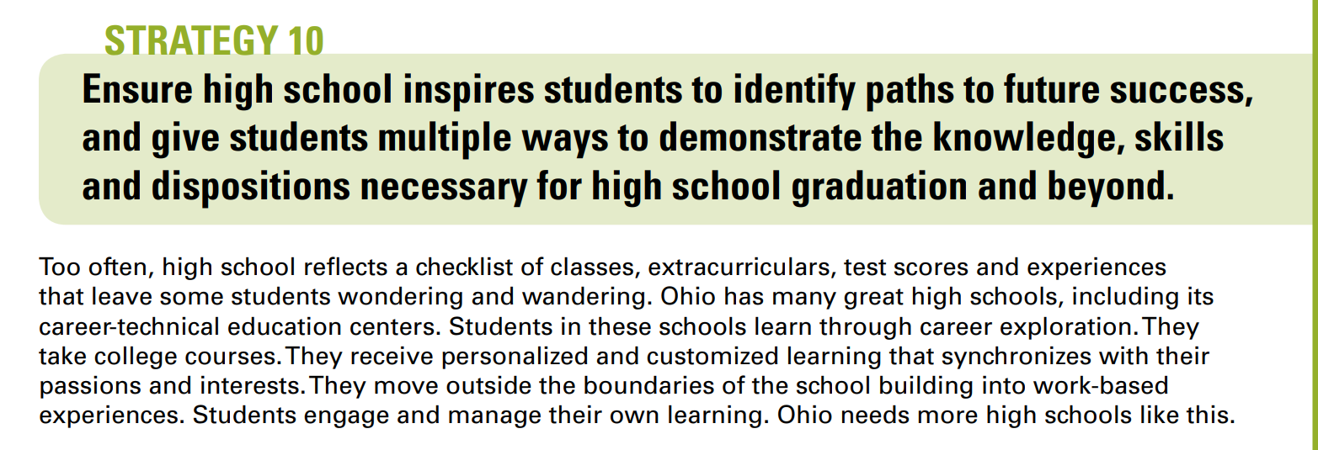

Slide 6

Ohio’s Graduation Requirements

Slide 7



Ohio’s High School Graduation Requirements
1. Course Requirements
2. Demonstration of Competency
3. Demonstration of Readiness

Slide 8




Demonstration of Competency
Competency on
Ohio’s State Tests
Military Enlistment
College Credit Plus
Career Readiness

Slide 9
Demonstration of Readiness
State law created 12 diploma seals and established the criteria for each seal.
Students must earn 2 diploma seals to qualify for a high school diploma.
State defined seals (9) and locally defined seals (3).
Seals must be attached or affixed to the diploma and transcript.

Slide 10
Consider Credit Flexibility to Innovate Course Requirements
Test out options
Work-based Learning Credit Options
Integrate Coursework for Simultaneous Credit

Slide 11

What is Simultaneous Credit?
Social Studies
English
Students receive credit in both content areas.
Notes:
What is Simultaneous Credit?
Courses integrating subject content from two areas
Students receive credit in both content areas
Optional for districts
Authorized by Ohio HB 59
This course may be called Humanities at the local level

Slide 12

Government & Agriculture

Slide 13

More dynamic learning environments
Students can meet graduation requirements faster
Why it’s good for your district
Notes:
Why it’s good for your district
More dynamic learning environments
Improved student engagement
Students can meet graduation requirements faster
Often higher test scores when CTE and academic content integrated*
New opportunities for teacher collaboration
*studies

Slide 14

Meet multiple learning expectations through a single course
Experience real-world applications for authentic learning
Why it’s good for your students
Notes:
Why it’s good for your students
Meet multiple learning expectations through a single course
Make connections across disciplines
Experience real-world applications for authentic learning
Have time left for more learning experiences

Slide 15
Questions?

Slide 16
What are Post-Secondary Pathways?
Combination of rigorous and high-quality education, training, and other services that:
(A) aligns with the skill needs of industries in the economy of the State or region;
(B) prepares an individual to be successful in any of a full range of secondary or postsecondary education options
(C) includes counseling to support an individual in achieving the individual's education and career goals;

Slide 17
Combination of rigorous and high-quality education, training, and other services that:
(D) organizes education, training and other services to meet the needs of an individual in a manner that accelerates their educational and career aspirations
(E) enables an individual to attain a secondary school diploma and at least one recognized postsecondary credential or college credits, preferably both; and
(F) helps an individual enter or advance within a specific occupation or occupational cluster

Slide 18

School Spotlight – Ranger Pathways

Slide 19

SUCCESSBOUND.OHIO.GOV

Slide 20

What are the top in-demand jobs in your region? What is your districts 6 year college graduation rate?
Notes:
Use county omj data on labor market
Show school report card data

Slide 21

What is your district and region offering to help fill these gaps?

Slide 22

House Bill 166 Changes
High School Testing Requirements
Graduation Planning
Graduation Requirements

Slide 23
Policy for the Identification of At-Risk Students
Policy for the identification of students at risk of not qualifying for a diploma.
Criteria for identification
Procedures
Notification process
Instructional Supports and/or Support Services
Graduation Planning

Slide 24


Foundational Demonstration:
Cumulative score of proficient or higher on WebXams
Earning an approved industry-recognized credential
Pre-apprenticeship or apprenticeship program
Supporting Demonstration:
250-hour Workplace Experience
WorkKeys
OhioMeansJobs Readiness Seal
Students must meet two criteria – of which one must be foundational.

Slide 25
Foundational Activities:
Proficient
scores on WebXams
A 12-point industry credential
A pre-apprenticeship or acceptance into an apprenticeship
Supporting Activities:
Work-Based Learning
Required score on WorkKeys
OhioMeansJobs
Readiness Seal
Notes:
Demonstrate Two Career-Focused Activities* : Foundational Proficient scores on WebXams A 12-point industry credential A pre-apprenticeship or acceptance into an approved apprenticeship program Supporting Work-based learning Earn the required score on WorkKeys Earn the OhioMeansJobs Readiness Seal

Slide 26

WebXam
Secondary Career-Technical Education (CTE) programs require career field pathway end-of-course tests. All tests are administered electronically through a web-based application. All tests are developed and administered by The Ohio State University, CETE through a proprietary system called WebXam©.
Notes:
Ohio’s new graduation requirements consist of three key components:
Course Completion
Students will satisfy Ohio’s curriculum requirements and any additional local requirements. Students will complete the state minimum 20 credits with specific credits required in each content area.
Competency Demonstration
Students will demonstrate competency in the foundational areas of English language arts and mathematics or through alternative demonstrations, which include College Credit Plus, career-focused activities or military enlistment.
Readiness Demonstration
Students will demonstrate readiness for their post-high school path by earning two seals intended to allow them to demonstrate important foundational and well-rounded academic and technical knowledge, professional skills, social and emotional competencies and leadership and reasoning skills.

Slide 27

Industry Credentials
An industry-recognized credential is a verification of an individual’s qualification or competence.
A third party with authority issues a credential.
Authorities include business, trade association, or other industry-group assessments that measure technical knowledge and skills in a specific industry.
This also includes licenses to engage in particular types of work that typically a government agency issues.
This Photo by Unknown Author is licensed under CC BY-SA-NC
Notes:
Ohio’s new graduation requirements consist of three key components:
Course Completion
Students will satisfy Ohio’s curriculum requirements and any additional local requirements. Students will complete the state minimum 20 credits with specific credits required in each content area.
Competency Demonstration
Students will demonstrate competency in the foundational areas of English language arts and mathematics or through alternative demonstrations, which include College Credit Plus, career-focused activities or military enlistment.
Readiness Demonstration
Students will demonstrate readiness for their post-high school path by earning two seals intended to allow them to demonstrate important foundational and well-rounded academic and technical knowledge, professional skills, social and emotional competencies and leadership and reasoning skills.

Slide 28
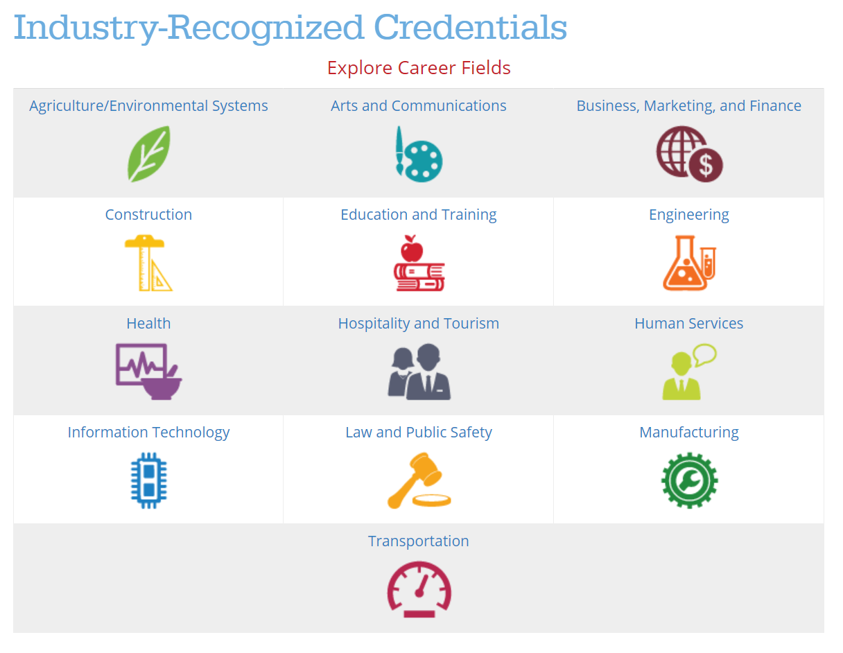
This Photo by Unknown Author is licensed under CC BY-SA-NC
Notes:
Ohio’s new graduation requirements consist of three key components:
Course Completion
Students will satisfy Ohio’s curriculum requirements and any additional local requirements. Students will complete the state minimum 20 credits with specific credits required in each content area.
Competency Demonstration
Students will demonstrate competency in the foundational areas of English language arts and mathematics or through alternative demonstrations, which include College Credit Plus, career-focused activities or military enlistment.
Readiness Demonstration
Students will demonstrate readiness for their post-high school path by earning two seals intended to allow them to demonstrate important foundational and well-rounded academic and technical knowledge, professional skills, social and emotional competencies and leadership and reasoning skills.

Slide 29

Industry-Recognized Credentials Overview
$8 million each year for credential reimbursement.
Schools must notify students when their career-tech course can conclude with an industry recognized credential.
Requires schools to pay the cost of credential exam.
Notes:
Industry-Recognized Credentials
Budget provides up to $8M in each fiscal year to support payments to public schools for students who earn an industry-recognized credential or receive journeyman certification
Requires a school to notify students when courses can conclude with an industry recognized credential.
Requires a school to pay for the cost of a student taking a credential exam.
Requires ODE to provide reimbursement to schools when a student earns a credential.

Slide 30
Industry-Recognized Credentials
Provides $12.5 million each year to pay schools $1,250 for each student who earns a qualifying credential
Incentivizes schools to establish qualifying credentialing programs, with $4.5 million in each fiscal year designated for this purpose
Notes:
Industry-Recognized Credentials
Creates the Innovative Workforce Incentive Program (IWIP)
$12.5M in each fiscal year that will be used to pay public schools up to $1,250 for each qualifying credential earned by students in the school.
The list of qualifying credentials will be developed by the Office of Workforce Transformation.
Incentivizes schools to establish credentialing programs that qualify for IWIP, with $4.5M in each fiscal year designated for this purpose
Priority will be for senior-only credential programs in schools that do not operate such programs.
Anticipate guidance on the program late fall/early winter, to coincide with the career-tech program approval process.

Slide 31

Apprenticeship
Approved Registered Apprenticeship industry partner
Program that teaches basic technical and job-readiness skills for a designated apprenticeable occupation or occupational sector, to prepare participants for Registered Apprenticeship training.
Features a classroom and/or lab setting but may also provide exposure to the work environment for the targeted occupation(s).
ApprenticeOhio
Ohio Department of Education
Notes:
Ohio’s new graduation requirements consist of three key components:
Course Completion
Students will satisfy Ohio’s curriculum requirements and any additional local requirements. Students will complete the state minimum 20 credits with specific credits required in each content area.
Competency Demonstration
Students will demonstrate competency in the foundational areas of English language arts and mathematics or through alternative demonstrations, which include College Credit Plus, career-focused activities or military enlistment.
Readiness Demonstration
Students will demonstrate readiness for their post-high school path by earning two seals intended to allow them to demonstrate important foundational and well-rounded academic and technical knowledge, professional skills, social and emotional competencies and leadership and reasoning skills.

Slide 32
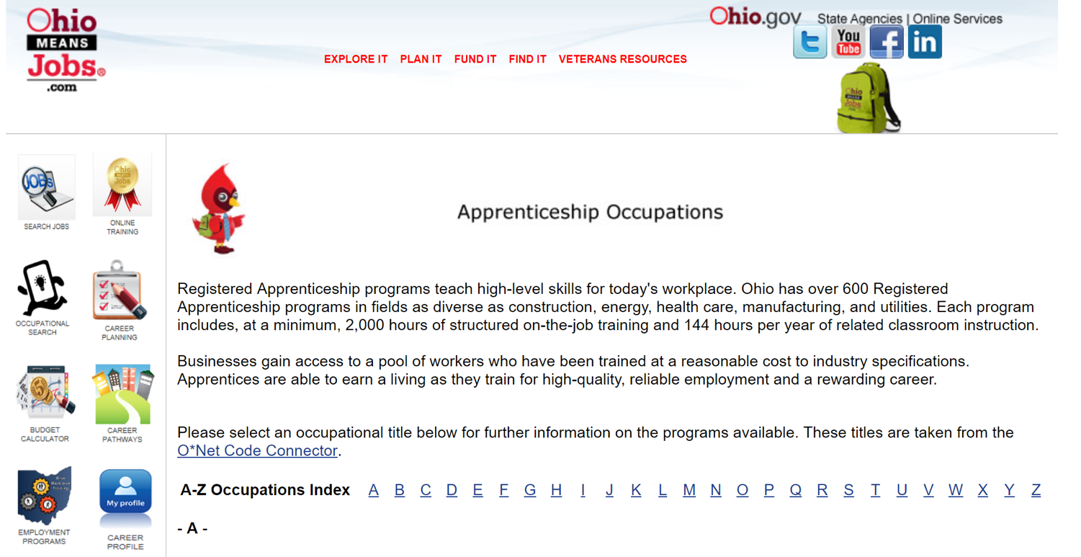
This Photo by Unknown Author is licensed under CC BY-SA-NC
Notes:
Ohio’s new graduation requirements consist of three key components:
Course Completion
Students will satisfy Ohio’s curriculum requirements and any additional local requirements. Students will complete the state minimum 20 credits with specific credits required in each content area.
Competency Demonstration
Students will demonstrate competency in the foundational areas of English language arts and mathematics or through alternative demonstrations, which include College Credit Plus, career-focused activities or military enlistment.
Readiness Demonstration
Students will demonstrate readiness for their post-high school path by earning two seals intended to allow them to demonstrate important foundational and well-rounded academic and technical knowledge, professional skills, social and emotional competencies and leadership and reasoning skills.

Slide 33
Supporting Activities:
Work-Based Learning
Required score on WorkKeys
OhioMeansJobs
Readiness Seal
250 Hours
Work-Based Learning Toolkit
Score to be determined
Find more information here
Can be used in a mentorship program
Notes:
Demonstrate Two Career-Focused Activities* : Foundational Proficient scores on WebXams A 12-point industry credential A pre-apprenticeship or acceptance into an approved apprenticeship program Supporting Work-based learning Earn the required score on WorkKeys Earn the OhioMeansJobs Readiness Seal

Slide 34

Demonstration of Readiness
OhioMeansJobs Readiness Seal
Seal of Biliteracy
College Ready Seal
Science Seal
Criteria for earning these Seals is set by existing Ohio law, code or board policy.
Honors Diploma Seal
Citizenship Seal
Notes:
Today’s discussion!

Slide 35

OhioMeansJobs Readiness Seal
Demonstration of professional skills and competencies
Students must have 3 mentors to validate the 15 professional skills needed to earn the Seal

Slide 36

Seal of Biliteracy
Student must demonstrate proficiency in English and high levels of proficiency in at least one other world language
Students can demonstrate proficiency in English and at least one other world language through a series of test-based options.

Slide 37

College Ready Seal
Earn remediation-free scores on the ACT or SAT

Slide 38


Science Seal
Proficient on the Biology test
Advanced Placement score of “2” or better
International Baccalaureate score of “2” or better
Earning a “B” or higher on an approved CCP course

Slide 39

Honors Diploma Seal
Meeting the criteria for one of six honors diplomas:
Honors Diploma
Career-Tech Honors Diploma
IB Honors Diploma
STEM Honors Diploma
Civics and Social Sciences
Fine Arts Honors Diploma

Slide 40


Citizenship Seal
Advanced Placement score of “2” or better
International Baccalaureate score of “2” or better
Proficient “3” on the American History and American Government test
Earning a “B” or higher on an approved CCP course

Slide 41
Demonstration of Readiness
Military Enlistment Seal
Technology Seal
Guidance for earning these seals will need to be developed.
Industry-Recognized Credential Seal
Notes:
Today’s discussion!

Slide 42

Military Enlistment Seal
Requirements
Provide evidence of enlistment in an armed services branch of the military; OR
Participating in an approved Junior Reserve Officer Training (JROTC) program
Determinations
At what point in the enlistment process has a student demonstrated sufficient "evidence of enlistment?" What is that evidence?
What qualifies as "participation in a JROTC program?"

Slide 43

Technology Seal
Requirements
Advanced Placement or International Baccalaureate; or
Earning a “B” or higher in an approved College Credit Plus course; or
Completing a course that meets guidelines set by the Ohio Department of Education
Determinations
Identification of Advanced Placement and International Baccalaureate courses and tests
Define approved College Credit Plus Technology course
Develop guidelines for local technology course

Slide 44

Industry-Recognized Credential Seal
Requirements:
Earn an industry-recognized credential that is aligned to a job that is determined to be “in-demand” in this state and its regions.
Determinations:
What is the required number of credential point(s) that a student must earn to be awarded the industry-recognized credential seal?

Slide 45
Demonstration of Readiness
Community Service Seal
Student Engagement Seal
State law directs the guidelines for at least 1 of these seals be set by districts and schools.
Fine and Performing Arts Seal
Notes:
Today’s discussion!

Slide 46

Community Service Seal
Completion of a community service project that is aligned with the guidelines adopted by the student’s district board or school governing authority

Slide 47

Student Engagement Seal
Participation in extracurricular activities such as athletics, clubs, or student government to a meaningful extent, as determined by local guidelines

Slide 48

Fine and Performing Arts Seal
Demonstration of skill in the fine or performing arts according to an evaluation that is aligned with the guidelines adopted by the student’s district board or school governing authority.

Slide 49

Available Resources
Preliminary Guidance Documents
Graduation Requirements by Cohort
Student/Family Graduation Handouts

Slide 50
Using Graduation Requirements to Build Pathways
Thinking about your earlier discoveries (e.g., top in-demand job, college completion rates) what programming could you offer or expand in your redesign plans that will satisfy graduation requirements, fill workforce needs, and help student’s attain post-secondary credentials (including degrees)?

Slide 51
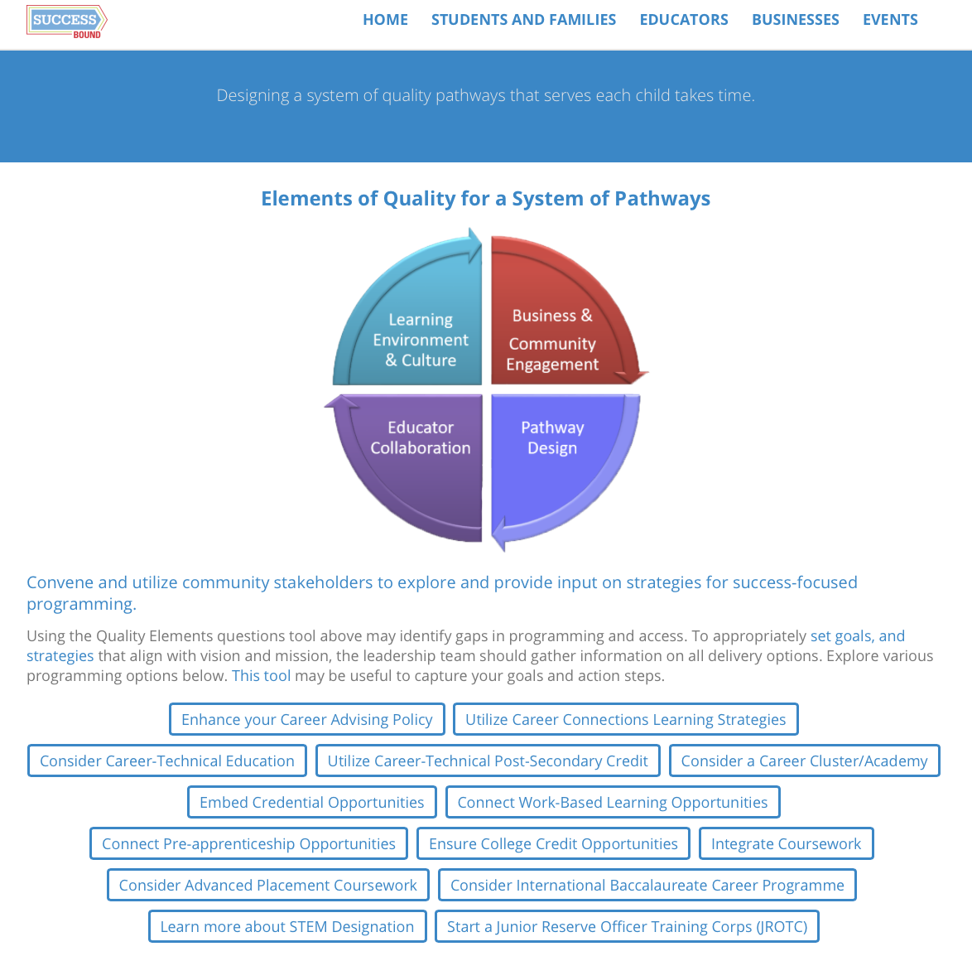

Slide 52
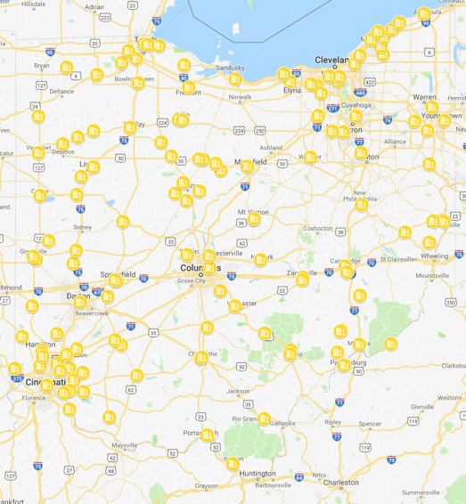
Who are your major partners? Do you utilize your districts Business Advisory Council? Partnerships are essential to this work

Slide 53

Career Connections is a foundation for all schools

Slide 54

Career-Technical Education pathways should be an important consideration

Slide 55



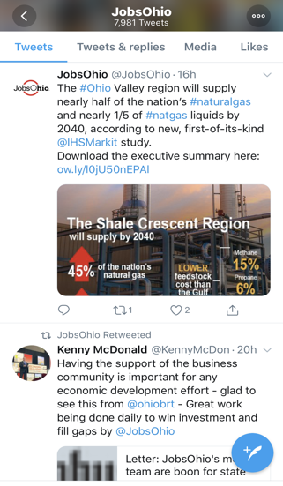

Get connected: #OHSuccessBound #EachChildOurFuture
Sign up for EdConnection!

