Slide 1
CCASN Master
Schedule Guide
A Guide to Scheduling Linked Learning Pathways, Academies, and other Small Learning Communities

Slide 2
Objectives
To increase our own expertise, efficiency, and effectiveness in building a successful Master Schedule
To acquire valuable master schedule tools, strategies and resources
To build and contribute to a community of practice around effective master scheduling.

Slide 3
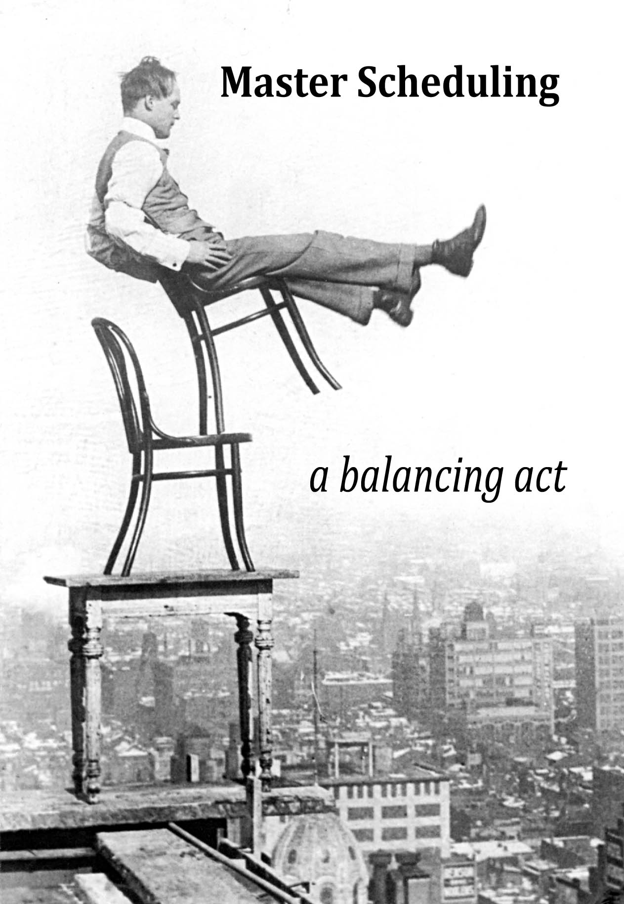

Slide 4
Master Scheduling
The process of matching philosophy and resources with requirements and needs in a system which recognizes the readiness of individuals and which increases the probability of success for all.

Slide 5
The Perfect Master Schedule
A schedule in which ALL students and teachers are successfully cohorted in their respective pathways; where each pathway team (or grade level pathway team or upper/lower division pathway team) of teachers shares common planning time; and where every student is supported to successfully complete a challenging, interdisciplinary program of study that results in her/him graduating college- and-career-ready.

Slide 6
Why is the Master Schedule so Important?
Fundamental need of Pathways/ system of Pathways and the school as a whole
Master Schedule problems are the most frequent complaint of struggling Pathways
If the schedule is done well, it supports the vision for learning and teaching in the school.
If the schedule is poorly done, the result is frustration for students, for teachers, and for parents

Slide 7
Why is the Master Schedule so challenging?
Scheduling is an inherently complex process
  Many factors to incorporate
  “Constraints & Opportunities”
Pathways/Academies add new complexities:
  Student “cohort” scheduling
  Teacher common planning (support for communities of practice)
  (If possible) Coordination time for Pathway Leads
  Partnerships and Work-based Learning opportunities

Slide 8
The Bottom Line
The Master Schedule is complicated, however….
Bottom line: As you build the scheduling expertise of your master schedule team, implement a thoughtful and inclusive process, and utilize best practices, it is very possible to do master scheduling well.

Slide 9
The Master Schedule in the Academy/Pathway Context
Smaller Learning Community
“…an environment in which a core group of teachers and other adults within the school know the needs, interests, and aspirations of each student well, closely monitor his or her progress, and provide the academic and other support he or she needs to succeed.” (U.S. Education Department)

Slide 10
College & Career Academies/
Linked Learning Pathways
*Small Learning Community
- a team of teachers working with a group of students over time
(sense of family)

Slide 11
College & Career Academies; Linked Learning Pathways
Program of Study: College preparatory curriculum organized around a career theme; 3-4 years
  Core academic classes
  A sequence of career-technical courses
  Interdisciplinary teaching and learning
  Project-based, inquiry approach to learning

Slide 12
College & Career Academies/Linked Learning Pathways
Industry, Labor, Postsecondary, Governmental, and Community Partnerships
  Support for work-based learning opportunities
  Support for high quality curriculum
  Support for student transition to adulthood
Other Supports for Student Success, College and Career Readiness (Adult advocacy, tutoring, etc.)

Slide 13
Scheduling with a Pathway Lens
Student recruitment/selection involves high expectations for all; heterogeneous grouping with each pathway reflecting the diversity of school/district
Cohort Scheduling
Common planning time/community of practice
Pathway Lead’s Coordination Time
Partnerships with Business, Postsecondary, Government, and Community

Slide 14
Scheduling with a Pathway Lens
College and Career Readiness (including, all students have access to advanced courses, access to CTE)
Work-based Learning (internships, practica)
Personalized Support

Slide 15
Stages of the Master Schedule
Stage I – Planning, Designing, Preliminary Tasks
Stage 2 – Student Pathway/Program of Study Selection; Elective Course Selection; Tallies
Stage 3 – Building the Master Schedule
Stage 4 – Analysis, Adjustment; Distribution of Student & Teacher Schedules
Stage 5 –Fine-Tuning, Readjustment & Assessment (… begin the cycle anew)

Slide 16
An Invitation to Share
CCASN will continue to add and refine resources and tools included in the CCASN Master Schedule Guide. We invite you to share your own master schedule tools, strategies, and effective practices.
Please share resources and suggestions with Patricia Clark (patricia510@gmail.com) and/or Phil Saroyan (jp9@jps.net)
THANK YOU.

