Slide 1
New Mexico High School Redesign Teams Founders and Cohort 2 February 19, 2020

Slide 2
Working Norms
Fully participate
Listen with respect to maximize learning from each other- one voice at a time to ensure all are heard
Return attention to large group when you hear the chime
To minimize distractions leave cell phone/ iPad/ laptop sound on silent and step out for essential communications
Recognize / share the wealth of experience, expertise and understanding among the group
Honor time
Have fun

Slide 3
Share your name and school.
Then complete the following:
I feel happiest when my actions
are aligned with….

Slide 4
Walk Through the Day
Connection Circle
Navigation Guides – How will we know what we are doing is taking us in the direction we would like to travel?
Case Study
A Core Story
Founders Showcase
Consultancies as Scheduled

Slide 5
How might we design navigation guides that let us know our redesign implementation is serving students and adults well in the school communities we support?
Notes:
Guiding Question

Slide 6
When Navigation Guidance Works
Help us steer and develop our redesign/improvement efforts
Alert our attention to things that matter (which we might miss without them)
Are actionable in the near term-now that we know current state we can do something to change it
Are not viewed as judgmental

Slide 7
Navigation Guidance for Flying a Small Plane-A set of instruments known as the six-pack provide the key information a pilot needs to fly. Pilots need to know each instrument’s characteristics and limitations. During flight, a pilot must interpret the information displayed on these six flight instruments to fly safely.

Slide 8
When Metrics Go Off Course
When the act of measuring, changes the action being measured e.g. high stakes test leads test prep and narrowing of curriculum
If you think or believe there is a ‘right answer’ or a ‘required outcome’ for external accountability, a metrics ability to provide navigation guidance can be lost (survival instinct and sense of best foot forward)
A focus on short term, easily measurable actions (i.e. checklist) can neglect more subtle changes with long term consequences (e.g. mindset shifts or lack there of)
External measures can discount agency and sense of internal worth – thus increasing dynamics of scarcity and blame rather than supporting strong relational trust

Slide 9
Case Study
Metric – driven harm: An exploration of unintended consequences of performance metrics

Slide 10
First Word/Last Word
Review the case study independently.
Highlight/annotate sentences that resonate deeply with you.
Informally group yourselves in groups of 3.
First person shares one sentence they highlighted – only the sentence.
In turn, each individual in the circle will respond to the sentence.
The first person gets the “last word” and shares their meaning related to the sentence.
Repeat with other two members.

Slide 11
Our Opportunity
High School Redesign allows the creation of new progress monitoring metrics WITH schools to make sure they are the right ones and can be reported in ways that have meaning (make sense) to them.

Slide 12
Values that Inform Navigation Guides
Constructive: created to help schools determine their response or next course of action
Focusing: provide insight for best use of available attention and capacity
Coherent: strives for balance between and among multiple perspectives
Adaptive: designed to evolve to meet needs of current circumstance and context
Authentic: integrated in the daily process of “the work”
Self-governing: provides feedback that supports and promotes end user agency
Restorative: uses a lens of racial equity and cultural competence in seeking to avoid unintended harm and consequences
Proximate: directly examines the actions and outcomes we care about

Slide 13
Two ways to measure impact
Short, replicable surveys
Descriptive rubrics
Notes:
Performances/Rubrics
Allow the individual/school to be internally directed and to co-create goals and measures of progress
Brief Surveys
Allow for multiple cycles of inquiry and action
In all cases – reflection and responses driven closes to end user

Slide 14
One Way to Measure Impact – Brief Replicable Survey
A few questions
Low lift (brief, free)
Give repeatedly to demonstrate change over time
Opportunity to iterate and adapt
End-user centered

Slide 15
Example PERTS Engagement Project
3+ Cycles of Inquiry and Action
Each cycle involves:
A 10-minute student survey (with setup)
A 45-minute collaborative meeting
30 minutes of individual learning and reflection

Slide 16
Students regularly complete surveys—and teachers quickly receive reports—that provide insight into how students perceive three learning conditions that foster engagement.
Teacher Caring (3 questions) “I feel like my teacher cares what I think.”
Feedback for Growth (3 questions) “This week, I got specific suggestions about how to improve my skills.”

Slide 17
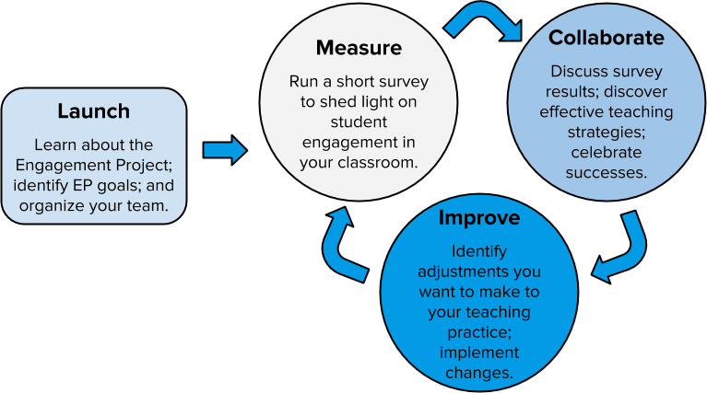

Slide 18
Review the Sample Report from PERTS and the Sample Survey Questions from Chicago Five Essentials.
Is there an area(s) of your high school redesign where your campus or a subset of your campus might benefit from a rapid cycle brief survey and time to collaborate around the results to better know if your actions are aligning with your intentions?
Notes:
Requires print copies of the PERT sample report and set of Chicago Essentials for Parents/Students

Slide 19
Two ways to measure impact
Short, replicable surveys
Descriptive rubrics
Notes:
Performances/Rubrics
Allow the individual/school to be internally directed and to co-create goals and measures of progress
Brief Surveys
Allow for multiple cycles of inquiry and action
In all cases – reflection and responses driven closes to end user

Slide 20
Big Ideas of Descriptive Rubrics
Vivid language
Promote coherent understanding and expression of current reality and future vision
Ability to self assess
Formative

Slide 21
Triad Brainstorm – 5 minutes
Where are you using descriptive rubrics? How might a descriptive rubric be used to measure progress of your high school redesign?

Slide 22
Notes:
I would like to give everyone the full set again…BUT we could have them access digitally…..????

Slide 23
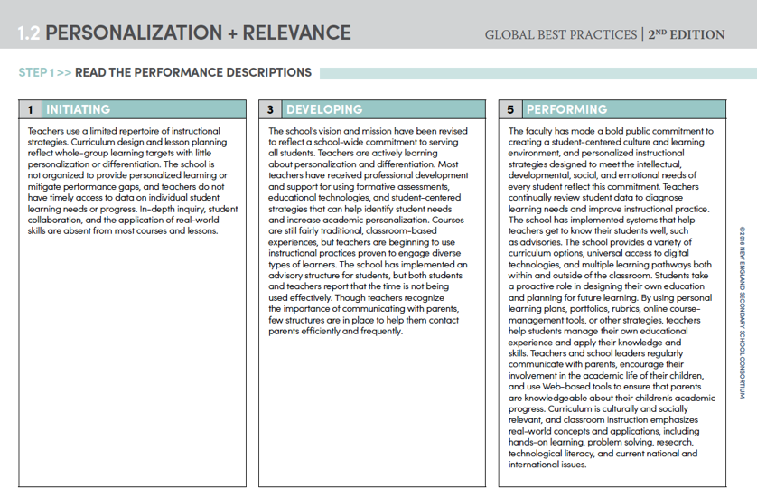
Select one component from Teaching and Learning or Organizational Design that has relevance to your redesign implementation. Read the three performance level descriptions for that component.

Slide 24
Review the performance strategies listed individually.
As a team note strategies in place at your high school from this dimension.

Slide 25
Review the list of sample evidence.
How are the strategies you have in place impacting students? What might you consider collecting or reviewing?

Slide 26
Assess your school.
The score should reflect consensus based on honest, frank discussion.

Slide 27
How might a similar process be useful to monitor growth and determine alignment of your actions and intentions? What resonated with you about this process? How might descriptive rubrics serve as navigation guides and tell your implementation story?

Slide 28
Predictive

Slide 29
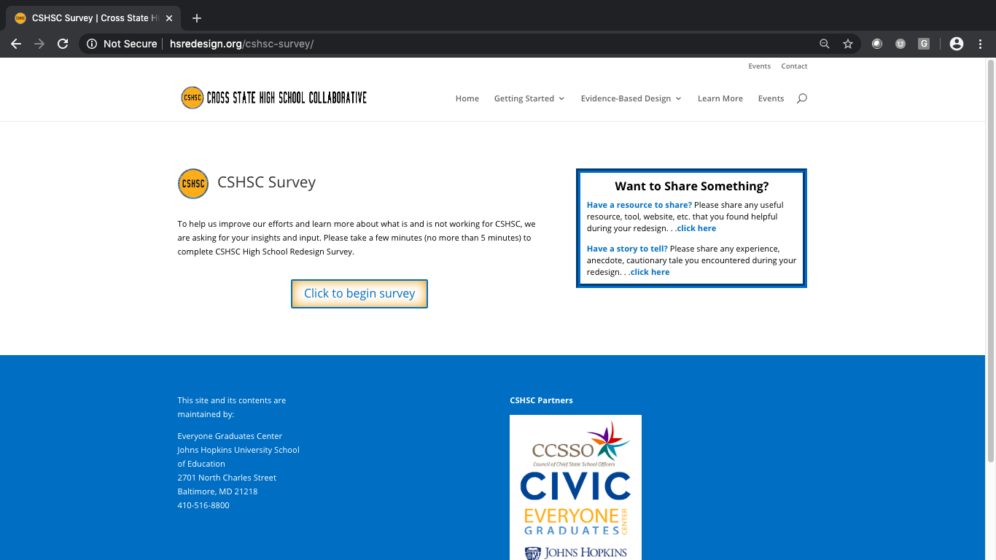
The survey has been moved to Survey Monkey. You can access the survey through the same page on our site:
https://www.hsredesign.org/cshsc-survey/ and directly at: https://www.surveymonkey.com/r/CQLGK2M

