Slide 1

New Mexico High School Redesign Teams
Continuing our Journey
Moving Forward with Resilience
February 19, 2020

Slide 2
When last we were together….

Slide 3
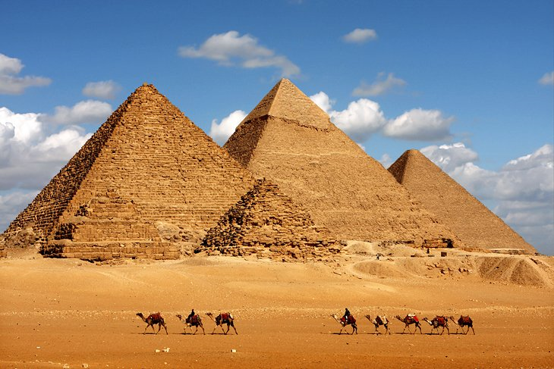

Sustainability
The ability to be maintained at a certain rate or level
Notes:
Meeting the needs of the present, without compromising future need, 4500 years ago, The Giza Pyramids, 85 years to build, withstood time – but for what intention now do they serve? Burial religious rituals

Slide 4
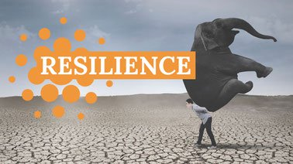

The capacity to recover quickly from difficult situations
Notes:
Tackling and overcoming changes without being overwhelmed by them
Design to endure physical, social and economic shocks and stresses

Slide 5
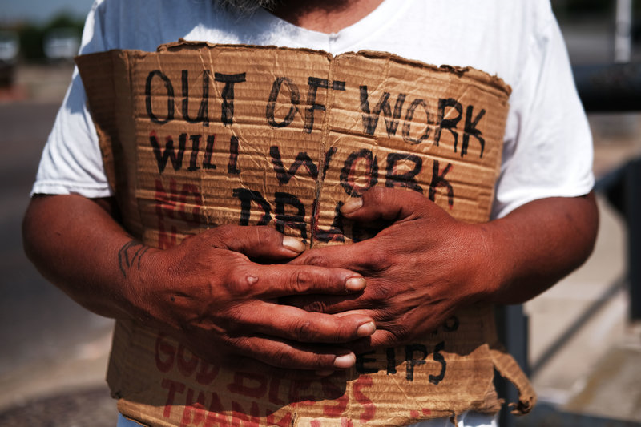
Meant to last
Just Cause vs End Goal
Child poverty in New Mexico 30%
Lyndon B. Johnson’s declaration
Notes:
NM< ranked worst in the nation child poverty, national average is 21% - ending poverty declares a loss or a victory. A Just Cause declares advancement which takes on other layers / adjust vision statement to skill building in lieu of putting an end to something

Slide 6
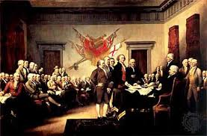
Ideal Future State
Just Cause – “We hold these truths to be self-evident, that all men are created equal.”
Short term – those who led against Great Britain
240 years – leaders, landscape, culture
100 Civil War-end to slavery
1920 Women’s suffrage
1965 the Voting Rights Act
Notes:
Just cause – meant to last – not “win” but to advance : carrying on the legacy of our vision, positive, specific alternative vision for the future
personally relate as people and easily committed to memory
AS Rebels, we are Fighting for lasting inspiration
Victories and goals met will serve as an inspiration for us to keep moving forward

Slide 8
Block Party – Finite and Infinite Mindsets
Read your passage – reflect on it from the perspective on your high school redesign
Find someone who has a different color passage
Take turns sharing your passage and reflection
*Passages taken from The Infinite Game – Simon Senek

Slide 9
Will before Resources
Resources – Tangible and Easily Measured
Will – Intangible – hard to measure
The feelings people have when they come to work
Notes:
Will represents the sum of all the human elements available that move the redesign vision forward

Slide 11
Resilience allows the shift from Transactional to Transformative
Safety Satisfaction Connection
Notes:
From Transactional – Quid Pro Quo – Negotiated Give/Take
Toward Transformative – keeps this going is it is about shared values / comitments

Slide 12
Safety
Being on your own side Feeling protected
Determination Clarity about threats
Grit Feeling alright right now
Sense of agency Calm
Relaxation Peace

Slide 13
Satisfaction
Gratitude Gladness
Pleasure Accomplishment
Clarity about goals Enthusiasm
Passion Motivation
Aspiration Feeling of Enoughness
Contentment

Slide 14
Connection
Compassion for oneself and others
Empathy Kindness
Self worth Skillful assertiveness
Forgiveness Generosity
Love

Slide 15
Where are we now?
Requirements for Relating Skillfully | Real-life examples | Real-life non-examples | Hunches……
Safety
Satisfaction
Connection
Notes:
First Individually – Then discuss as a Team

Slide 16
Design Time

