Slide 1

New Mexico High School Redesign Teams
People and Change
The Paradox of Resistance
February 20, 2020

Slide 2
Paradox noun – a seemingly absurd or self contradictory statement or proposition that when investigated or explained may prove to be more founded or true.

Slide 3
Turn and talk – think about a time you were highly resistant to a new innovation/situation.
What were the underlying factors?

Slide 4
What we resist persists

Slide 5
Root Causes of Resistance
Lack of awareness of why the change was being made
Impact on current job role
Organization’s past performance with change
Lack of visible support and commitment from managers
Fear of job loss

Slide 6
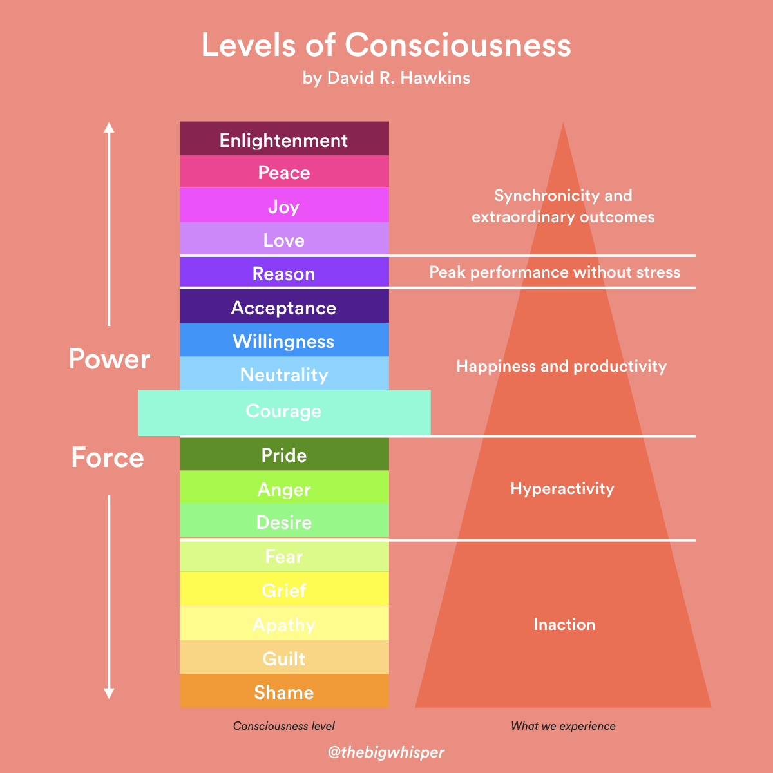

Slide 7
Core Values shifting to Accidental Values
Culture = Core (intentional values) + Accidental (unintended values)

Slide 8
Table Talk
If you were to name a Core Value paired with unintended Accidental Value at your campus that may contribute to what appears to be “resistance” to ”the new” what might that be?

Slide 10
Generative Listening
https://www.youtube.com/watch?v=eLfXpRkVZaI&feature=youtu.be
Notes:
Downloading: At this level, we listen from our habits and existing understanding in order to confirm what we already know or think we know. A social media echo chamber is a fantastic example of listening by downloading: we’re simply reinforcing an existing story or worldview. Nothing that contradicts that story finds its way into our brains. Many organizational meetings exist at this level as do many of the conversations we have with friends. For many of us, ‘downloading’ is our default setting.
Factual: At the factual level, there’s room for discordance. We start to notice things that don’t necessarily fit with our point of view or story about the world. A few weeks ago, I had a session with a new client. My guard was down and, given where I met this person and how they presented, I came into the meeting with a set of assumption about who they were and what they sought. Within 10 seconds, this person presented data about themselves that contradicted those assumptions; and suddenly I was listening at a factual level. A window had opened that allowed for the potential of change.
Good science can happen at the factual level, the collection and investigation of conflicting data. But complex change happens at deeper levels, starting with the next level of listening:
Empathic Listening: Empathy is one of the most powerful forces in human history and evolution. It’s responsible for bringing us together in tribes, for bringing an end to interpersonal (and even international) conflicts, and for the success of every Pixar movie made to date. At this level, we’re not just listening at the cognitive level, we’re listening with the heart as an organ of perception. As we open to the feelings, experiences, and perspectives of another human being, we are able to see the situation, and the world, through their eyes. This creates an immediate emotional connection.
Anyone who has ever been moved by a story or felt close to someone after they’ve shared a particularly vulnerable moment has experienced empathic listening. By their very nature, powerful stories invite empathy and, in fact, there’s fascinating research that shows that centuries of evolution have wired our brains to respond to stories by releasing hormones that promote empathy.
So empathy is powerful. But even it is not enough to move into a place of growth, change and development. Which brings us to the fourth level of listening.
Generative Listening: This is listening as a dynamic act of co-creation. When we open our will, letting go of thoughts, expectations, and urges as they come in, listening becomes about much more that what’s being said: it becomes about what’s not being said and about connection with future potential.
At this level, we’re fully present. It’s the type of listening practiced by great coaches, leaders, and friends. Those who listen to more than our words; they listen from a place of holding your highest, most fully realized possibility.
This type of listening is a bit tough to describe, so here are some signs that you’re listening generatively:

Slide 12
Design Time
What insights might be emerging for you about your implementation and what may look like resistance to change?
Is there a commitment you might be willing to generate as High School Redesign Team that helps others to see themselves in the “new” being crafted?

