Slide 1

Social Emotional Learning at Rocinante HS

Slide 2
Timeline
November 2018 – SEL Team formed under the School Culture section of the High School Redesign Team.
Spring 2019 – SEL Team took the CASEL survey to find a program to suit our student needs and school culture. TOP was selected by the Team out of 4 curriculums.
September 2019 – Jennifer Dowdy trained in St. Louis, MO with Wyman and became a licensed Facilitator/Program Coordinator for the TOP program.
October 2019 – HSRD Team attended the CASEL National Conference in Chicago.
December 2019 – Cheryl Smiley trained in St. Louis, MO with Wyman and became a licensed Facilitator/Program Coordinator for the TOP program.
December 2019 – 14 RHS staff members trained by Ms. Dowdy and Ms. Smiley as TOP Certified Facilitators.
January 2020 – TOP Clubs began at RHS. Currently 155 total participants.

Slide 3

What is TOP?

Slide 4
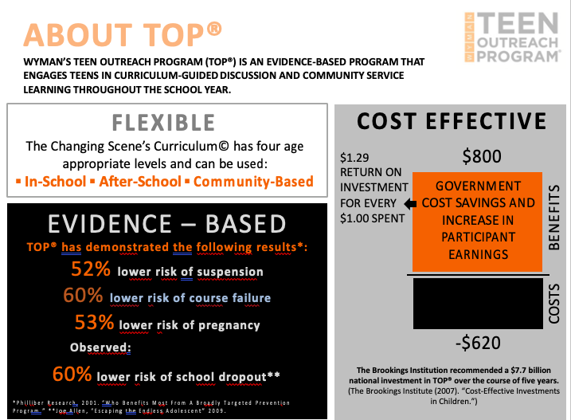

Slide 5
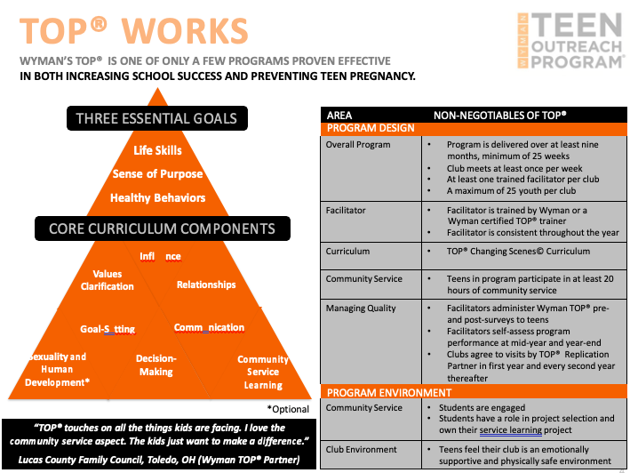

Slide 6
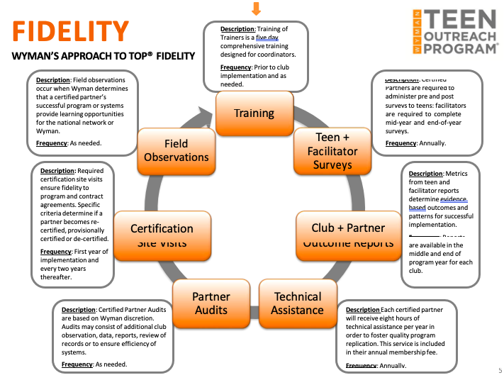

Slide 7
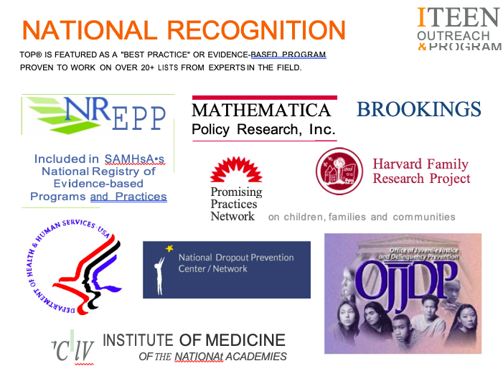

Slide 8
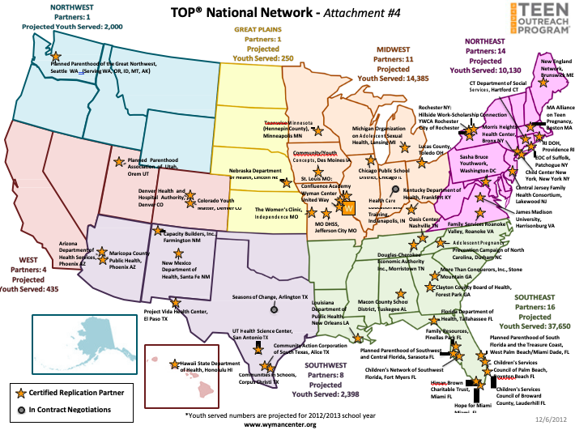

Slide 9
TOP Curriculum
Building My Skills: Emotion management, decision-making, problem-solving, goal-setting.
Learning About Myself: Self understanding, social identity, health and wellness.
Connecting With Others: Relationships, communication, empathy, community.
All lessons are offered in Foundational, Intermediate, and Advanced versions.

Slide 10
What does top look like at RHS?
7 team facilitated TOP Clubs. Each club capped at 25 students.
Grouped by age/maturity.
One all boys Club facilitated by Mr. Gardenhire and Mr. Levine.
Pre-surveys and group norms have been completed in each Club.
Students will receive 9 SEL lessons and complete 10 hours of community service learning this school year.

Slide 11
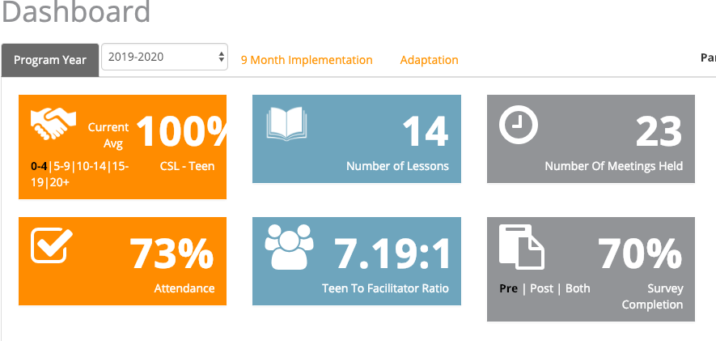
RHS – week 4 of top

